Slide 1
PREVIOUSLY ON…

Slide 2
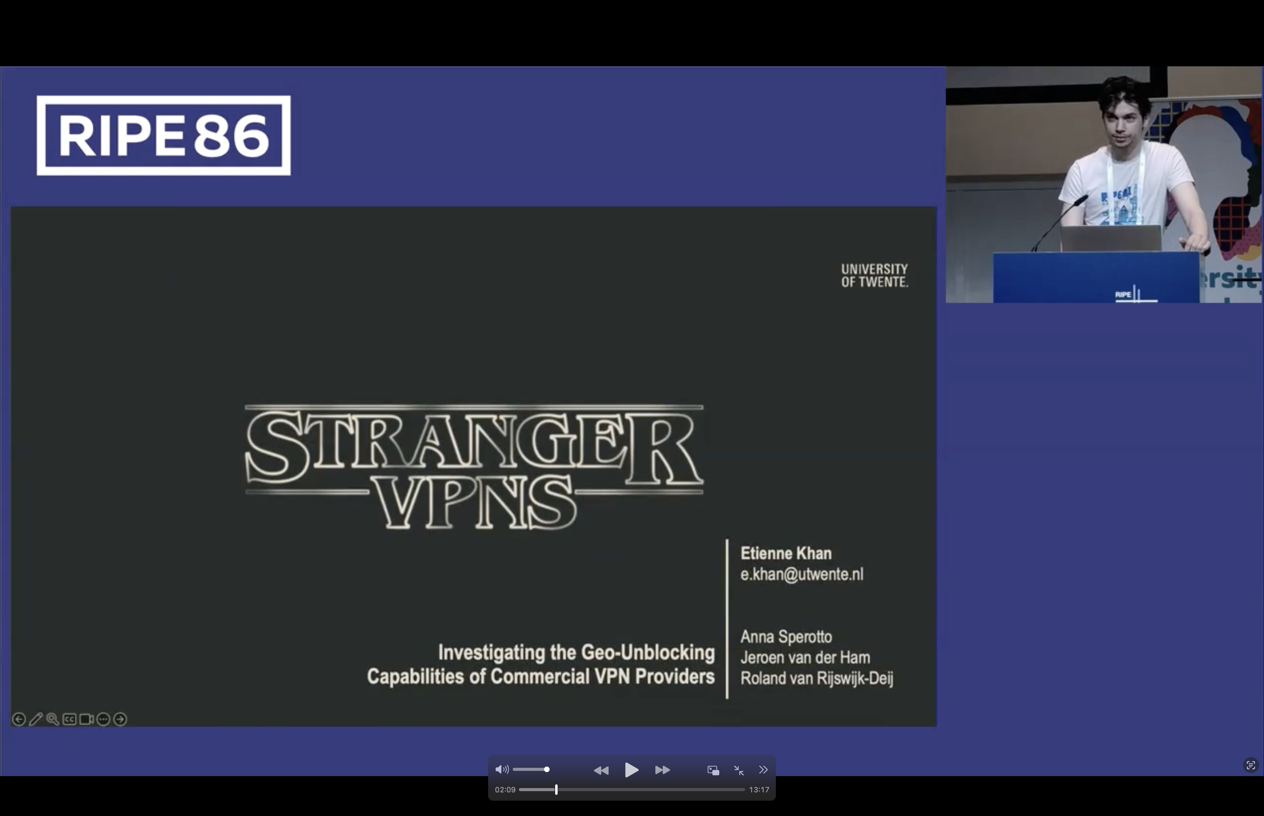
Episode 1
SKIP INTRO

Slide 3
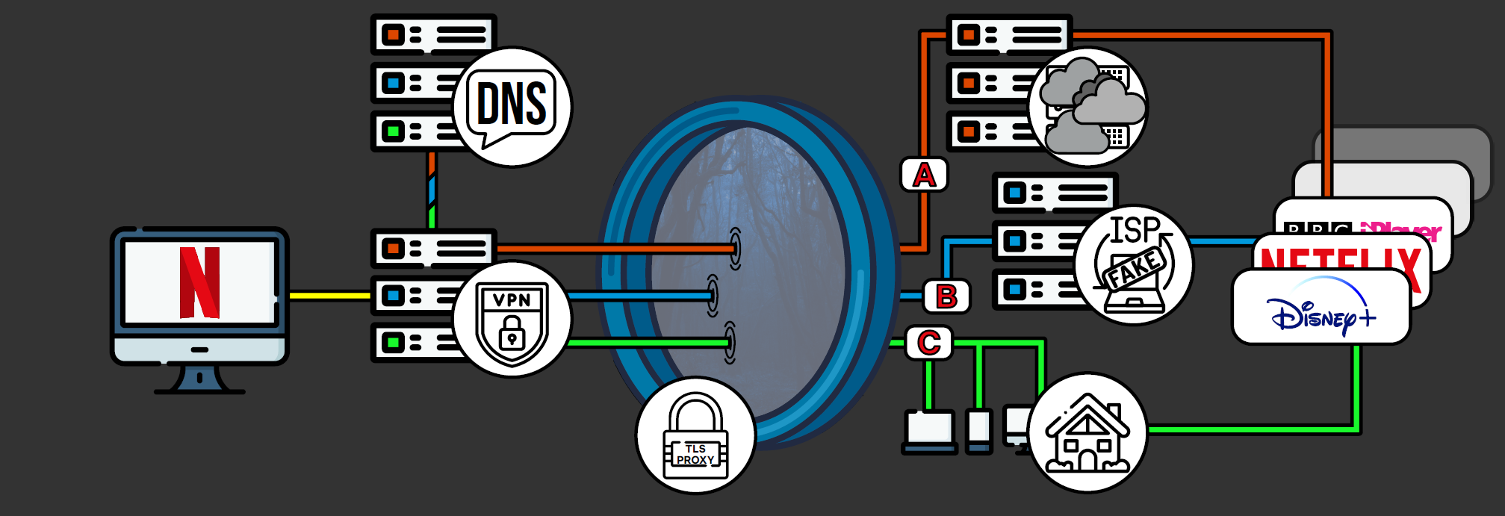
Recap

Slide 4
Episode 2
A First Look at User-Installed Residential Proxies
From a Network Operator’s Perspective
Etienne Khan, Elisa Chiapponi, Martijn Verkleij,
Anna Sperotto, Roland van Rijswijk-Deij and Jeroen van der Ham-de Vos

Slide 5
Episode 2
A First Look at User-Installed Residential Proxies
From a Network Operator’s Perspective

Slide 6

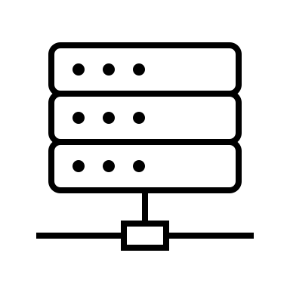

Residential Proxies
Client AS
Client AS
Res. AS

Slide 7
Episode 2
A First Look at User-Installed Residential Proxies
From a Network Operator’s Perspective

Slide 8
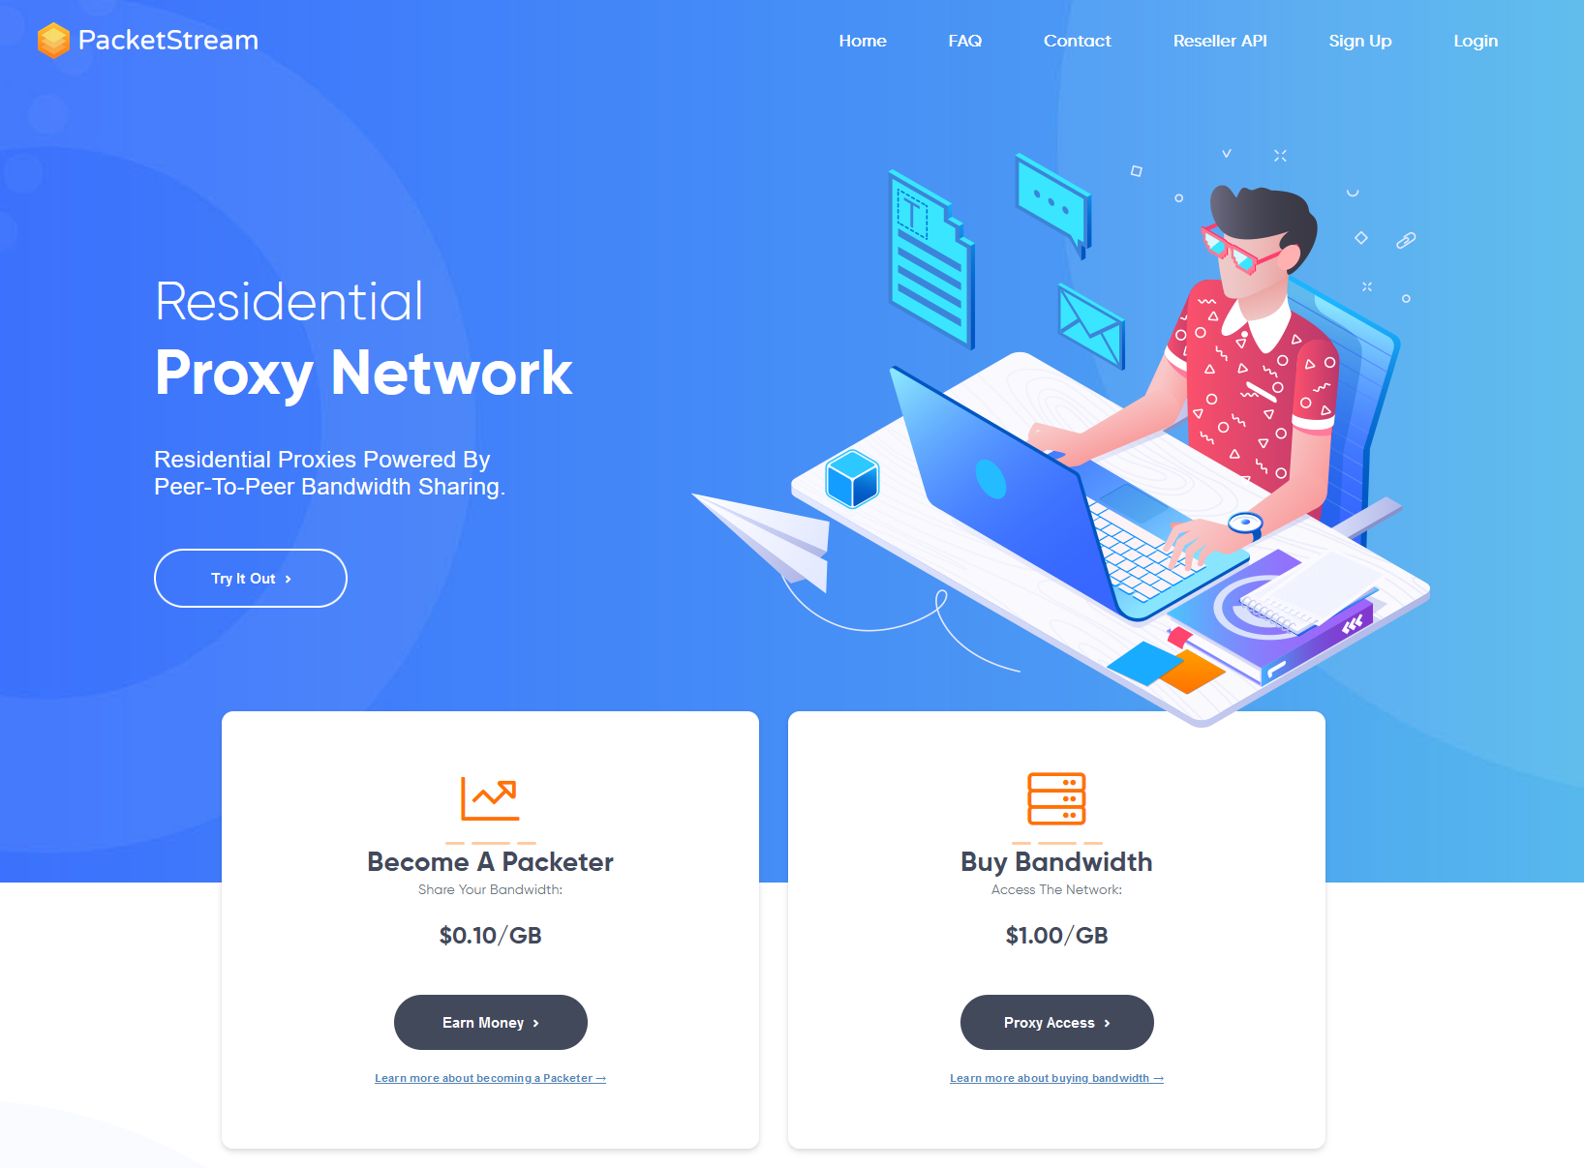
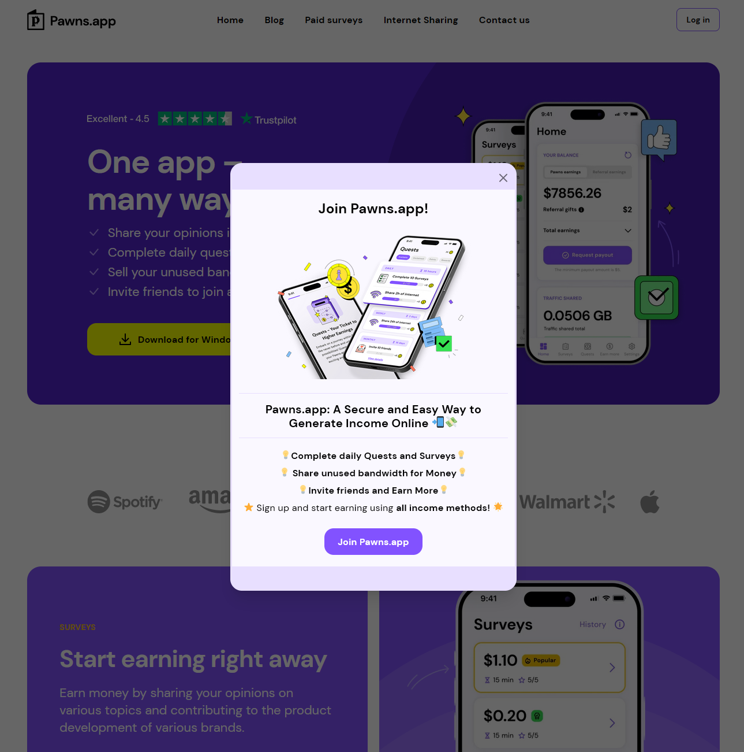

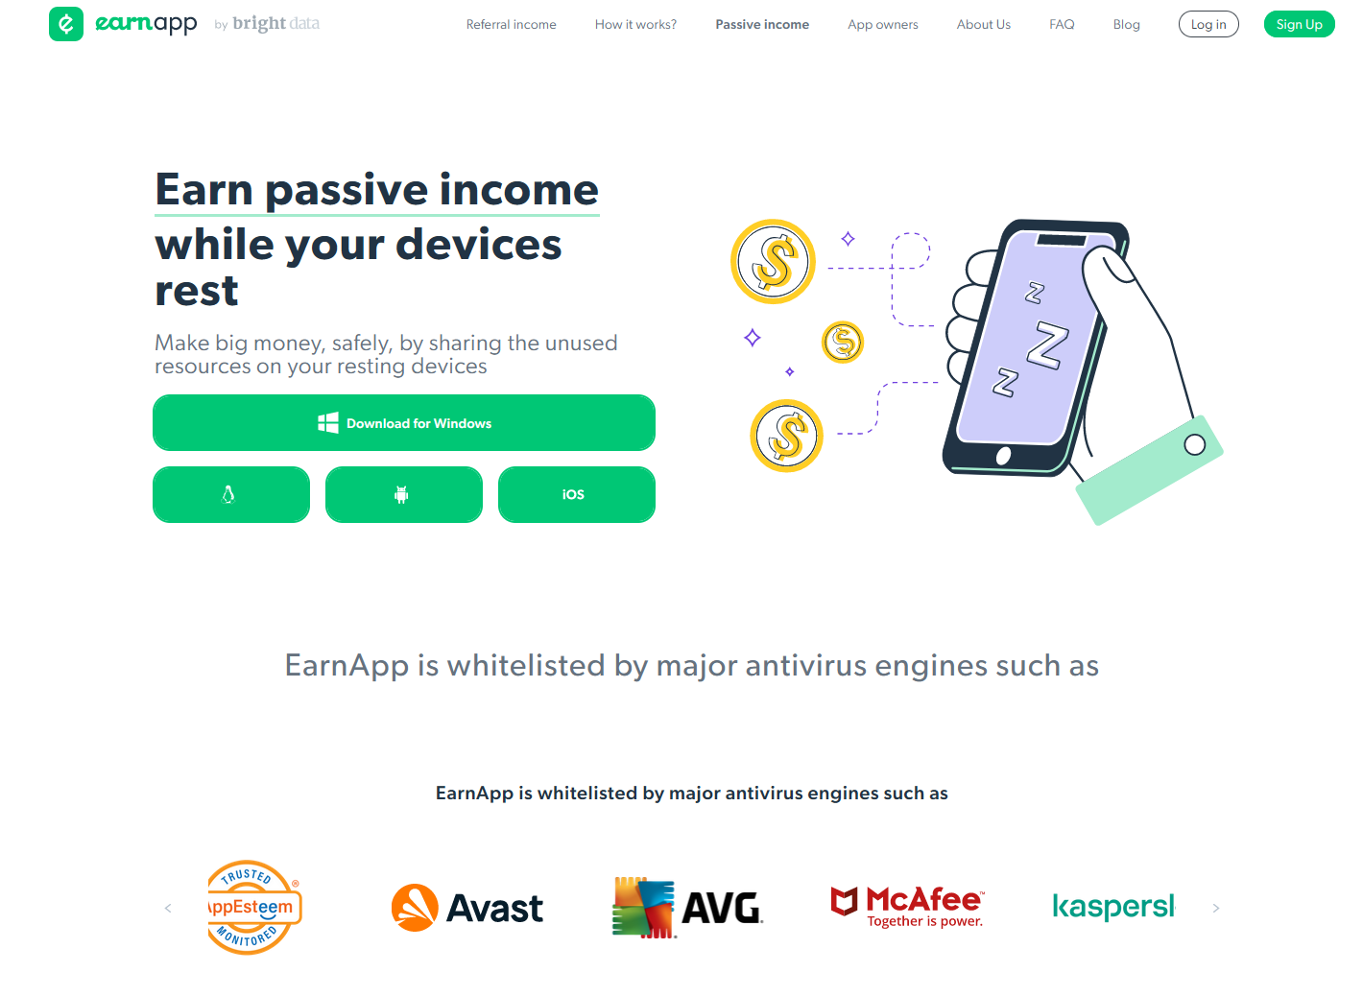
User-Installed

Slide 9
User-Installed
Notes:
8 different RESIPs
7.5 months

Slide 10
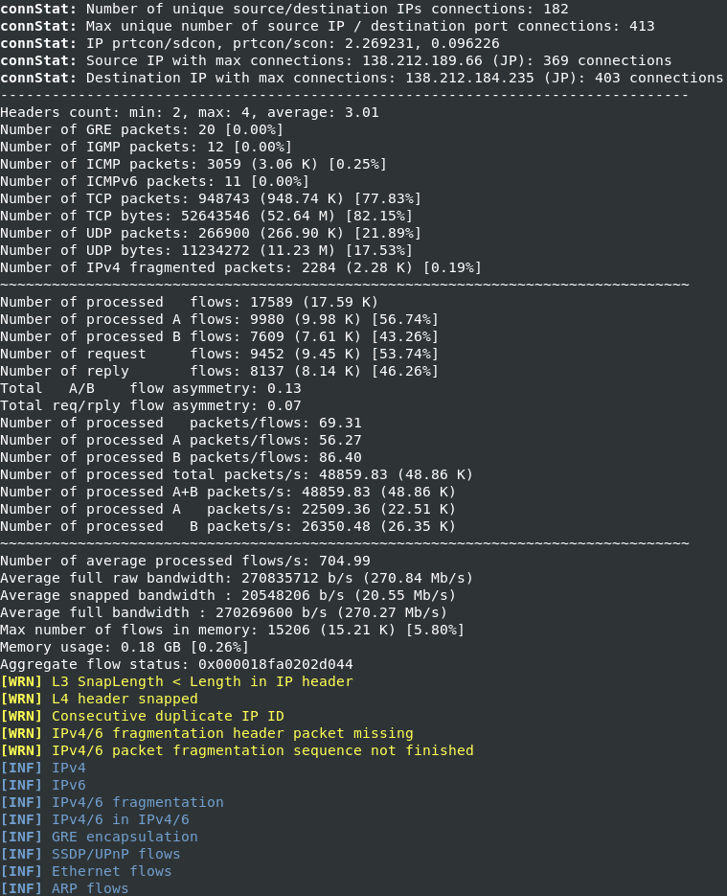

Tranalyzer

Slide 11

User-Installed

Slide 12
Episode 2
A First Look at User-Installed Residential Proxies
From a Network Operator’s Perspective

Slide 13

First Look

Slide 14
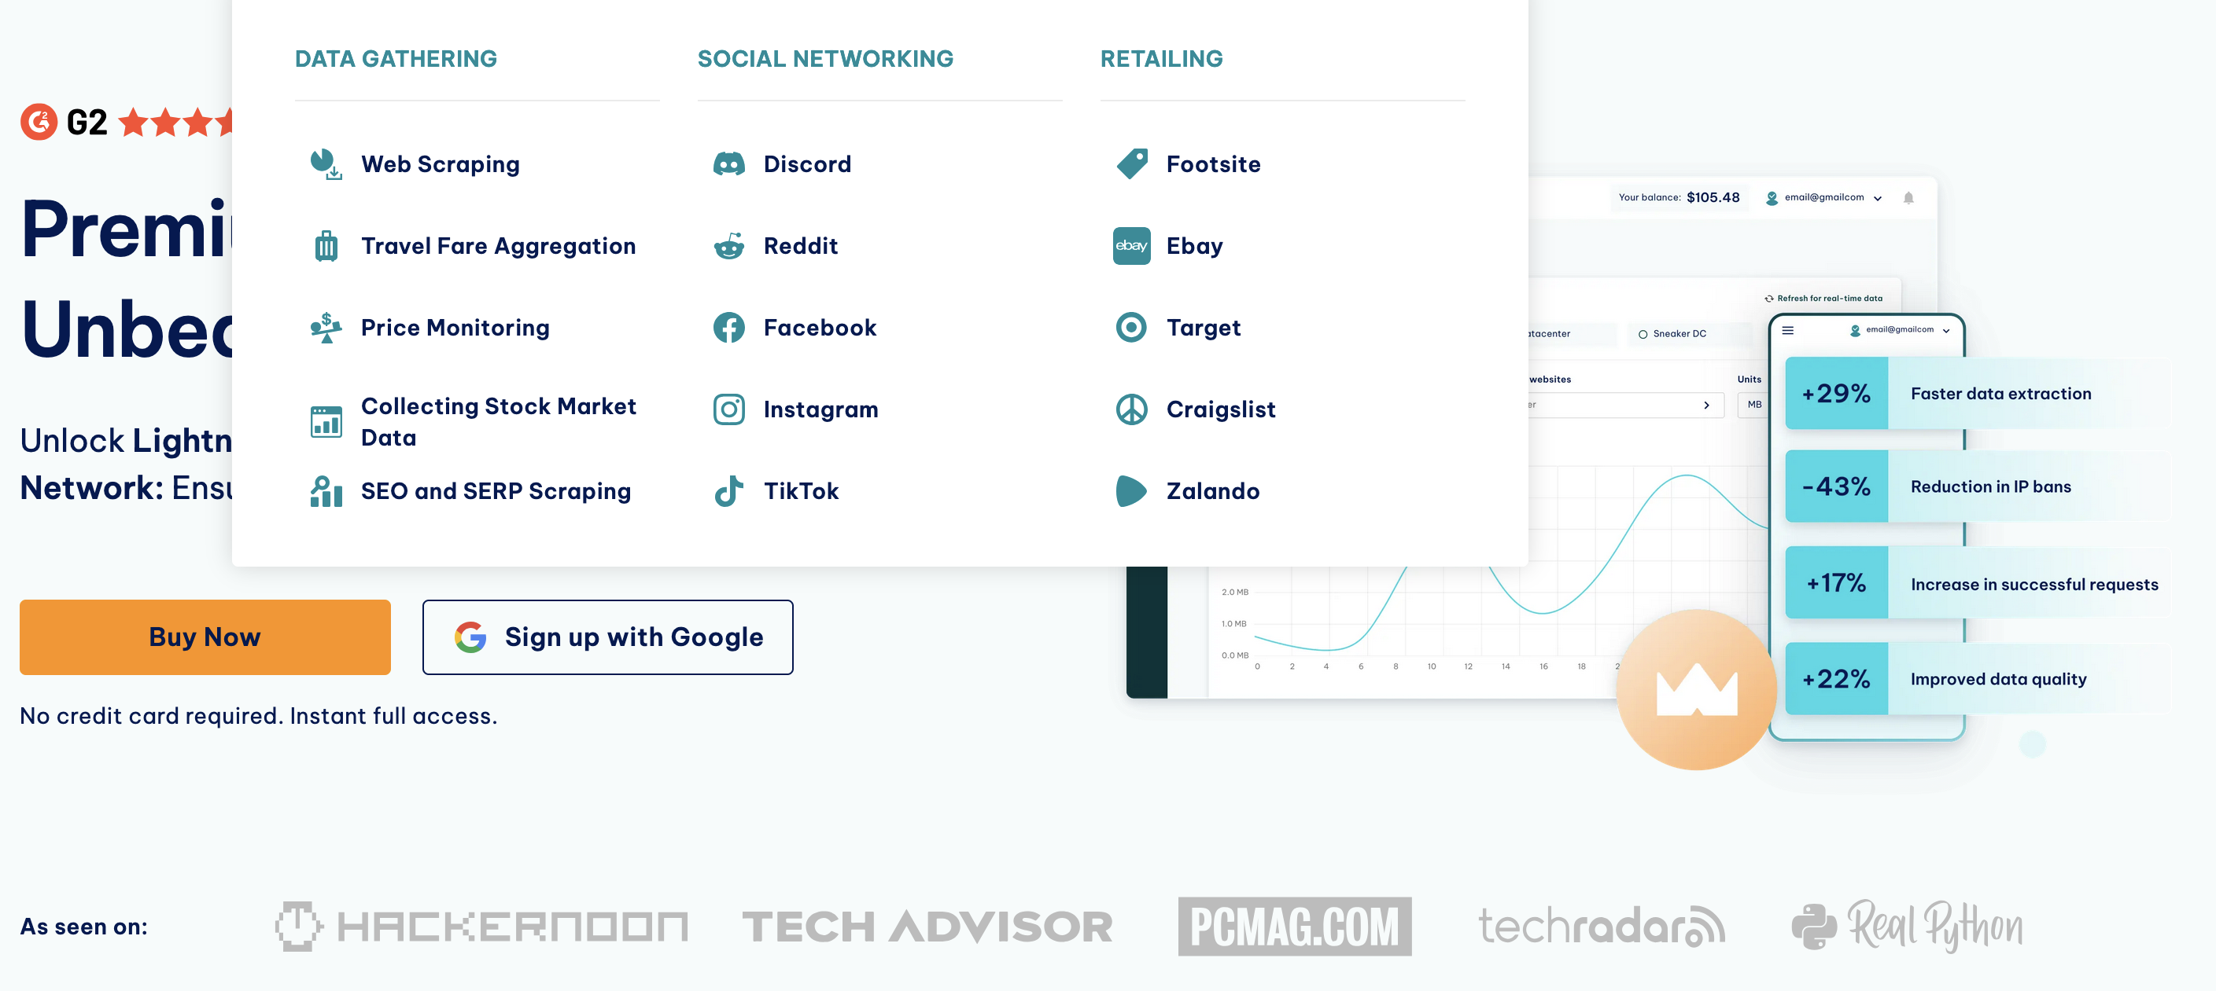
First Look

Slide 15
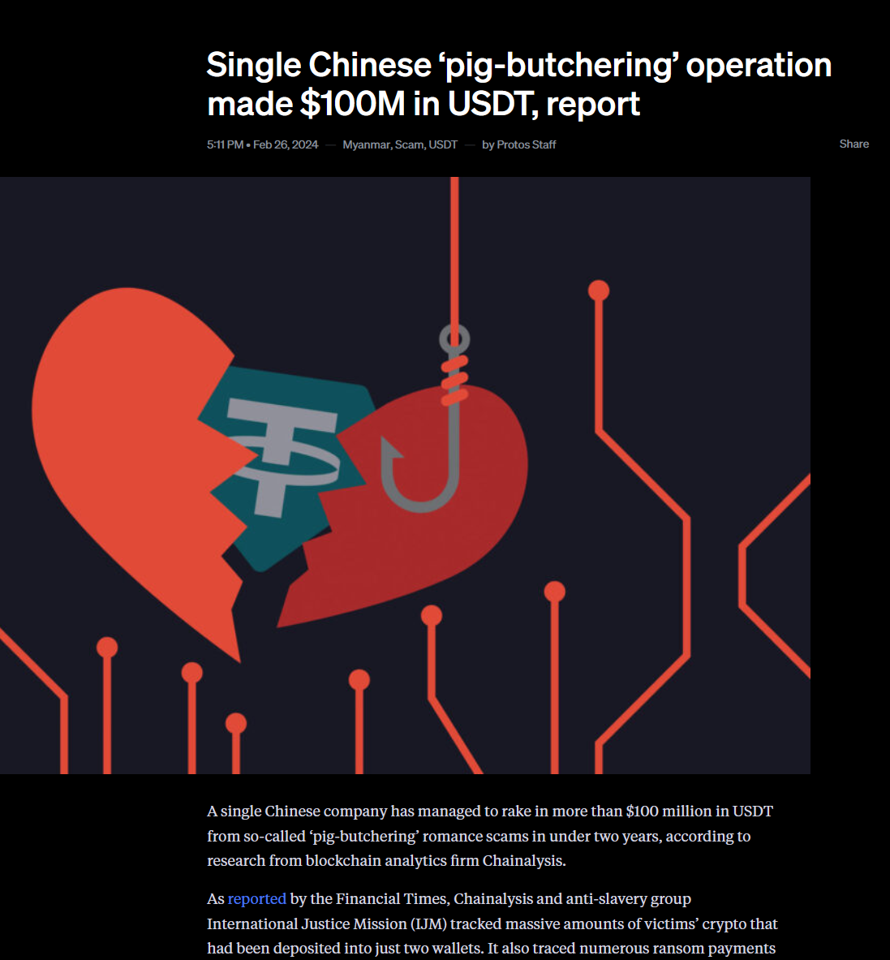
First Look

Slide 16
First Look - Tinder

Slide 17
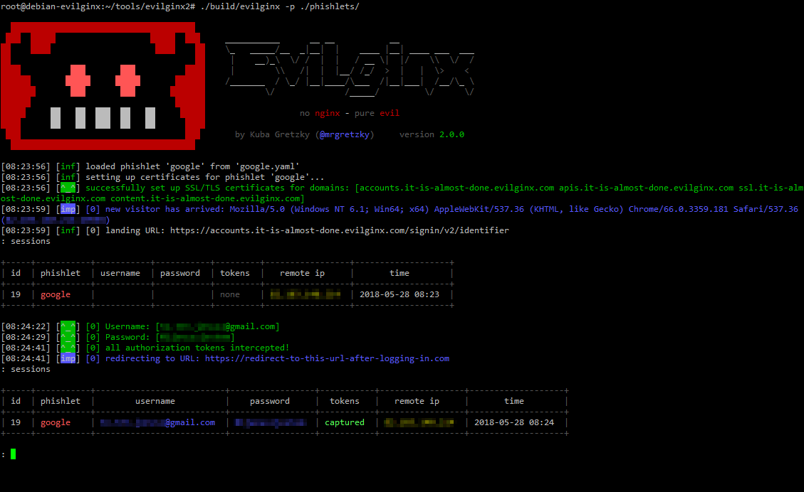
First Look - Phishing

Slide 18
First Look - Phishing

Slide 19

First Look - Phishing: TLS Fingerprinting
+ SNI =

Slide 20
First Look - Phishing: TLS Fingerprinting
account.booking.com
outlook.office365.com
discord.com
paypal.com
And more

Slide 21
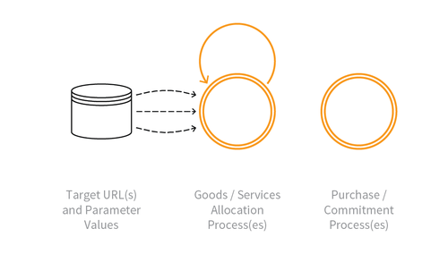
First Look - Sophisticated Bots

Slide 22
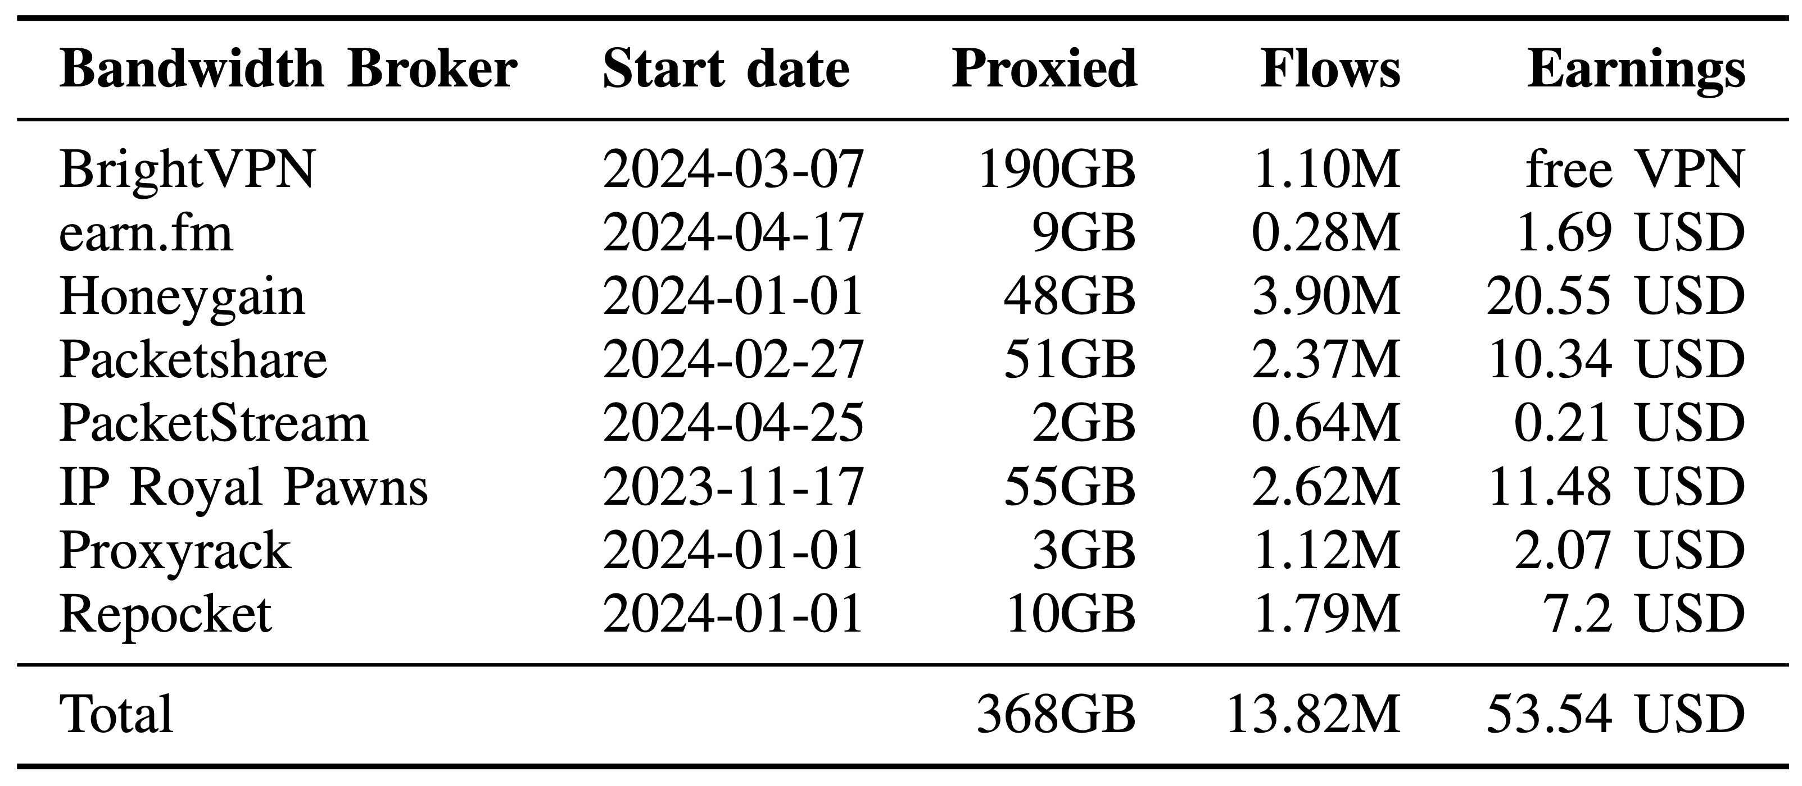
First Look - Riches Beyond Imagination

Slide 23
Episode 2
A First Look at User-Installed Residential Proxies
From a Network Operator’s Perspective

Slide 24
From a Network Operator’s Perspective
My testbed consisted only of one network operator…

Slide 25
Call to Action
We can deepen our understanding of this phenomenon by sampling for proxy indicators in end-user networks or at IXPs

Slide 26
Takeaways
Don’t share your Internet connection for money
Vehicle for serious crime
Looking for traces in end-user networks might reveal the true extent of these residential proxies

Slide 27
Contact, Questions, Discussions
Etienne Khan
e.khan@utwente.nl
Or here, in person

