Slide 1

IETF/IAB: NM Workshop 2024
Next Era of Network Management Operations (NEMOPS)
NEMOPS Workshop Program Committee:
IAB Members: Wes Hardaker, Qin Wu, Suresh Krishnan, Dhruv Dhody
IETF Ops Area Directors: Mahesh Jethanandani and Warren Kumari
NMOP WG Chairs: Med Boucadair and Benoît Claise
NETCONF/NETMOD WG Chair: Kent Watsen
24-OCT-2024
.

Slide 2

Why Are We Here?
To announce that the IETF/IAB is conducting a workshop on the Next Era of Network Management Operations (NEMOPS)
    Host: The Internet Architecture Board (IAB)
    Where: Virtual Online
    When: December 3-5, for 3 hours/day
    You’re invited!
To kindly request filling out the survey (see QRC code) & providing feedback
Mirja and I are here to help, during the week: questions, feedback, helping with the survey, etc.
  Survey: https://ietf.iad1.qualtrics.com/jfe/form/SV_9vQxBRiZqDntarc
Survey

Slide 3
Working Together
IETF has a long tradition of collaborating with NOG
To listen to operator's concerns when developing new protocols.
To explore technology and operational issues on IETF work.
To bridge the gap between IETF work and real-world deployments
IETF wants to understand Operator’s current and perceived future issues
Operators are currently not well represented in the IETF
Concern that Operator voices are currently not heard
To address this:
IETF created a new working group (Network Management Operations - NMOP)
to focus on Operator Network Management
IAB created the NEMOPS program committee that:
  Published a survey and is currently collecting responses
  Is reaching out to Operators: NANOG, RIPE, LACNOG, AutoConn, Apricot, etc.
  Will synthesize the survey results before the workshop (into a “position paper”)
  Will conduct the NEMOPS Workshop 2024 and publish a workshop report

Slide 4
Showcase: Swisscom, NTT, INSA, and Telefonica
In 2020, several operators started to engage the NETCONF WG to improve telemetry collection.
Background:
RFC 8639 (Subscription to YANG Notifications) only defines support for dynamic subscriptions, but this was insufficient for these Operators
Goals:
To be able to configure subscriptions
To be able to receive telemetry data over UDP
To be able to send telemetry from line-cards
To be able to annotate telemetry with metadata
To be able to import telemetry into time-series databases
Current NETCONF WG Status:
Operators have one draft that is currently post NETCONF WG Last Call
Operators have two drafts that are about to enter NETCONF WG Last Call
Operators have three drafts that are about to be adopted by the NETCONF WG
With hackathon implementations!

Slide 5
Internet Society Survey Results
“Operators and the IETF”
Some issues are easy to solve:
Don’t know what IETF does: 8%
Don’t know how to participate: 58%
Aware that the work in the IETF happens on mailing lists: 54%
Some are harder:
Don't have enough time: 64%
Don't feel my operator input is welcomed: 44%
Source: https://www.internetsociety.org/deploy360/projects/operators-and-the-ietf/

Slide 6
Internet Architecture Board (IAB)
Internet Architecture Board
(IAB)
Internet Research Task Force (IRTF)
Research Group
Architectural oversight
Runs workshops to:
  address current challenges
  explore emerging technologies
  create input for future work within the IETF and IRTF
Runs programs to address long term perspectives/issues
Liaison management
Research Group
Internet Engineering Steering Group (IESG)
14 Area Directors
General
(GEN)
Working Group
Working Group
Routing
(RTG)
Working Group
Applications & Realtime
(ART)
Working Group
Working Group
Working Group
Working Group
Working Group
Internet
(INT)
Security
(SEC)
Working Group
Working Group
Working Group
Working Group
Working Group
Ops & Mgmt
(OPS)
Web and Internet Transport
(WIT)
Working Group
Working Group
Working Group
Working Group

Slide 7

First IAB Workshop on Network Management
  1990-2000
IETF OPS area has been collecting network management requirements
  Configuration requirements
  Monitoring requirements
  Security requirements
April, 2001~ May 2002
OPS-NW Road Show visits Operators at RIPE, NANOG, and LISA
  Unusable configuration management
  Network monitoring is complex with so many alternative protocols and tools
June 2002
3-day IAB workshop on Network Management in Reston, VA, USA
Operators
IETF

Slide 8
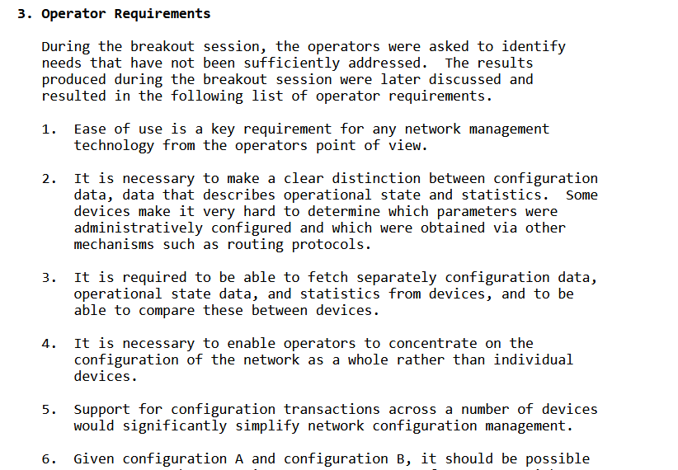
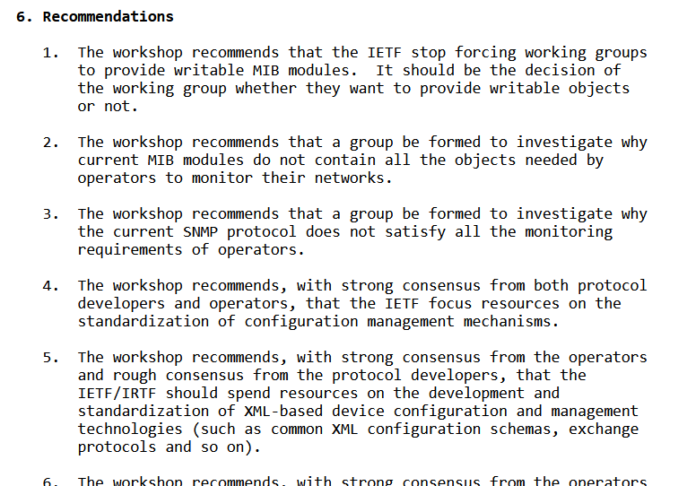
RFC 3535:
Overview of the 2002 IAB Network Management Workshop
From RFC 3535
From RFC 3535
Notes:
Requirements:
10 of 14 requirements related to Configuration management
3 of 14 requirements related to security
Recommentations:
encouraged to use XML
discouraged to use SNMP MIBs

Slide 9
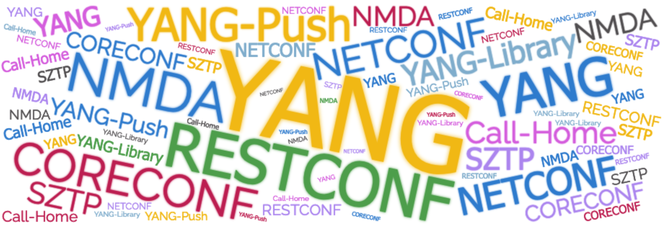
Key Outcomes
Importantly, all IETF WGs work together to develop a cohesive collection of YANG data models, at both the element and service levels

Slide 10
Some Current IETF Network Management Topics
NETCONF (NETwork CONFiguration) WG
NETCONF-next, RESTCONF-next, configuration of clients and servers, list pagination, transaction correlation, YANG-push transports (Protocols and YANG models)
NETMOD (NETwork MODelling) WG
YANG-next, YANG versioning, system configuration, data immutability (Language and YANG models)
NMOP (Network Management Operations) WG
YANG-push integration with Apache Kafka & time series databases, anomaly detection and incident management, digital map modelling
Network Inventory (IVY) WG
Hardware & software components, physical location, etc. correlating with existing IETF models (topolopy, service attachment points)

Slide 11
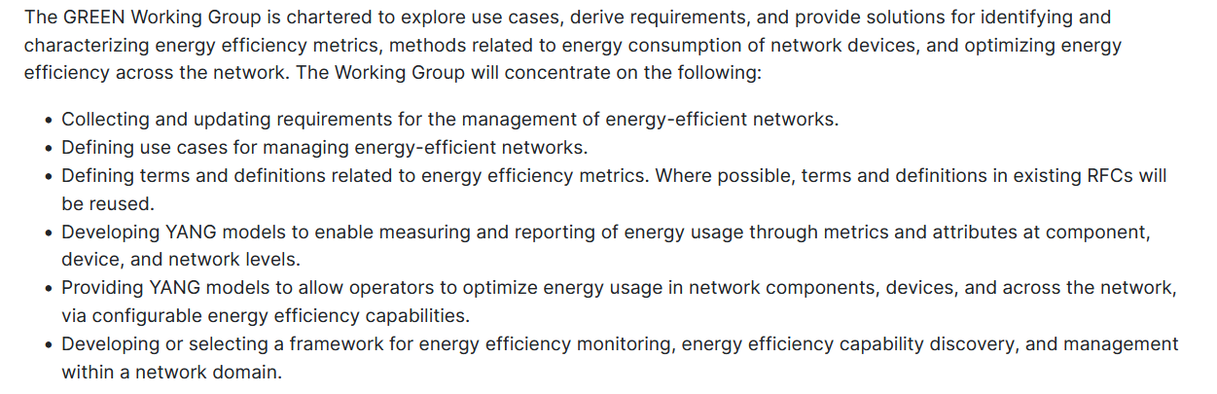
Getting Ready for Energy-Efficient Network (GREEN)
Brand new Working Group (First meeting next week, @IETF in Dublin)
https://datatracker.ietf.org/wg/green/about/

Slide 12

22 Years Later, It Is Time To Review Where We Are (Again)
IAB / IETF NM Workshop 2024
Next Era of Network Management Operations (NEMOPS)
December 3-5
Virtual Online

Slide 13
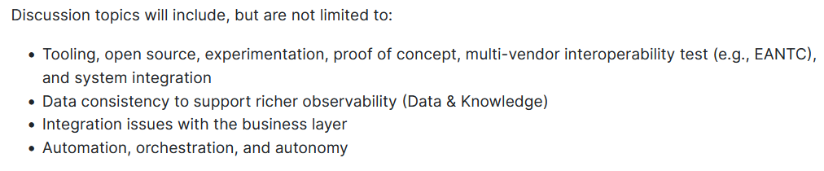
Objectives
Review the outcomes and results of the 2002 workshop (e.g., current deployments, state of the art) and identify any operational barriers that prevent these technologies from being widely implemented (limitations, hurdles).
Explore new requirements for future network management operations in a collaborative manner with the industry, network operators, and protocol engineers.
Develop a plan of action and recommendations for the IETF.

Slide 14
How to Participate with NEMOPS
To participate in the Workshop (online call)
  Submit a short "position paper" or “expression of interest” to nemops-workshop-pc@iab.org
  Deadline: November 17th
Submit the online NEMOPS survey (online).
Speak with NEMOPS program committee members at various operator community events including this one. (onsite) => Benoit Claise and Mirja Kuehlewind here during the entire week
Recording of the workshop will be made available.
Survey
Time /
Commitment
Notes:
Interested participants in this area are invited to submit position papers on the workshop topics.

Slide 15
Thank You (Q&A)
NEMOPS Workshop Page:
https://datatracker.ietf.org/group/nemopsws
Survey: https://ietf.iad1.qualtrics.com/jfe/form/SV_9vQxBRiZqDntarc
Feel free to contact the program committee with any further questions: nemops-workshop-pc@iab.org.
We need your voice! Join the mailing list:
nemops-interest@iab.org
Please consider attending the workshop!
Survey

Slide 16
Survey Question Examples

Slide 17
Context: Configuration
What tools do you use for configuration management? What protocols do those tools use? Which issues did you encounter with those?
  Tools examples: Please provide the name of specific open-source, vendor-supplied, in-house developed, and/or proprietary tools you use (e.g., Ansible, MG Soft, CLI, etc.).
  API/Protocol examples: Please provide the name of specific APIs and/or protocols those tools use. (e.g., libyang, SNMP, NETCONF, RESTCONF, gNMI)
What requirements & recommendations for network configuration management do you have for the IETF?

Slide 18
Context: Monitoring
What tools do you use for network monitoring? What protocols do those tools use? Do you use streaming telemetry? Which issues did you encounter with those?
  Tools examples: Please provide the name of specific open-source, vendor-supplied, in-house developed, and/or proprietary tools you use (e.g., Nagios, Prometheus, Kentik, etc.)
  API/Protocol examples: Please provide the name of specific APIs and/or protocols those tools use. (e.g., Syslog, SNMP, BMP, IPFIX, YANG-Push, GNMI)
What requirements & recommendations for network monitoring do you have for the IETF?

Slide 19
Context: Others
Apart from tools already mentioned, are there any other network management tools (and underlying protocols) do you use today? Which issues did you encounter with those?
Examples - Automation, Visualisation, Security
Management, Audit & Accounting etc. (Feel free to
name the tools)
Any other requirements & recommendations for network management do you have for the IETF?

Slide 20
Thank You (Q&A)
NEMOPS Workshop Page:
https://datatracker.ietf.org/group/nemopsws
Feel free to contact the program committee with any further questions: nemops-workshop-pc@iab.org.
We need your voice! Join the mailing list:
nemops-interest@iab.org
Please consider attending the workshop!
Survey

Slide 21
Backup Slides

Slide 22
The Dream
In a perfect world…
The IETF creates standard protocols with operator input and they work great.
Deployment and operationalization concerns are consistently addressed.
The level of operator engagement balanced with vendors and academics.
Operators always know when their input is needed.
Operators always provide their input when it’s needed.

Slide 23
The Reality
Operator engagement not balanced with vendors and academics
Academics and vendors rule many decision making processes within the IETF
The operators expected to deploy these technologies, often don’t even know that they are being developed
Critical new technologies are developed with little to no direct operator input
Things may be and often are broken…

Slide 24
RFC3535, 22 Years Later
IAB 1st NM Workshop
In 2002
NETCONF WG Creation in 2003
NETMOD WG Creation in 2008
Service Model Kick off in 2015 (e.g., L3SM, L2SM)
2023.6
IVY WG
2023.11
NMOP WG
2024.05
SRv6OPS WG
IAB new NM Workshop
In 2024
NMDA
Kick off
In 2012
YANG Push Series and SZTP published
In 2019
Network Slicing
Kick off in Nov, 2019
YANG Take off 2014
SRv6OPS: SRv6 Operations
  operational aspects of deploying and managing SRv6 networks.
L3SM: L3VPN Service Model
  YANG Data model for L3VPN Service.
L2SM: L2VPN Service Model
  YANG Data model for L2VPN Service
NMOP: Network Management Operations
  Network Management problem faced by operators such as YANG Push integration with Kafka, Anomaly detection and incident management
  updating RFC 3535-bis (collecting
  updated operator requirements for IETF network management solutions)
IVY: Network Inventory YANG
  Core model for Inventory of network equipment including correlation with existing IETF models

