Slide 1
Open Source Working Group
RIPE 89, Thu Oct 31, 2024 11:00-12:30
Martin Winter &
Marcos Sanz &
Sasha Romijn

Slide 2
Agenda
Administrative Matters [WG Chairs]
Welcome
finalize agenda
approval of minutes from previous WG meeting(s)
Chair Changes
(Martin Winter, Co-chair)

Slide 3
Agenda
Leveraging Vagrant to Simulate Complex Systems for Network Application Development
(Barry O’Donovan)
PiranhaBGP: Failure Detection in BGP Networks
(Pascal Gloor)

Slide 4
Agenda
Lightning Talks
CRA and Open source projects
(August Bournique)
Green tech hackathon
(Vesna Manojlovic)
Using YANG for code generation
(Maria Matejka, Vojtech Vilimek)
AOB

Slide 5
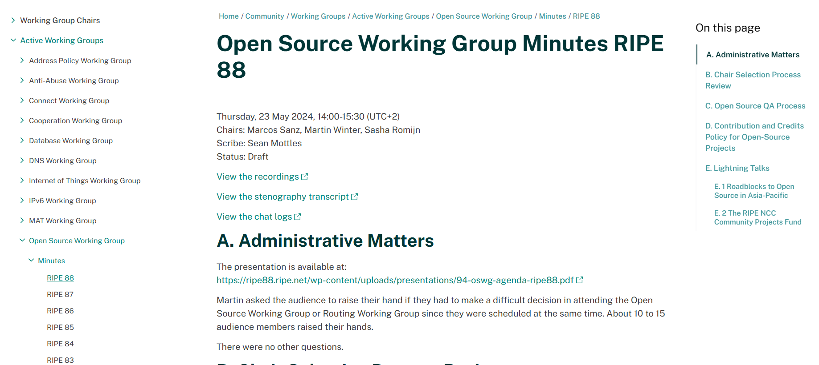
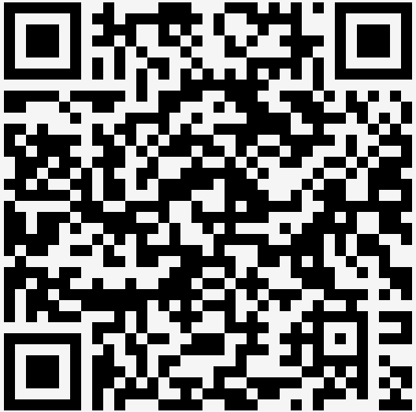
Approval of Minutes

Slide 6
Chair Changes
An announcement by Martin Winter

