Slide 1
Reviving BGP Zombies
Peering in the Routed Dead
Iliana Xygkou, Antonios Chariton, Fontas Dimitropoulos
  RIPE 89 - Prague

Slide 2
What are BGP Zombies?

Slide 3
What are BGP Zombies?
AS 64500
AS 64501
AS 64502

Slide 4
What are BGP Zombies?
UPDATE - Announce
2001:db8::/32
AS 64500
AS 64501
AS 64502

Slide 5
What are BGP Zombies?
UPDATE - Announce
2001:db8::/32
AS 64500
AS 64501
AS 64502

Slide 6
What are BGP Zombies?
UPDATE - Announce
2001:db8::/32
AS 64500
AS 64501
AS 64502

Slide 7
What are BGP Zombies?
UPDATE - Withdraw
2001:db8::/32
AS 64500
AS 64501
AS 64502

Slide 8
What are BGP Zombies?
UPDATE - Withdraw
2001:db8::/32
AS 64500
AS 64501
AS 64502

Slide 9
What are BGP Zombies?
?
AS 64500
AS 64501
AS 64502

Slide 10
What are BGP Zombies?
AS 64500
AS 64501
AS 64502
Routing Table
2001:db8::/32
Not found
Routing Table
2001:db8::/32
Not found
Routing Table
2001:db8::/32
via AS64501

Slide 11
What are BGP Zombies?
AS 64503
AS 64500
AS 64501
AS 64502
AS 64504
…

Slide 12
Why is this a problem?

Slide 13
Effects of Zombies
Why is this a problem?
Non-exhaustive
Deaggregated prefixes for Traffic Engineering / DDoS Mitigation may remain in some locations
Paths that are no longer there may appear and be used
    Routing loops
    Dropped traffic
  Sold or revoked IP space may cause small percentage of traffic being redirected
  False BGP Hijack Alerts / RPKI Invalids
  The number of prefixes on the Internet will keep going up

Slide 14
This is a problem both if your prefixes are stuck and if others’ prefixes are stuck in yours or your upstreams’ routers.

Slide 15
Why is this a problem?
UPDATE - Withdraw
2001:db8::/32

Slide 16
Why is this a problem?
UPDATE - Announce
2001:db8::/32

Slide 17
Is this a big problem?

Slide 18

Is this a big problem?

Slide 19
RIPE RIS Beacons
Is this a big problem?
RIS Peer 1
Announce its prefix every 4 hours (00:00, 04:00, …)
Withdraw the prefix 2 hours later (02:00, 06:00, …)
RIS Peer 5
RIS Peer 2
RIPE RIS
UPDATE - Announce
2001:7fb:fe01::/48
84.205.65.0/24
RIS Peer 4
RIS Peer 3
UPDATE - Withdraw
2001:7fb:fe01::/48
84.205.65.0/24

Slide 20
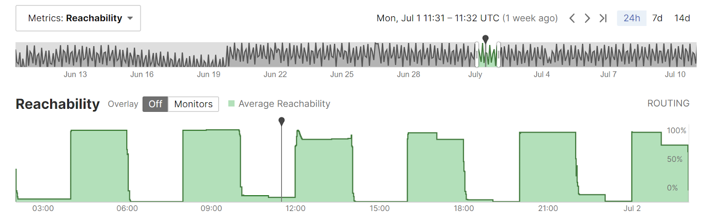
RIPE RIS Beacons
Is this a big problem?

Slide 21
RIPE RIS Beacons
Is this a big problem?
1h30m

Slide 22
Zombie Outbreaks
Is this a big problem?
Fontugne et al, 2019
Start | End | IPv6 Outbreaks | IPv4 Outbreaks
2017-03-01 | 2017-04-28 | 591 | 1’732
2017-10-01 | 2018-12-28 | 1’202 | 384
2018-07-19 | 2018-08-31 | 686 | 520

Slide 23
Zombie Outbreaks
Is this a big problem?
Fontugne et al, 2019
Start | End | IPv6 Outbreaks | IPv4 Outbreaks
2017-03-01 | 2017-04-28 | 591 | 1’732
2017-10-01 | 2017-12-28 | 1’202 | 384
2018-07-19 | 2018-08-31 | 686 | 520

Slide 24
Zombie Outbreaks
Is this a big problem?
Start | End | Study IPv6 Outbreaks | Study IPv4 Outbreaks | Our IPv6 Outbreaks | Our IPv4 Outbreaks
2017-03-01 | 2017-04-28 | 591 | 1’732 | 610 | 1’781
2017-10-01 | 2017-12-28 | 1’202 | 384 | 1’378 | 705
2018-07-19 | 2018-08-31 | 686 | 520 | 745 | 536
We are using RIB Dumps, UPDATEs, and STATE
The study used the LG and filtered the results with UPDATEs

Slide 25
RIPE RIS Beacons
Is this a big problem?

Slide 26
RIPE RIS Beacons
Is this a big problem?

Slide 27
Aggregator Address
Is this a big problem?
10.XX.YY.ZZ
24-bit seconds since
beginning of month UTC
01/11/24 11:00 CET (~Now)
10.[36’000] = 10.0.140.160

Slide 28
Zombie Outbreaks
Is this a big problem?
Start | End | Study IPv6 Outbreaks | Study IPv4 Outbreaks | Our IPv6 Outbreaks | Our IPv4 Outbreaks | IPv6 Outbreaks | IPv4 Outbreaks
2017-03-01 | 2017-04-28 | 591 | 1’732 | 610 | 1’781 | 610 | 1’319
2017-10-01 | 2017-12-28 | 1’202 | 384 | 1’378 | 705 | 1’370 | 478
2018-07-19 | 2018-08-31 | 686 | 520 | 745 | 536 | 514 | 226

Slide 29
Research Findings
Is this a big problem?
~19% of RIPE RIS <PeerAS,BeaconPfx> were not affected by BGP Zombies
50% of pairs have ~0.26% probability of falling for them
On average, ~1.6% of IPv6 and ~0.5% of IPv4 probability for a pair to see Zombies
Over 90-95% of the time, the Zombie path was NOT the best path

Slide 30
Can we improve our understanding?

Slide 31
RIPE RIS Beacons
Can we improve our understanding?

Slide 32
BGP Clock

Slide 33
2a0d:3dc1:HHMM::/48
Can we improve our understanding?
Every 15’

Slide 34
2a0d:3dc1:(HH)(MM+dd%15)::/48
Can we improve our understanding?
Every 15’

Slide 35
🔏
Can we improve our understanding?
RPKI ROA
2a0d:3dc1::/32-48 AS210312

Slide 36
BGP Clock
Can we improve our understanding?
Prefixes recycled every 24h / 15d, not every 4 hours
Allows us to see beyond the 1h30m – 2h mark into the unknown
Many more prefixes – 4 / Hour -> More data to study
Originated from AS210312 to over 1’700 direct adjacencies
Ben Cartwright-Cox called this the Route Cycler, as I found out later :)

Slide 37
2a0d:3dc1:2327::/48
Can we improve our understanding?
  Findings
Stuck in 8 RIPE RIS Peers (6 Unique ASNs)
Common Subpath: 30781 5511 25091 8298 210312
Stuck in Free Pro SAS in France (>200 ASNs in Cone)
    Probably all 200+ ASes in the Cone were “infected”, but only 6 had RIS Peers

Slide 38
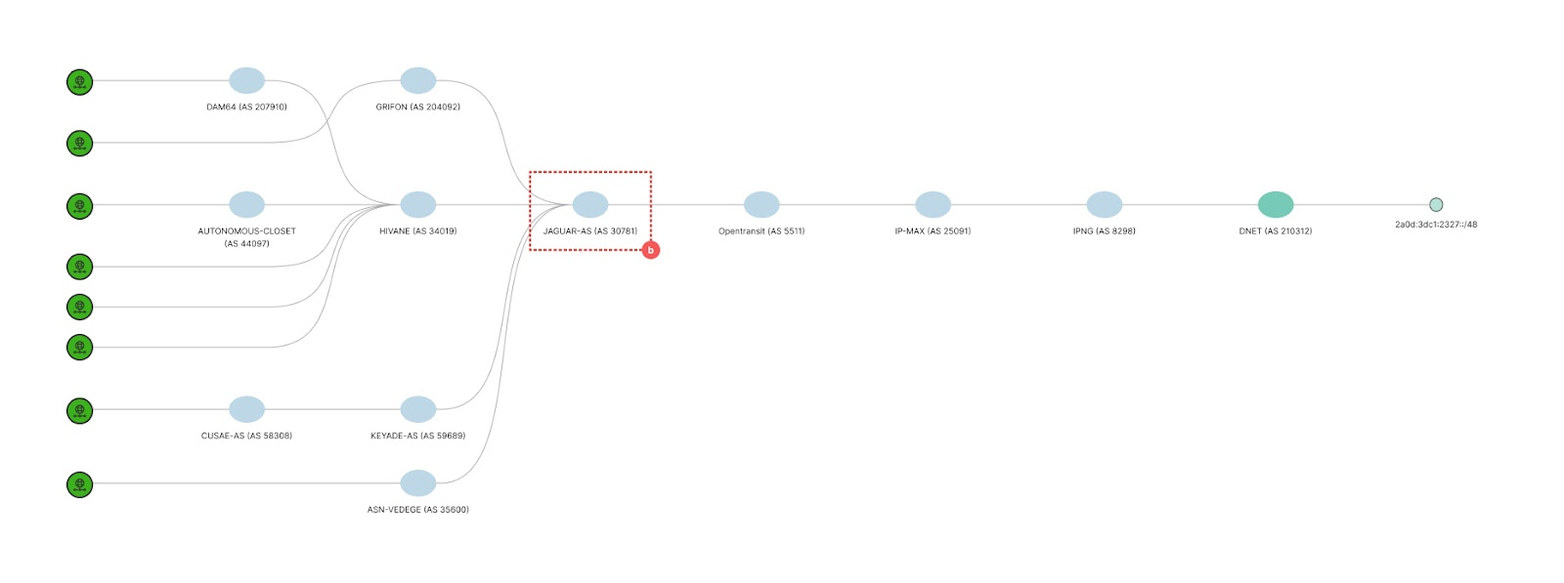
Visualization
Can we improve our understanding?

Slide 39
2a0d:3dc1:2233::/48
Can we improve our understanding?
  Findings
Stuck in 24 RIPE RIS Peers (21 Unique ASNs)
Common Subpath: 33891 25091 8298 210312
Stuck in Core Backbone GmbH in Germany (>2’000 ASNs in Cone)
    Probably all ASes in the Cone were “infected”, but only 21 had RIS Peers

Slide 40
2a0d:3dc1:1737::/48
Can we improve our understanding?
  Findings
Stuck in 7 RIPE RIS Peers
Common Subpath: 24961 210312
Stuck in WIIT AG / myLoc in Germany (>200 ASNs in Cone)
    Probably all 200+ ASes in the Cone were “infected”, but only 7 had RIS Peers

Slide 41
🔏
Can we improve our understanding?
RPKI ROA
2a0d:3dc1::/32-48 AS210312

Slide 42
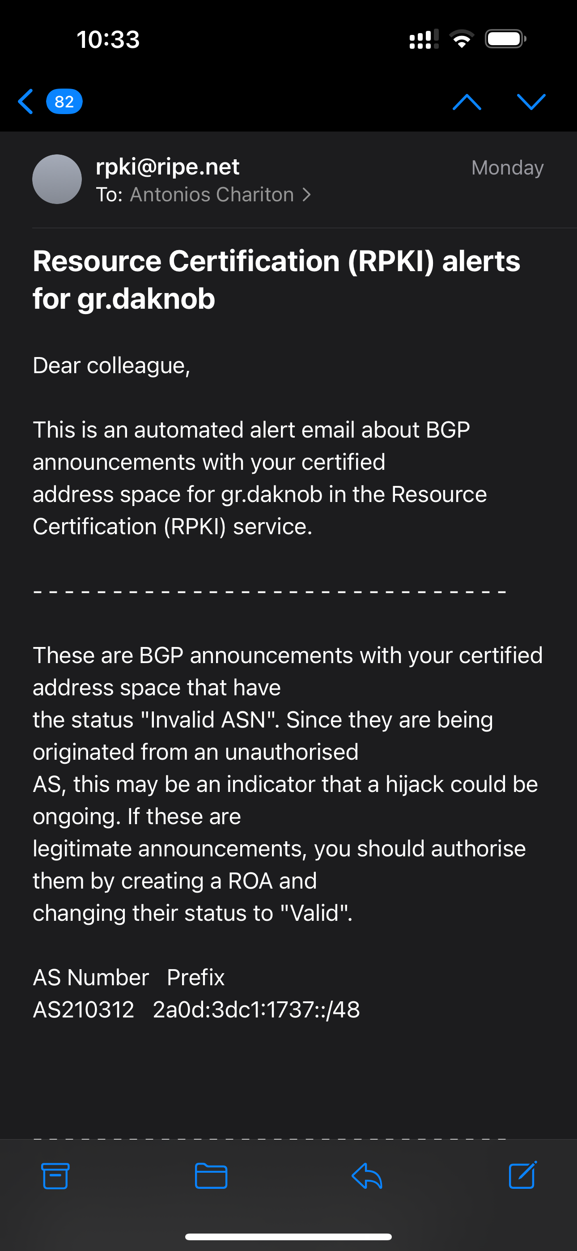
Can we improve our understanding?

Slide 43
Can we improve our understanding?
3.5 Months Later!

Slide 44
Routes still stuck…
Can we improve our understanding?
  Over 4 months later, we can see:
1 in RIPE RIS (Lasted 2.5 mo)
3 in bgp.tools
4 2 in bgp.he.net (Half life of 3 months!)
RPKI Invalid for > 3-4 months ¯\_(ツ)_/¯

Slide 45
What did we learn?

Slide 46
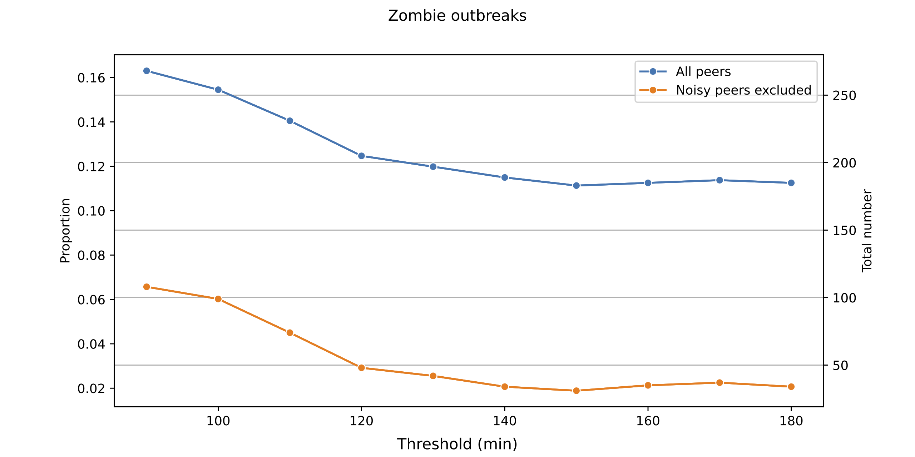
Thresholds Matter
What did we learn?

Slide 47
Thresholds Matter
What did we learn?

Slide 48
Noisy Peers
What did we learn?
Peer IP | ASN | 1h30m Threshold | 3h Threshold
176.119.234.201 | 211509 Rudakov Ihor | 9.91% | 9.06%
2001:678:3f4:5::1 | 211509 Rudakov Ihor | 9.91% | 9.06%
2a0c:9a40:1031::504 | 211380 Simulhost Limited | 7% | 6.88%

Slide 49
Thresholds Matter
What did we learn?

Slide 50
Stuck routes up over time?
What did we learn?
  What happened
We observed zombies increasing at ~160’
Prefixes that withdrew 10’ earlier, are coming back
There’s a new Announcement!
Common subpath: 4637 1299 25091 8298 210312
Telstra Global, with >5’000 ASNs in Cone
Session reset? Filter update?
Reinfections can happen!

Slide 51
Can we do something?

Slide 52
Yes!
Can we do something?
  draft-ietf-idr-bgp-sendholdtimer:
Practically an RFC already
Adds a SendHoldTimer in addition to the HoldTimer
Tears down sessions if messages can’t be sent (not just received)
Addresses XX% of stuck route causes
Ask for support from your vendor!
Has to be added, included in stable releases, operators have to upgrade, ???, profit!

Slide 53

Learn more

