Slide 1
RPKI-flutter
A high-resolution RPKI observatory
Emile Aben, Ties de Kock, Agustín Formoso | RIPE NCC | 2024-10-29

Slide 2
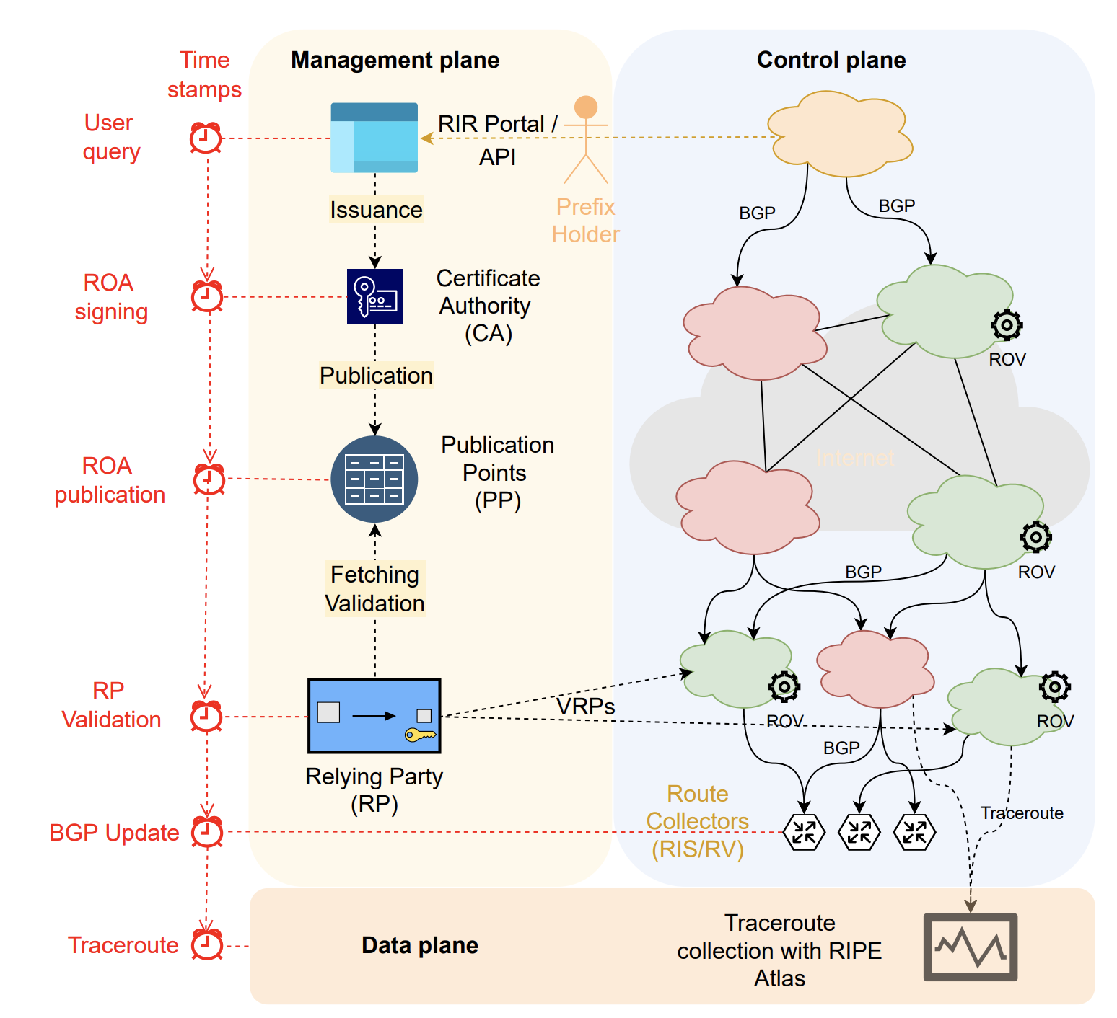
How do RPKI and BGP interact?
From RPKI Time-of-Flight: Tracking Delays in the Management, Control, and Data Planes:
“We observe significant disparities in ISPs’ reaction time to new RPKI information, ranging from a few minutes to one hour”
What does this look like “in the wild” ?

Slide 3
Enter “RPKI-flutter”
We built a data collection prototype:
“RPKI-flutter”
Goal: Observe changes in RPKI outputs at high time granularity
By-catch: Interesting low volume RPKI dataset, potentially filling a gap in near-realtime observability and post-mortem analysis

Slide 4
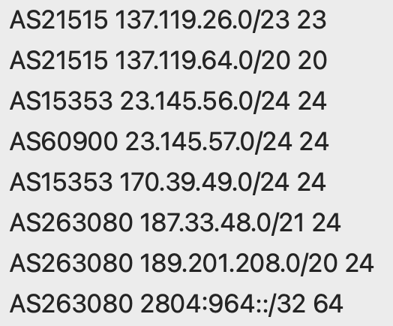
How does RPKI-flutter collect data?
We poll 4 Routinator instances for VRP Up/Down:
Snapshot of state at start of day (“bview”)
VRP Up/Down every 30s (“updates”)
Daily parquet aggregate at: https://rd-www-1.ripe.net/rpki_flutter/daily/
 | Granularity | Vantage points | Daily volume | Pre validation data | Post validation data
RIPE NCC RPKI archive | daily | 1 | 750 MB | yes | yes
RPKIviews | 15 min | 5 | 180 GB | yes | yes
RPKI-flutter | <= 30 sec | 4 | 30 MB | no | yes

Slide 5
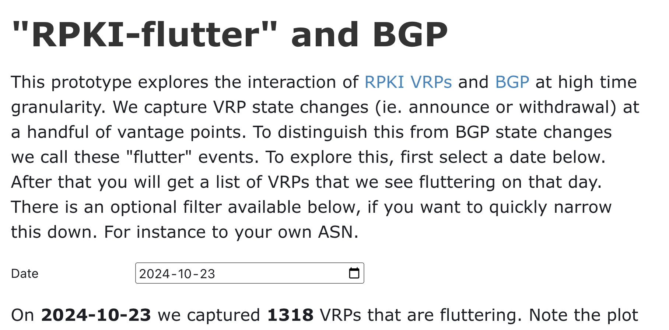
The Interface: Compare RPKI and BGP Timing
This interface allows you to select and zoom in to individual VRPs and exact BGP matches
Limitations: ie. future work :)
Not looking at more/less specific prefixes yet
BGP data only as recent as current BGPlay API
https://observablehq.com/@emileaben/rpki-flutter-and-bgp

Slide 6
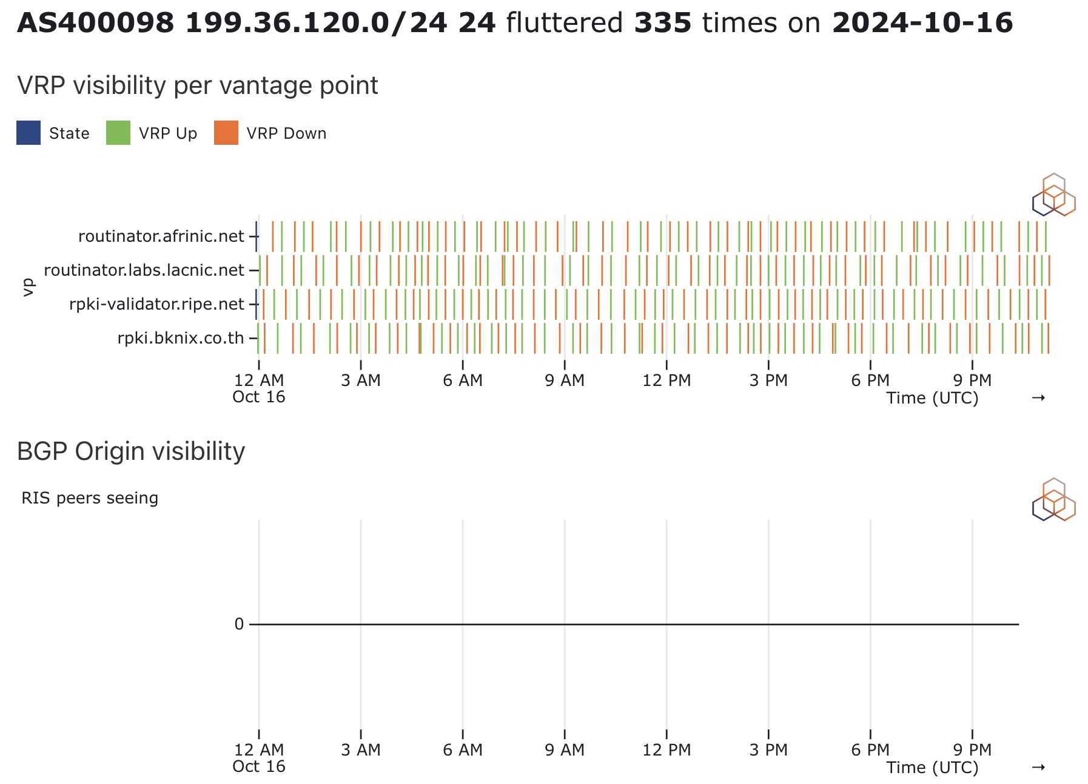
Example Observation: Top flutterer
This Amazon VRP keeps being added/removed
View from our 4 VPs is different!
No prefix in BGP that matches this
Amazon is monitoring the RPKI [1]
[1] https://manrs.org/2023/10/coordination-key-to-largest-rpki-deployment/

Slide 7
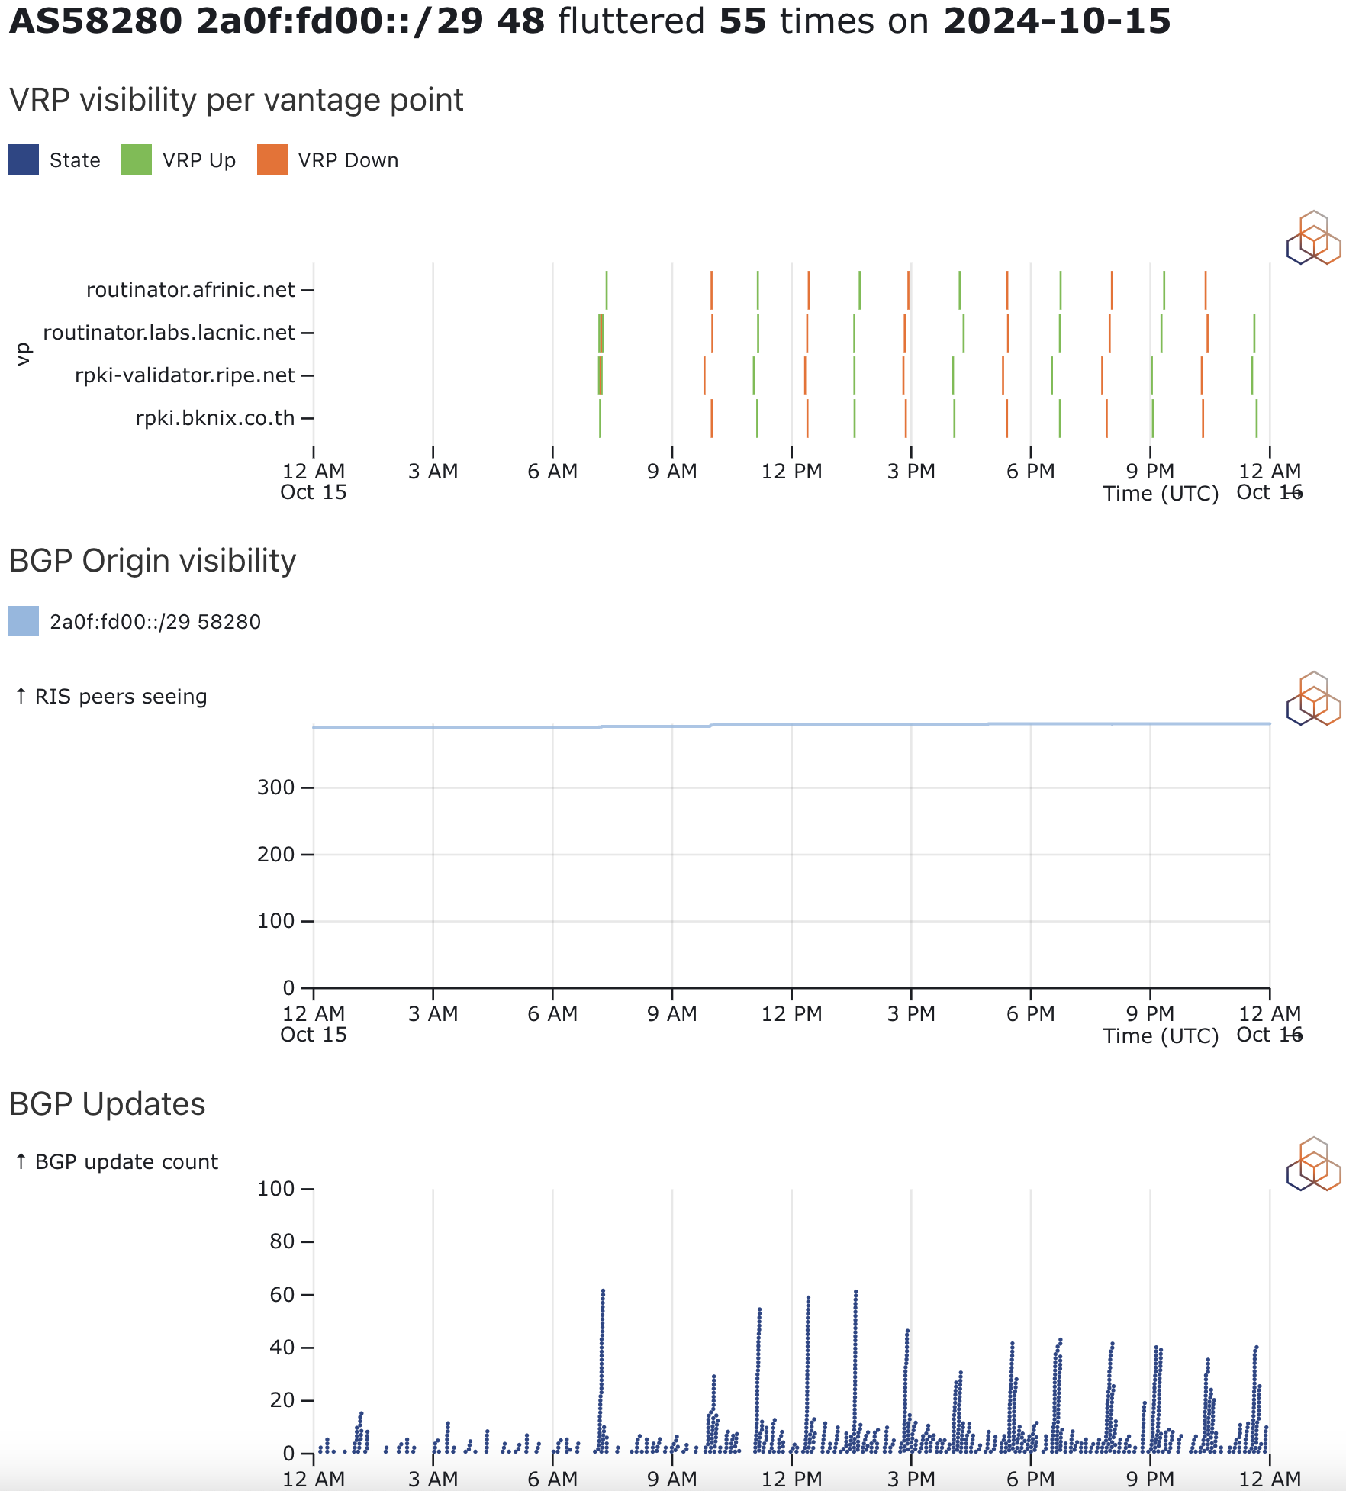
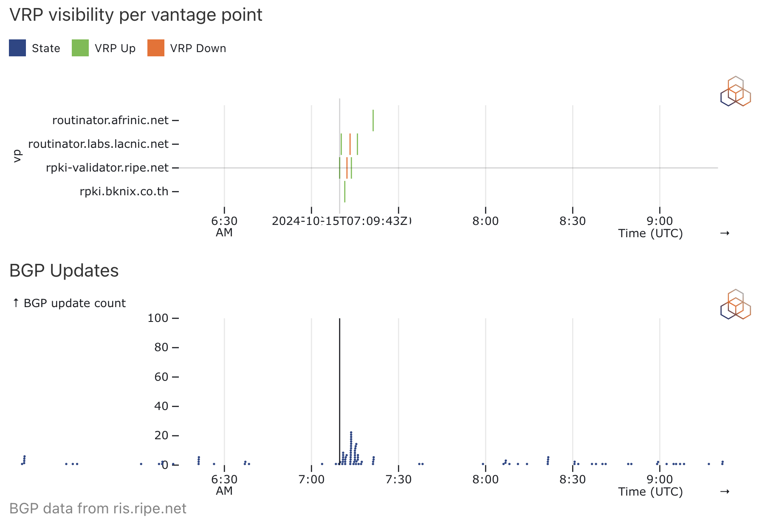
Example Observation: BGP Churn, but no visibility change
Test in collaboration with Max Stucchi (AS58280):
Changing VRP so BGP prefix RPKI status flapped between ‘Valid’ and ‘NotFound’
No change in BGP visibility, prefix was not withdrawn (as expected)
But noticeable BGP update churn, see [1]
Interesting artefacts if you zoom
[1] https://labs.ripe.net/author/stucchimax/a-bgp-side-effect-of-rpki/

Slide 8
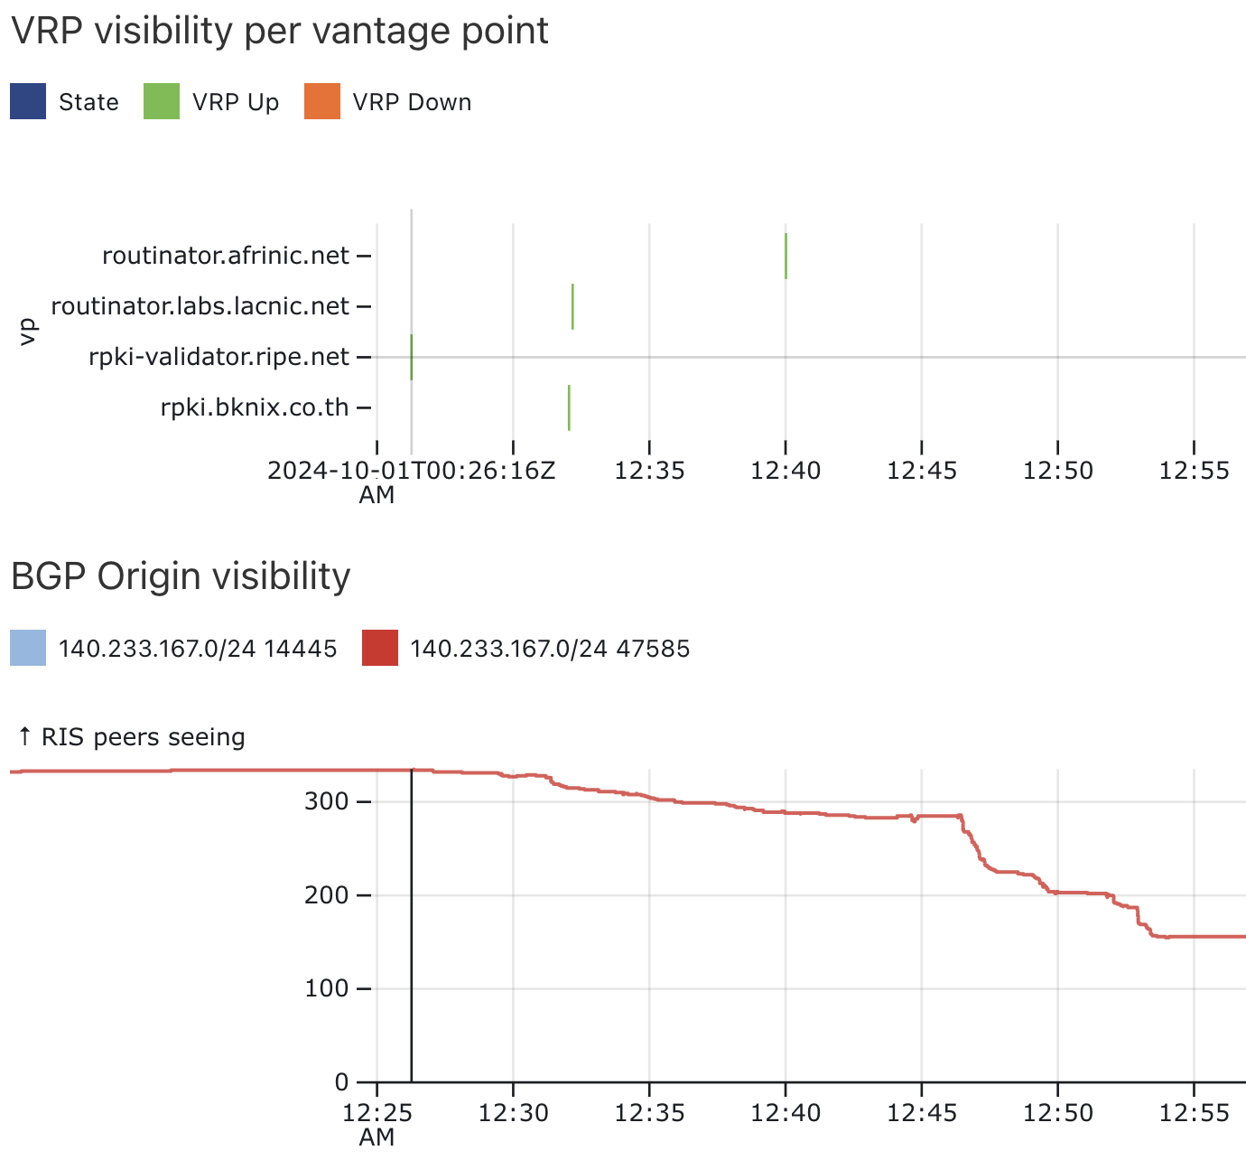
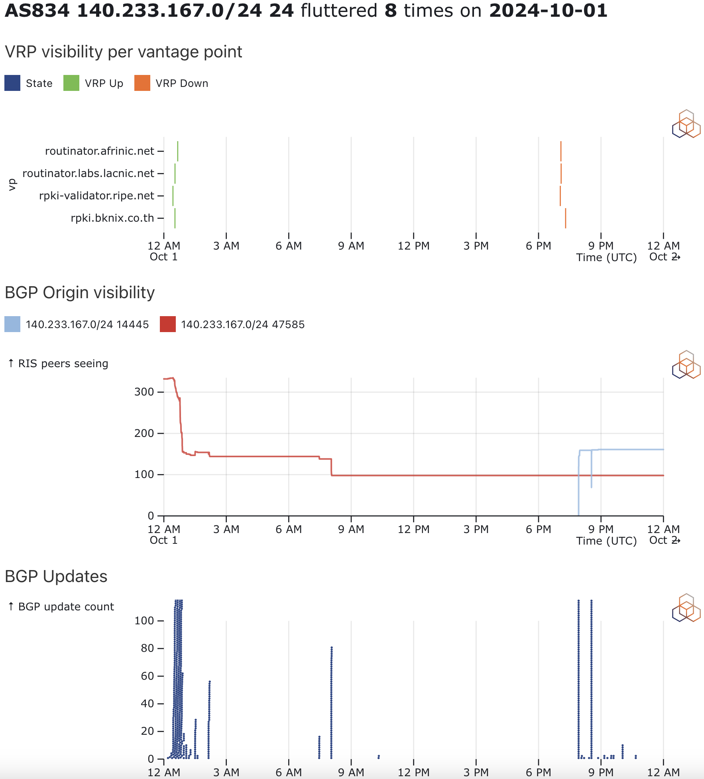
Example Observation: IP Leasing Enforcement?
A VRP appears for a prefix that is announced by another ASN. No other VRPs
=> prefix becomes “invalid”
BGP visibility of the prefix drops significantly
Zoom in shows when BGP change starts and reaches maximum effect
=> BGP changes happen in the 20-30 mins after VRP change

Slide 9
Conclusion
We make a flutter notebook available for netops (post mortem use-case) and researchers:
https://observablehq.com/@emileaben/rpki-flutter-and-bgp
We make the flutter data available:
https://rd-www-1.ripe.net/rpki_flutter/daily/
Wishlist:
Make this VRP-to-BGP observatory near-real time
Other vantage points (other validators^w relying-party software)
If you find an interesting case, please post on social media (tag #RPKIFlutter)
Feedback appreciated!

Slide 10
?
Questions & Comments
emile.aben@ripe.net

