Slide 1
NOG BOF
RIPE 89
31 October 2024
Alastair Strachan | RIPE NCC | 31 October 2024

Slide 2
The Future of Network Operator Groups

Slide 3
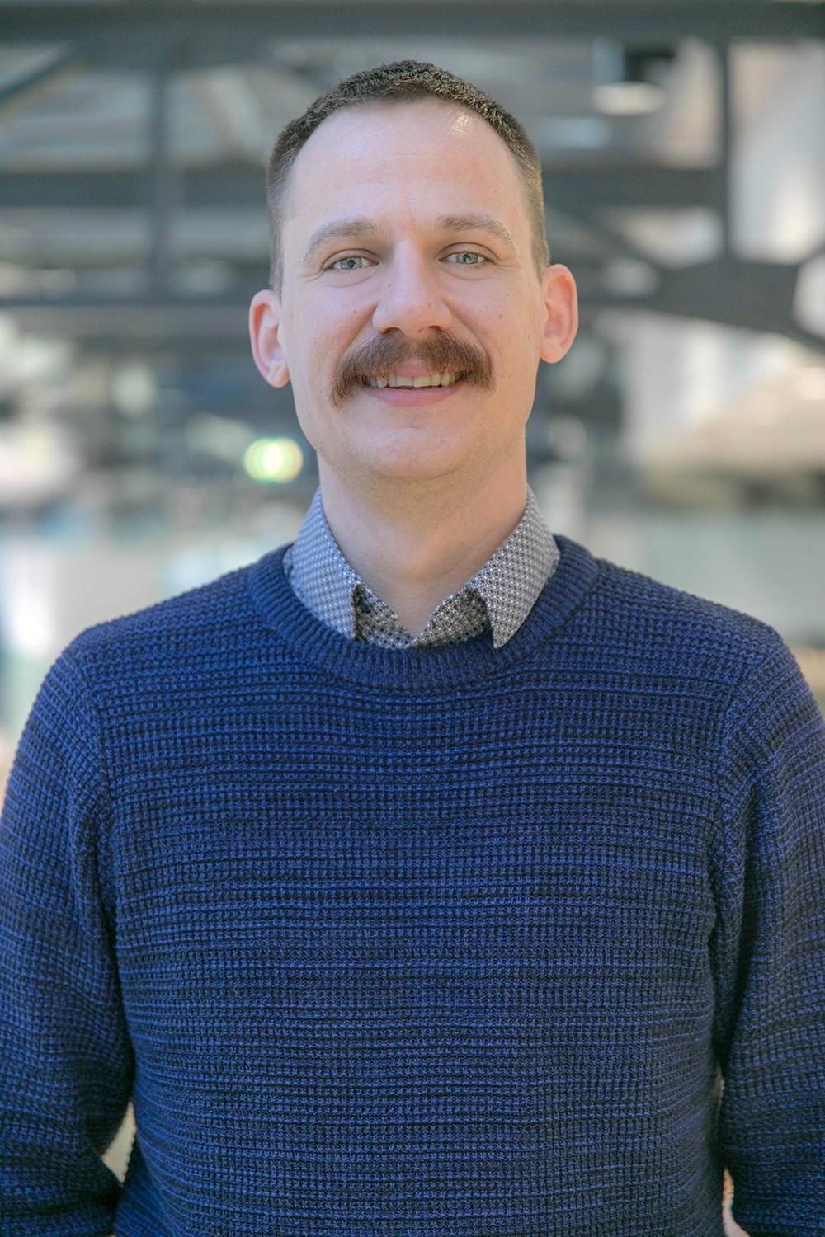
Hello!
Alastair Strachan
Community Development Officer
astracha@ripe.net

Slide 4
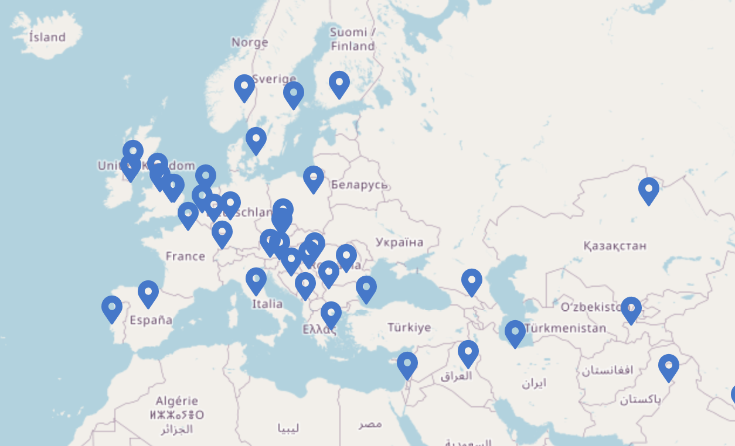
NOGs in the RIPE NCC Service Region
36 NOGs within our service region
Various formats and sizes
Oldest - SwiNOG - 2000
Newest - tbd

Slide 5
NOGs in the RIPE NCC Service Region
What the RIPE NCC does to support NOGs
Financial support
Provide speakers
Workshops
Sessions to support NOG organisers

Slide 6
Panel Discussion
Maria Isabel Gandia - ESNOG
Sander Steffann - Global NOG Alliance
Ondřej Caletka - CSNOG
Jan Žorž - SINOG
Johanna Eriksson - NETNOD
Patrick Bussmann - DENOG

