Slide 1




Anycast Discovery:
Daily Mapping of Anycast
RIPE 89, PRAGUE, CZECH REPUBLIC
28 OCT – 1 NOV, 2024
Remi Hendriks
Notes:
Good afternoon. My name is Remi Hendriks and today I will talk about Anycast Discover
A project from us at University of Twente

Slide 2




Our Team @ DACS
Remi Hendriks
PhD Candidate University of Twente
Raffaele Sommese
Assistant Professor
University of Twente
Mattijs Jonker
Assistant Professor University of Twente
Roland Van Rijswijk-Deij
Full Professor
University of Twente
Notes:
This is the team with which we developed this project.
Me, Remi Hendriks
And my supervisors
Raffaele Sommese, Mattijs Jonker, And Roland van Rijswijk-Deij

Slide 3
Content
Anycast
Census
Introduction
Conclusion
Q&A
Anycast
Measurement
Tool
Methodology
Results
Notes:
This talk is structured in two parts.
First, I will talk about the anycast census that we provide
Where I will introduce the census and explain why it’s important
Then I will go over the methodology that realizes the census
And I will share census results
Next, I will quickly share more about the measurement tool we developed to realize the census,
and how anycast operators can use it to improve their deployment
Finally, I will conclude

Slide 4
Content
Anycast
Census
Introduction
Conclusion
Q&A
Anycast
Measurement
Tool
Methodology
Results
Notes:
Let’s get started with the census

Slide 5
What is anycast?
Anycast is the geographical distribution of Internet services
  Achieved by announcing a single IP address at multiple locations
  Widely used as it provides resilience, low-latency, and load distribution
Notes:
What is anycast?
Anycast is the geographical distribution of Internet services
This is done by announcing a single IP address at multiple locations
And it’s widely used as it provides resilience, low-latency, and load distribution of a service

Slide 6
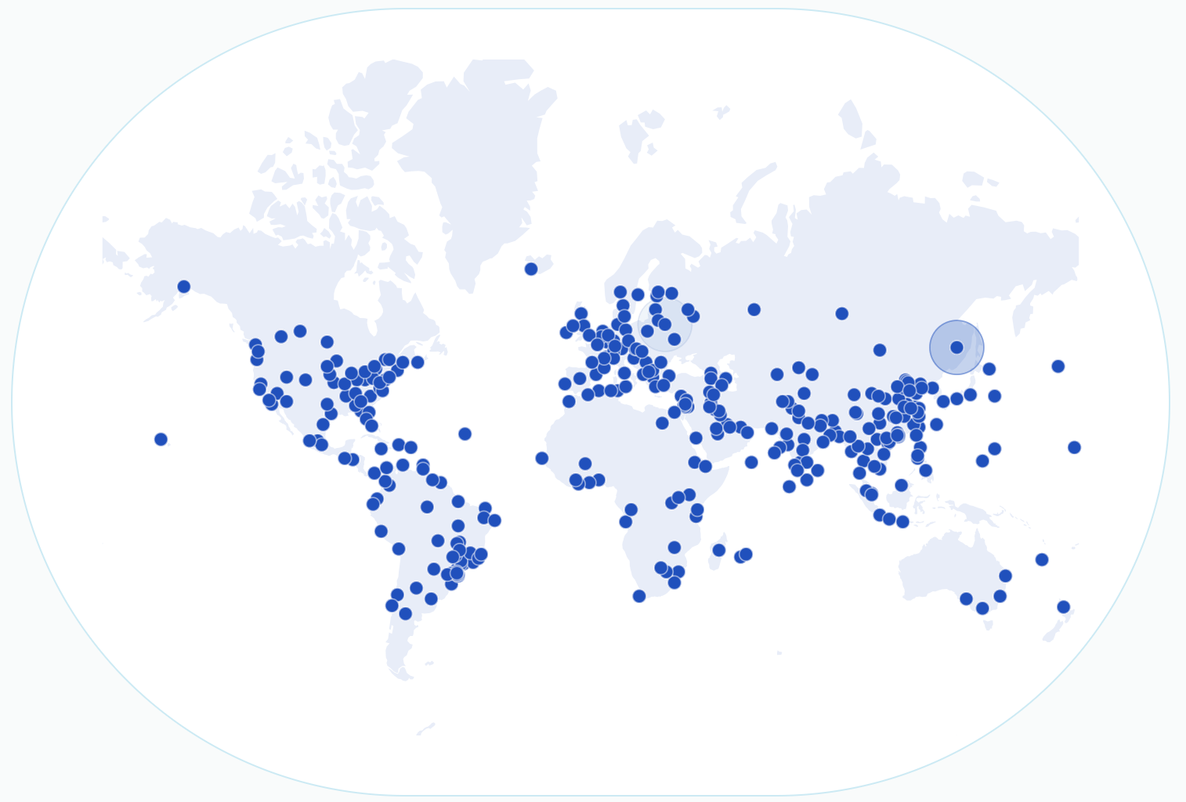
What is anycast?
Cloudflare’s global network
https://www.cloudflare.com/en-gb/network/
Notes:
Here you see Cloudflare’s quad 1 deployment, which is their public DNS resolver
If you make use of this service from here, you will receive a reply from the resolver in Prague
If you connect to this IP in New Zealand, you receive a reply from the resolver in Auckland

Slide 7
Providing a daily anycast census
Funded by RIPE NCC Community Project Fund (50 K€)
  Deployment, infrastructure, and other research costs
Establishing a measurement pipeline
A reliable daily census of anycast
  Publicly available for operators and researchers
Notes:
This project measures these addresses daily, thereby providing a daily anycast census
it is funded by RIPE NCC Community Project Funds,
We use the money for deployment and infrastructure to realize the census, and other research costs
For our daily census we established a measurement pipeline
To provide a reliable daily census of anycast
We make this census publicly available for operators and researchers

Slide 8
Anycast census; why?
Anycast is one of the most effective distribution and resilience techniques
  Used for critical Internet services (e.g., DNS)
  Deployed by CDNs for low-latency, reliability, ..
  DDoS mitigation (used to provide DDoS protection services)
Notes:
So why do we care about an anycast census?
Well, Anycast is one of the most effective distribution and resilience techniques
It's used by critical internet services, like the DNS
It is used by CDNs as it provides low-latency and relibaility
And it's used as DDoS mitigation, including DDoS protection services

Slide 9
Anycast census; why?
Anycast is one of the most effective distribution and resilience techniques
  Used for critical Internet services (e.g., DNS)
  Deployed by CDNs for low-latency, reliability, ..
  DDoS mitigation (used to provide DDoS protection services)
Anycast is opaque
  Unknown if an address is anycast
  Unknown if a service is provided using anycast
  Unknown where anycast sites are located
Notes:
But the issue is that anycast is opaque
If you have an Internet address, it is unknown whether it is an anycast or unicast address
Furthermore, if you connect to an Internet service, you don't know if it's provided using anycast
And you also don't know where the sites behind an anycast prefix are located

Slide 10
Why do operators care?
Knowing what is, and what is not, anycast is useful for:
Making better Traffic Engineering decisions
  Troubleshoot network problems
  Anycast to anycast routing problems
Resilience assessment of third parties
Notes:
For operators, the census is useful for
Making better traffic engineering decisions
In particular it is useful for troubleshooting network problems
Especially for anycast operators, they might see horrible routing from anycast to anycast,
That may lead to wrong TE decisions when not filtering out anycast prefixes from these policies
Finally, this census is useful for assessing the resilience of third parties,
You can both see which parties are deploying anycast
And you will have insights as to how large, and where, their anycast deployments are located

Slide 11
Content
Anycast
Census
Introduction
Conclusion
Q&A
Anycast
Measurement
Tool
Methodology
Results
Notes:
Now let’s talk about how we realize the census

Slide 12
Realizing the census
Daily measurement pipeline utilizes two methodologies
  Anycast-based (ICMP, TCP , UDP/DNS)
  Latency-based (ICMP, TCP)
Anycast-based measurement uses MAnycast² approach
  Developed in an IMC2020 submission [1]
  Leverages the concept of using anycast to measure anycast
Latency-based measurement based on iGreedy [2]
[1] Sommese et al. "MAnycast²: Using Anycast to Measure Anycast" ACM IMC '20
[2] Cicalese et al. "Latency-Based Anycast Geolocation: Algorithms, Software, and Data Sets," in IEEE Journal on Selected Areas in Communications '16
Notes:
This is achieved using two methodologies
One is anycast-based and the other is latency-based
The anycast-based approach is based on MAnycast2
Which was developed in an IMC 2020 submission
And it leverages the concept of anycast to measure anycast
The latency-based approach is based on a methodology called iGreedy
And it uses speed-of-light violations to detect anycast
We perform these methodologies with various protocols to maximize responsiveness and coverage
I will now explain both methodologies

Slide 13
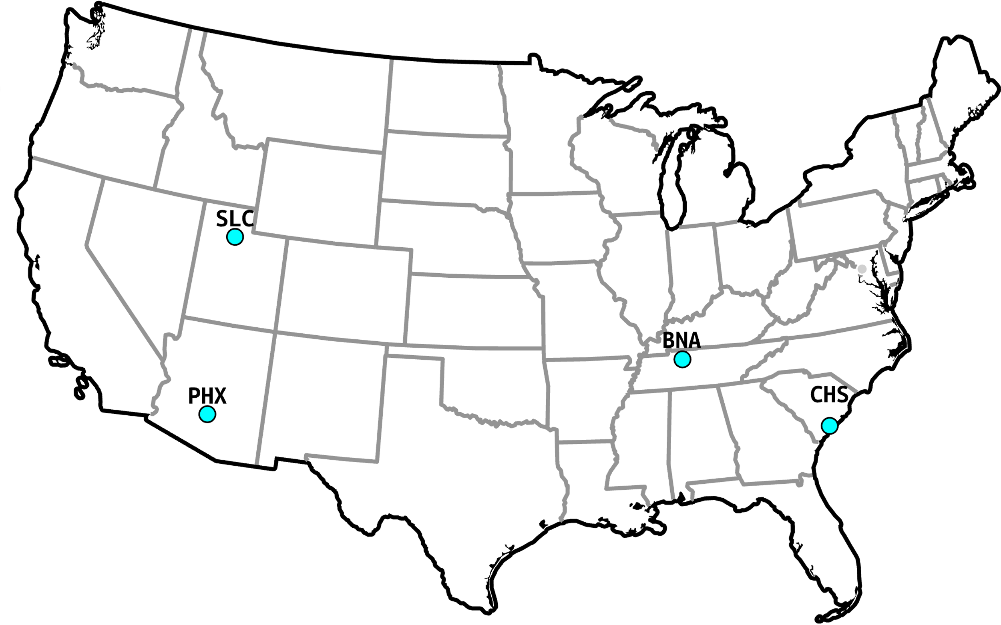
Anycast-based measurement
Set-up
Notes:
Starting with the anycast-based methodology
So as I mentioned, it uses anycast to measure anycast
And for this we need an anycast deployment from which we measure,
We indicate this deployment using the light blue dots
So if we probe an Internet address from all these locations, using their anycast address this is what happens:

Slide 14
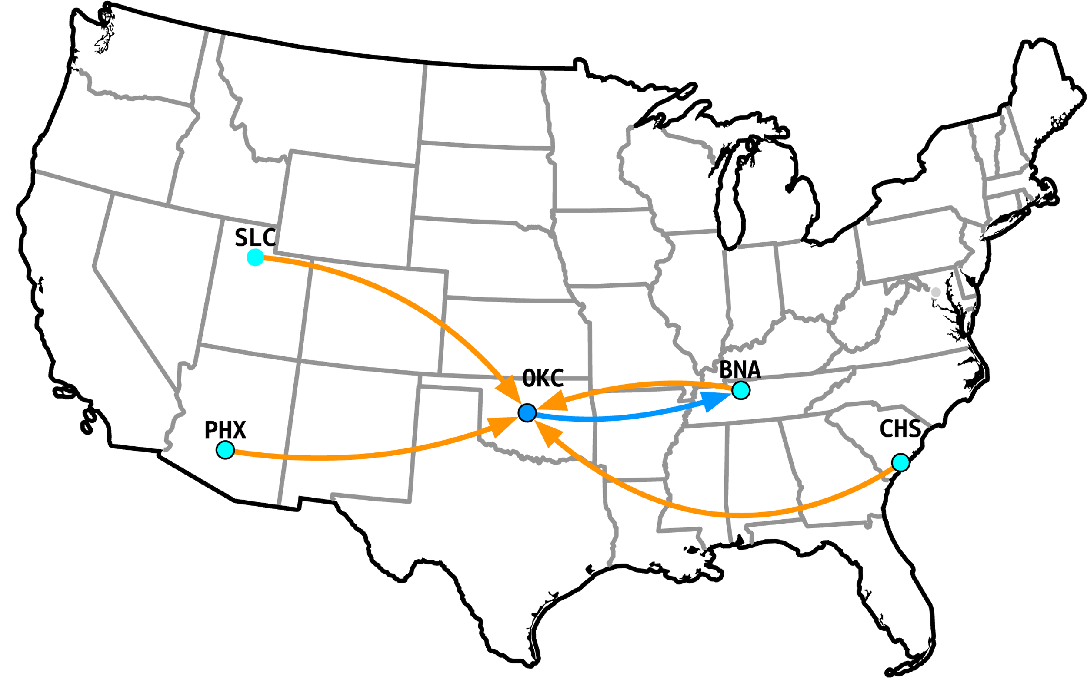
Anycast-based measurement
Unicast
Notes:
If the target is unicast, all the probes will go towards this unicast target
And this unicast target will send a response for each probe he receives
And these responses get routed to the nearest anycast location
So in this example, the BNA node will receive 4 probe replies

Slide 15
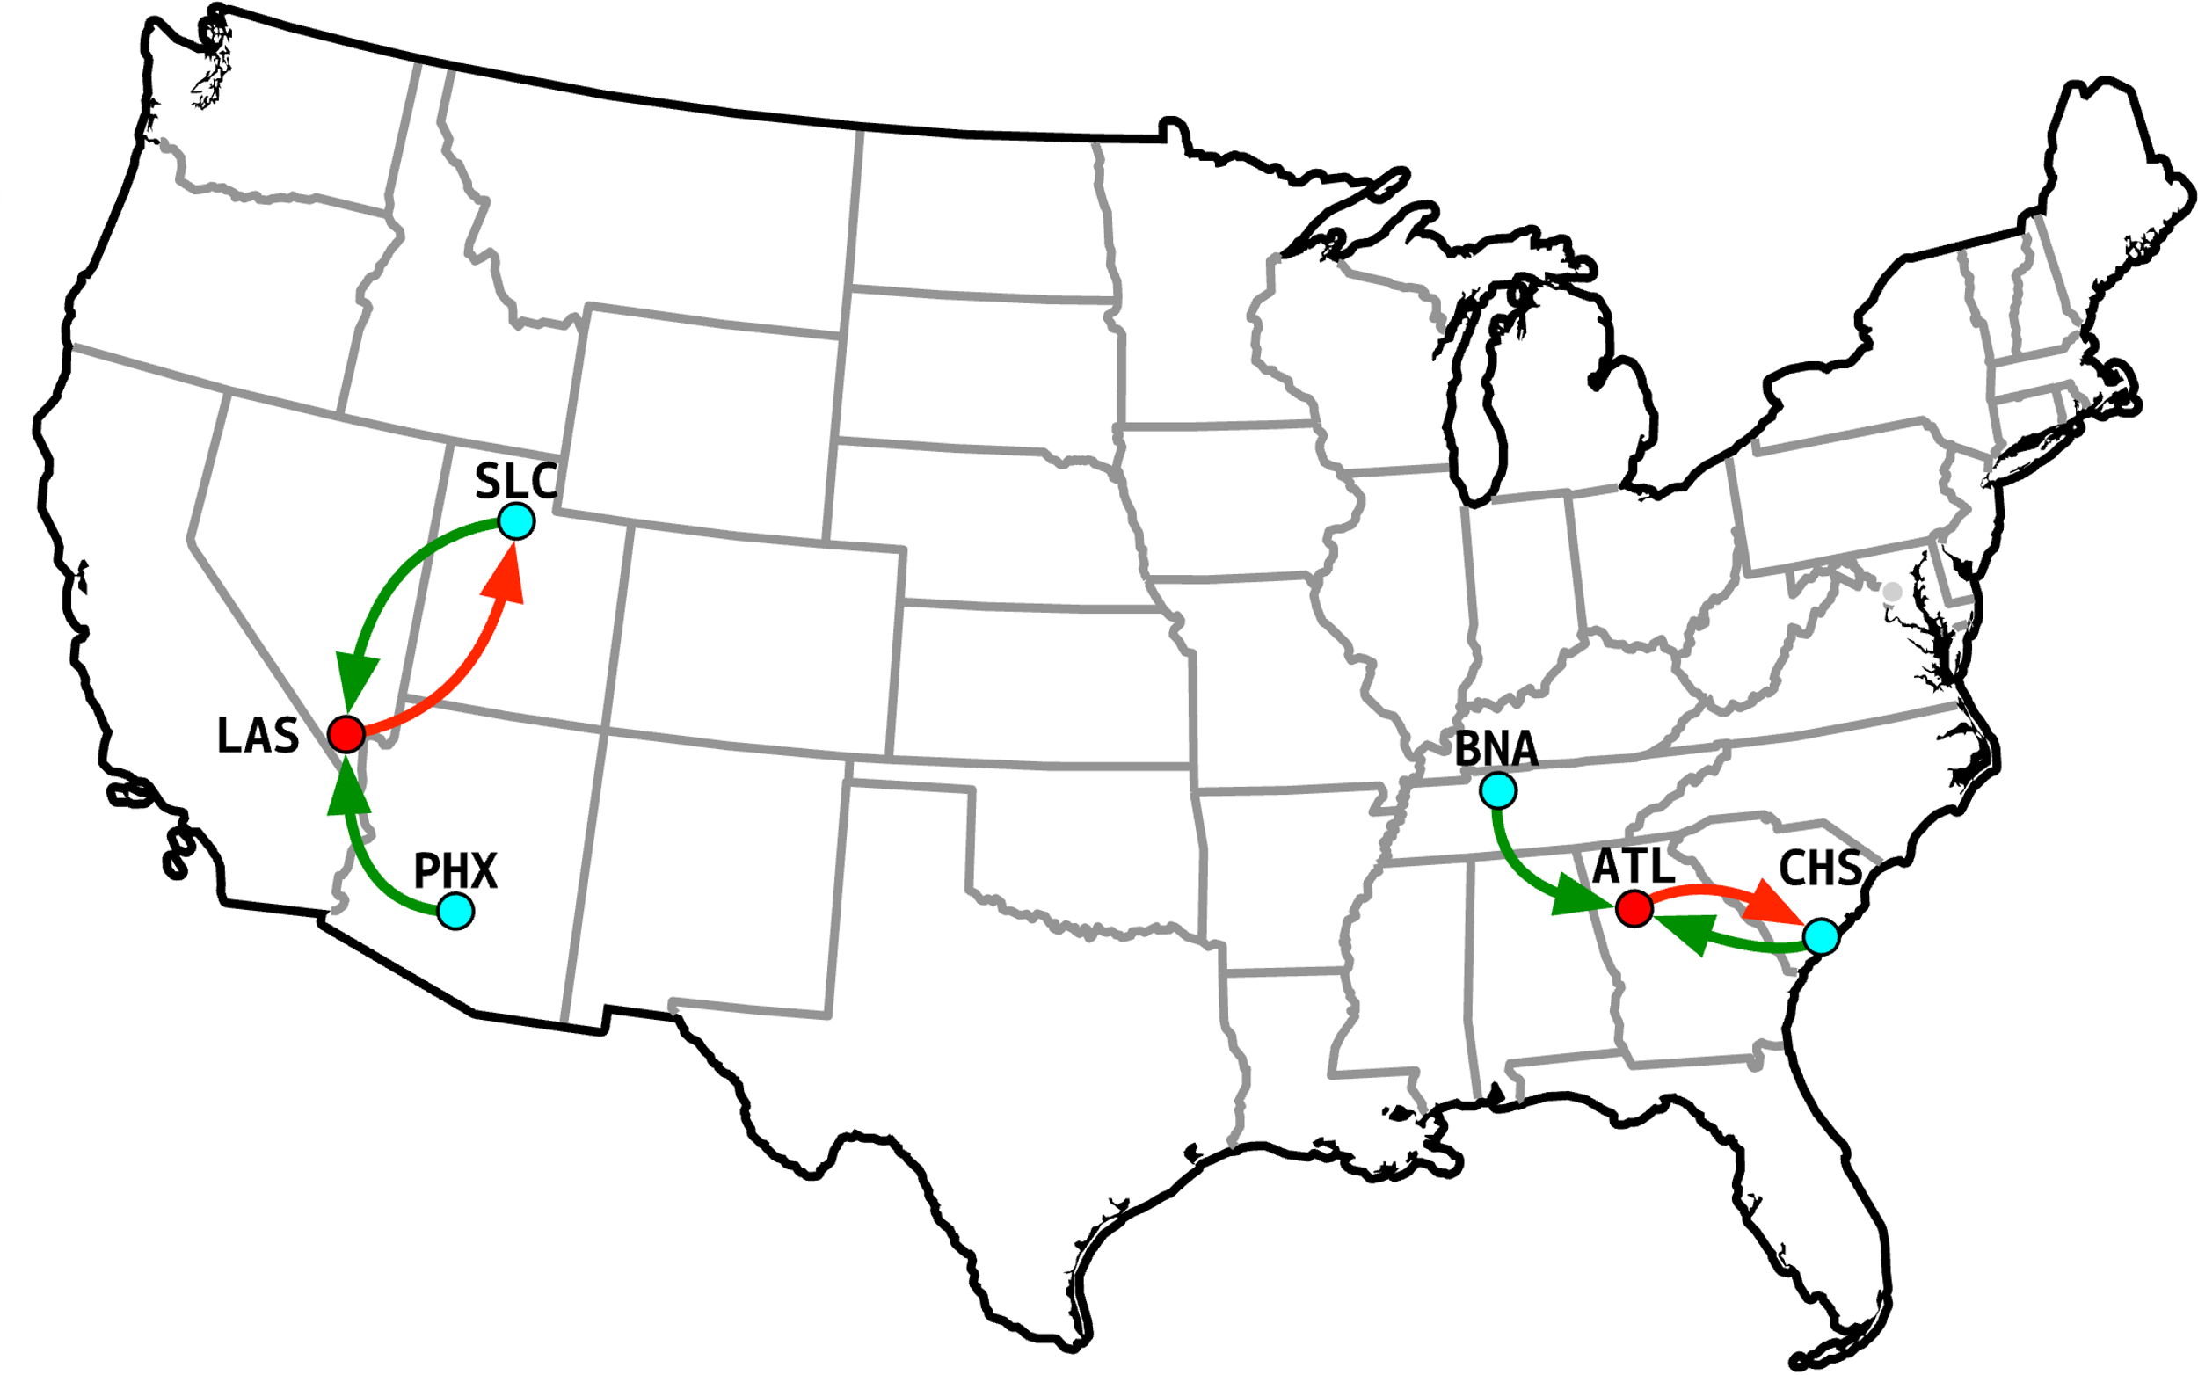
Anycast-based measurement
Anycast
Notes:
But if we probe an address that is also anycast,
In this example we probe an address that is anycasted in two locations
Then we see that our probes reach different anycast sites
Our probes on the west coast route to the target anycast site in Las Vegas
And our probes on the east coast route to the target anycast site in Atlanta
What we see is that each target anycast site will send back its route replies to different of our anycast sites
So the node in Las Vegas sends back replies to Salt Lake City
And the node in Atlanta sends back its replies to Charleston

Slide 16
Anycast-based measurement
Pros and cons
Pros:
  Low probing-cost (suitable for Internet scale measurement)
  Low FN rate (rarely misclassifies anycast as unicast)
Cons:
  Considerable FP rate (falsely classifying unicast as anycast)
  No geolocation of sites (only detection & enumeration)
Notes:
What we find with this methodology is that it has a low probing cost,
Which makes it suitable for measurements at Internet scale
And it has a low False Negative rate, meaning it rarely misclassifies anycast as unicast
The drawbacks however are that it has a considerable False Positive rate
Meaning it will falsely classify unicast addresses as anycast
This happens when a unicast address is in-between two of our anycast sites and sends back replies to both
Furthermore, this methodology does not provide geolocation of anycast sites, it only detects and provides an enumeration count

Slide 17
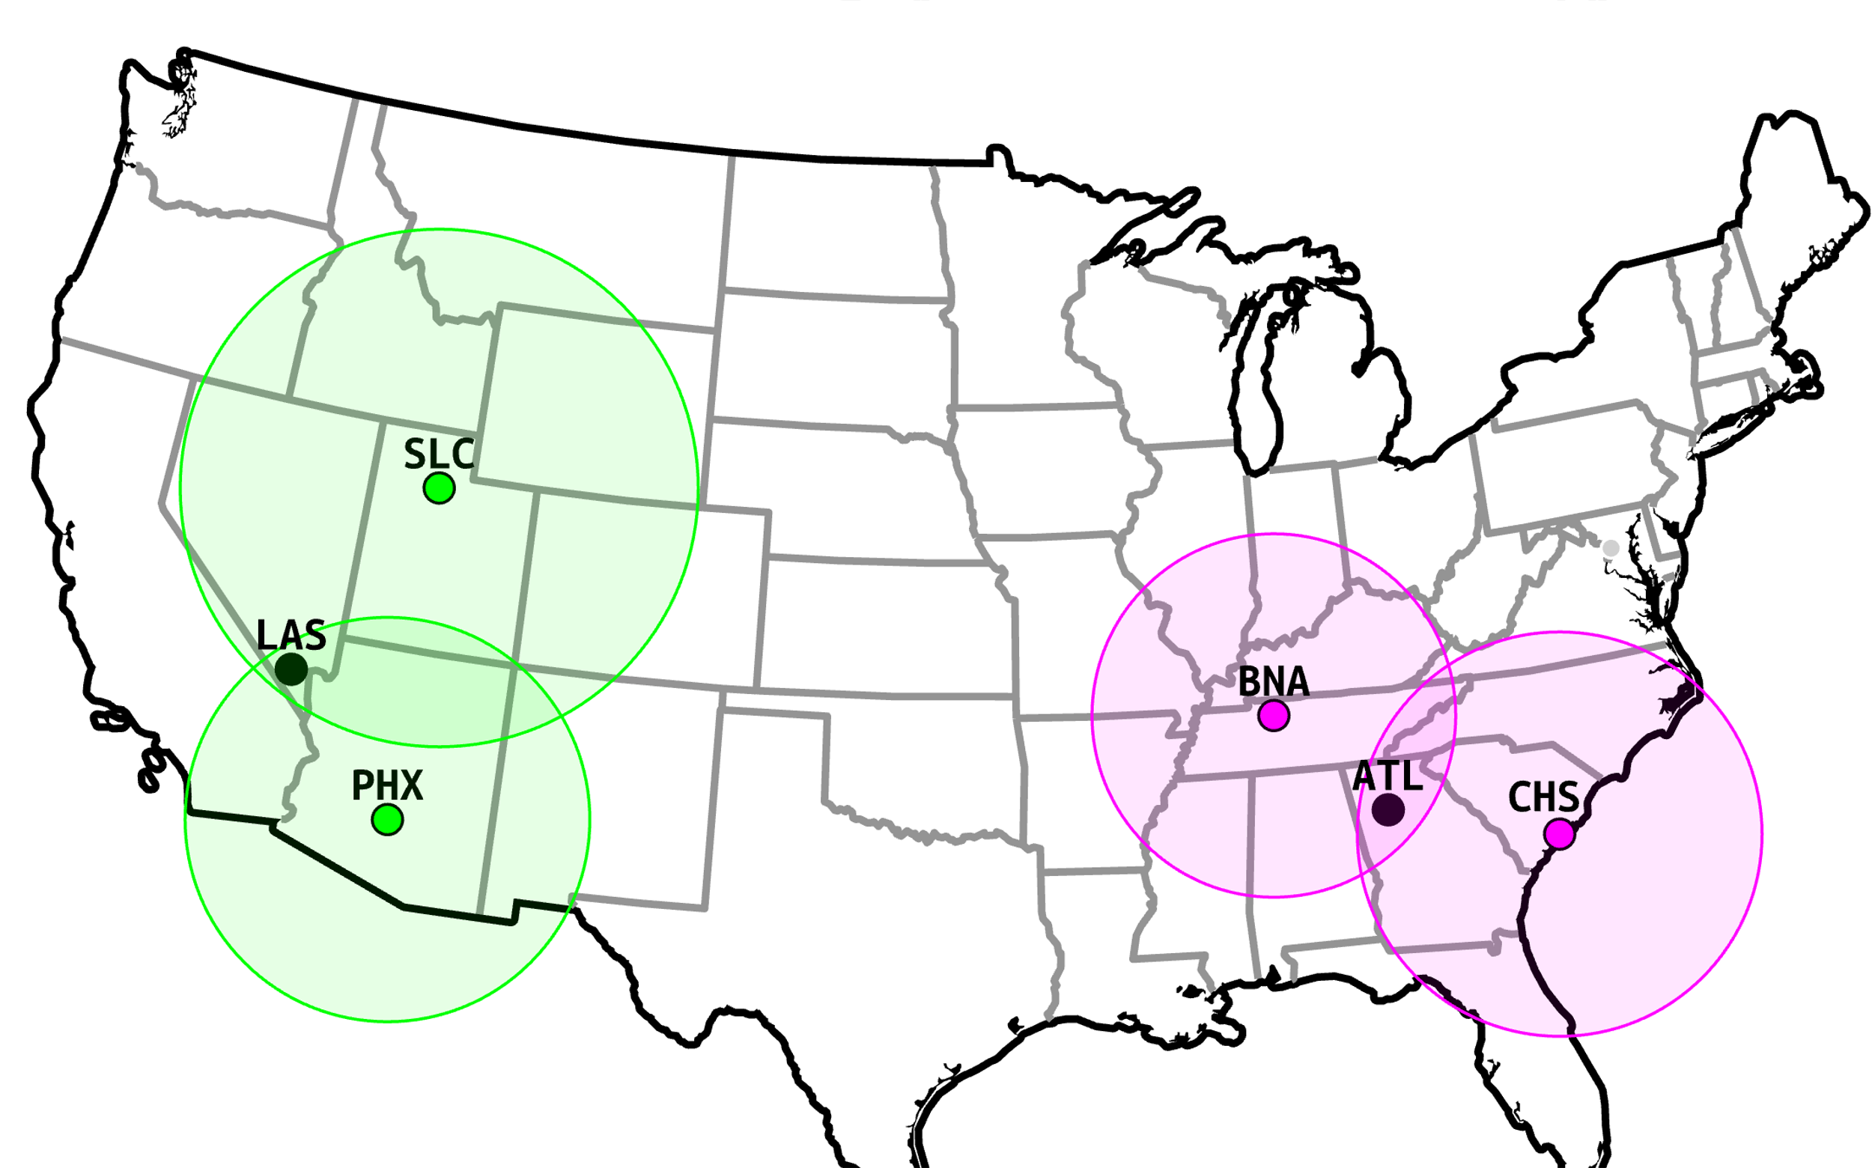
Latency-based measurement (GCD)
GCD (Great Circle Distance)
Latency-based measurement using
speed-of-light violations
Current state-of-the-art
Notes:
The second methodology we use is a Great Circle Distance technique that uses latency measurements
What it does is it probes an address and draws circles based on the distance the packet could have traveled based on the time it took to get a reply
Just like regular geolocation techniques
What we find is that in the case of anycast, it observes speed-of-light violations
So in this example, not all circles overlap.
So the probed address must be anycast.
Next, it infers the location of the anycast site by looking at the overlapping circles and taking the city with the largest population

Slide 18
Latency-based measurement (GCD)
GCD (Great Circle Distance)
Latency-based measurement using
speed-of-light violations
Current state-of-the-art
Pros:
Low FP/FN rate (highly accurate)
Geolocation possible
Cons:
    Requires large measurement platform
  (e.g., RIPE Atlas, CAIDA Ark)
    High probing cost
  (unsuitable for Internet scale)
Notes:
Its pros are that it is highly accurate, and that it allows for geolocation
But the cons are that it requires a large measurement platform, and it has a high probing cost, which makes it unsuitable for Internet scale measurements

Slide 19
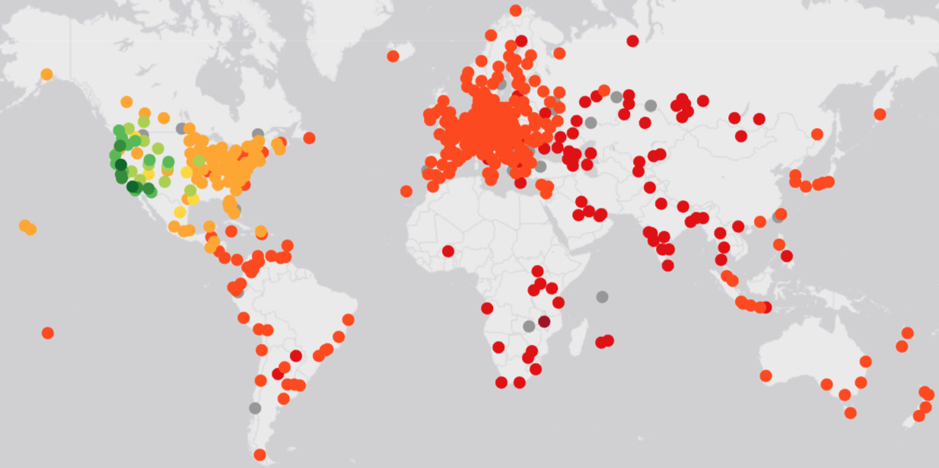
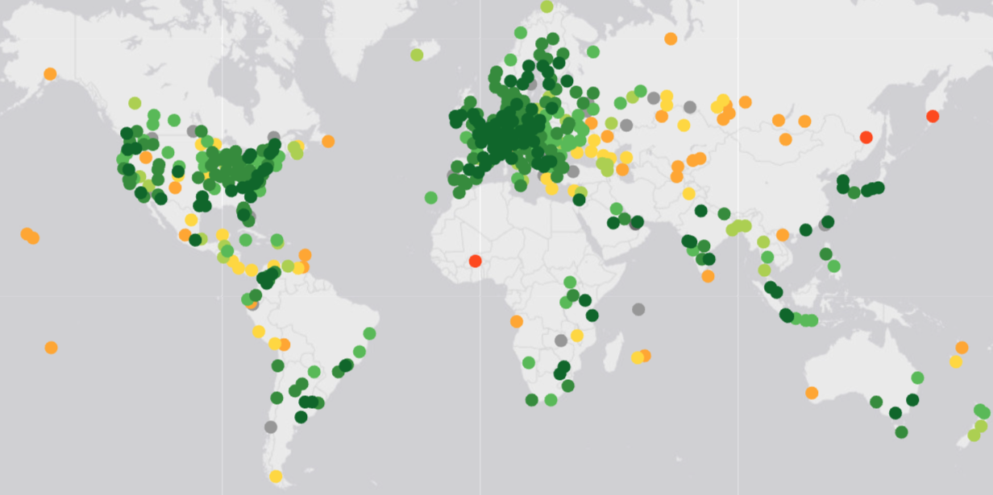

GCD measurement
RIPE Atlas example
Unicast
Anycast
https://atlas.ripe.net/measurements/79147535/
https://atlas.ripe.net/measurements/79137270/
Notes:
These illustrations give a good example of a GCD measurement using RIPE Atlas
On the left you see what latency measurements to a unicast address looks like
The green dots indicate a low latency response, which we see around the unicast location
And on the right you see what it looks like towards an anycast address
Where we observe low latencies in multiple continents

Slide 20
We combine the two
Perform anycast-based census
  Input: Internet wide hitlist
  (10^6 prefixes)
  Output: set of "anycast targets" (AT) (includes TPs and FPs)
Perform GCD-based measurement
  Input: AT
  (10^4 prefixes)
  Output: Anycast prefixes + enumeration + locations individual sites
Notes:
For our census we combine both methodologies
First, we perform the anycast-based methodology.
We do this at Internet scale, using the USC/ISI hitlist for IPv4
And the IPv6 hitlist from TU Munich, in combination with AAAA record addresses found with OpenINTEL
We scan at a 24 prefix granularity for IPv4 and 48 prefix granularity for IPv6.
This is because it is the smallest prefix size that is propagated by BGP
These hitlists contains millions of prefixes
After scanning these prefixes, we get a set of anycast targets,
Which consists of the prefixes that the anycast-based methodology classified as anycast
This includes both the True and False classifications of Anycast
Next, we perform the latency based measurement.
For this we target the Anycast Targets found from the previous measurement,
We limit this measurement for these targets due to the high burden of the approach
The final output is the set of anycast prefixes detected by either methodology, the enumeration found with both methodologies
And the locations of individual sites behind each prefix

Slide 21
Our hitlists
Hitlist: a set of responsive Internet hosts
/24 granularity for IPv4, /48 for IPv6
  Smallest routable prefix size
IPv4
  USC/ISI hitlist
IPv6
  TUM public IPv6 hitlist
  AAAA record addresses from OpenINTEL
Notes:
The hitlist we use for this work, is responsive hosts on the Internet
In particular, we probe a single responsive address for each /24 prefix (if it’s available)
And one in each /48 for IPv6
This is because they are the smallest routable prefix sizes
For IPv4 we use responsive address from the USC ISI hitlist
And for IPv6 we use the TUM public IPv6 hitlist
In combination with AAAA record addresses from OpenINTEL

Slide 22
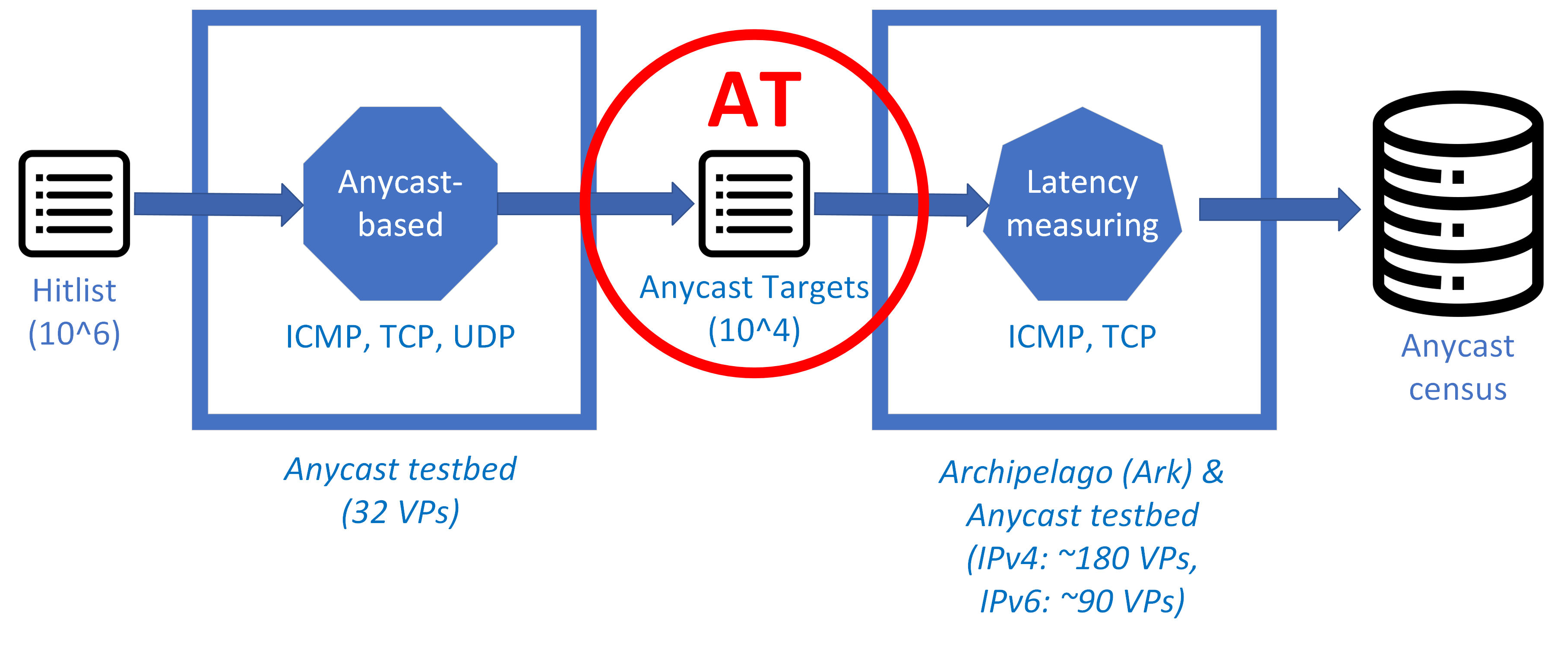
Pipeline
Notes:
To visualize the pipeline
We have the hitlist with millions of targets
We perform the anycast-based measurement
This is done for ICMP, TCP, and UDP
We use our anycast testbed to achieve this, which consists of 32 vantage points
This generates a set of Anycast targets
And for these targets we perform latency-based measurements using ICMP and TCP
Where we use the Ark platform and our testbed, that combined give us 180 vantage points for IPv4
And 90 for IPv6
The final result of both methodologies, and all protocols, is uploaded to our census

Slide 23
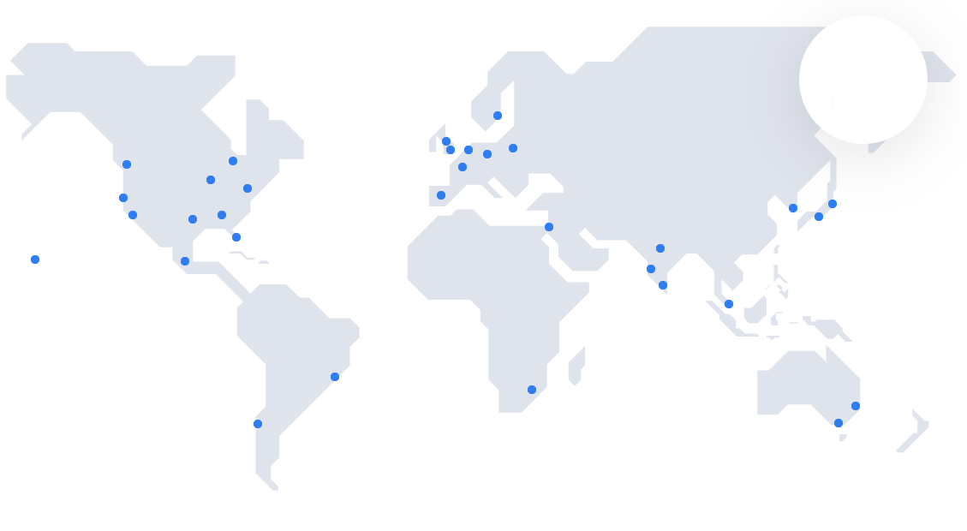
Anycast-based measurement tool
Developed anycast measurement tool
  More on this later …
Deployed using Vultr
  19 countries, 6 continents
Our anycast deployment (32 locations)
[https://www.vultr.com/features/datacenter-locations/]
Notes:
To achieve the anycast-based measurements we developed a measurement tool
Which is not limited to this census, but also useful for operators to measure and improve their anycast infrastructure
For our census we deploy this in Vultr, that is present in 19 countries and 6 continents
I will talk more about the measurement tool later

Slide 24
Latency-based measurement system
GCD measurements with CAIDA's Ark [1] and Vultr VPs
  ~ 180 vantage points
Implemented using Scamper [2] tool
Accurate geolocation and enumeration of 'small' anycast deployments
  * Fails to differentiate between sites with near geographic proximity
Geolocation and enumeration up to 60 sites for 'large' deployments
[1] https://www.caida.org/projects/ark
[2] https://www.caida.org/catalog/software/scamper/
Notes:
For the latency-based measurement we use CAIDA’s Ark platform and Vultr VPs
And we implemented this using the Scamper tool
We find that this measurement is able to accurately geolocate and enumerate small anycast deployments
However, it fails to differentiate between sites with near geographic proximity
For large deployments, think of Google and Cloudflare, our approach enumerates up to 60 sites

Slide 25
A combined view
Neither methodology perfect
Census contains both anycast-based and latency-based results
  Latency-based approach has rare cases of FNs
  Example: anycast in Belgium + Netherlands
  Anycast-based approach has FPs
Criteria up to you...
  Filter on both -> accept some FNs
  Filter on either -> accept some FPs
Notes:
Since neither methodology is perfect, we provide both results in our census
We find that the latency-based approach has rare cases of false negatives,
For example, it will struggle with anycast deployments that are deployed in Belgium and the Netherlands
For the anycast-based approach, we find it has numerous false classifications.
The criteria to use is up to the user of the census. Depending on the requirements of their analysis

Slide 26
Content
Anycast
Census
Introduction
Conclusion
Q&A
Anycast
Measurement
Tool
Methodology
Results
Notes:
I will now share results for a particular day of our census

Slide 27
Results
GCD-confirmed prefixes
~12.3k anycasted /24s (769 ASes)
~6.0k anycasted /48s (462 ASes)
299 ASes found to anycast both IPv4 and IPv6
Notes:
On average, our census finds 12.3 thousand /24 prefixes that are anycasted
And 6 thousand /48 prefixes that are anycaste for IPv6
For v4 we find 769 ASes, and for v6 we find 462 ASes that deploy anycast
Taking the intersection, we see 299 ASes that perform anycast for both IPv4 and IPv6
This means that 470 ASes are only found to perform IPv4 anycast.
We suspect many of these do anycast for both IPv4 and IPv6, but we have limited coverage with our IPv6 hitlist.
For the 160 ASes that we find to do only IPv6 anycast, we believe these are for the vast majority not doing IPv4 anycast, since our IPv4 hitlist provides far better coverage.
One reason could be the high price of obtaining a /24 in IPv4, which costs roughly 10 thousand USD, whereas for IPv6 a /48 is basically free.

Slide 28
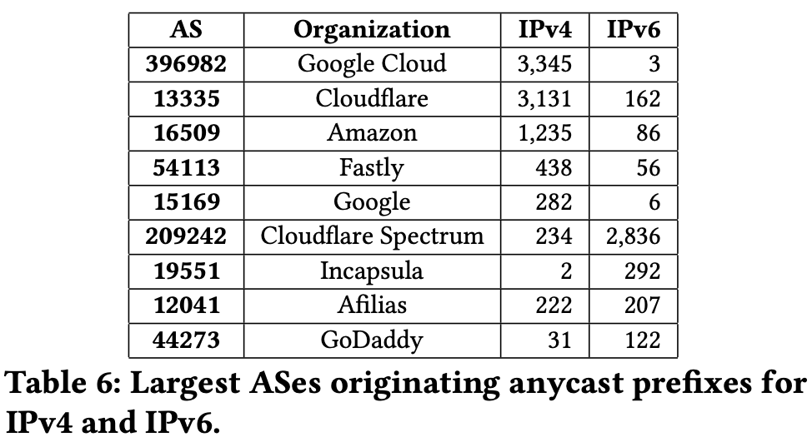
Results
GCD-confirmed prefixes
Notes:
This table shows the largest Ases that deploy Anycast.
We find the vast majority of anycast is deployed by cloud providers

Slide 29
Results
GCD-confirmed prefixes
Top 5 IPv4 anycast ASes
Notes:
For IPv4, half the census consists of Google Cloud and Cloudflare prefixes

Slide 30
Results
GCD-confirmed prefixes
Top 5 IPv6 anycast ASes
Notes:
For IPv6, half of the census are prefixes from Cloudflare

Slide 31
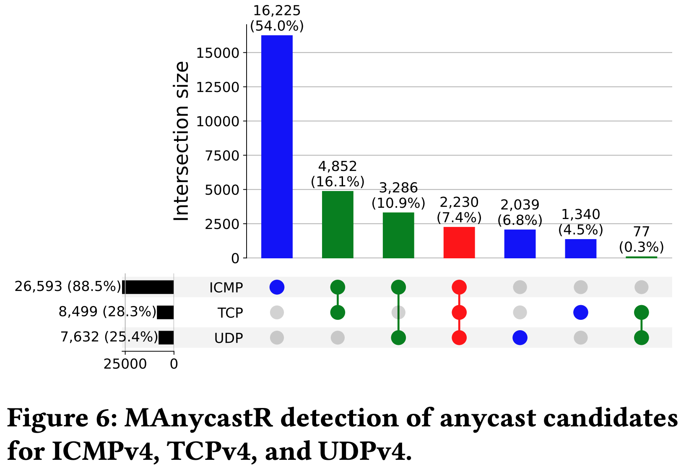
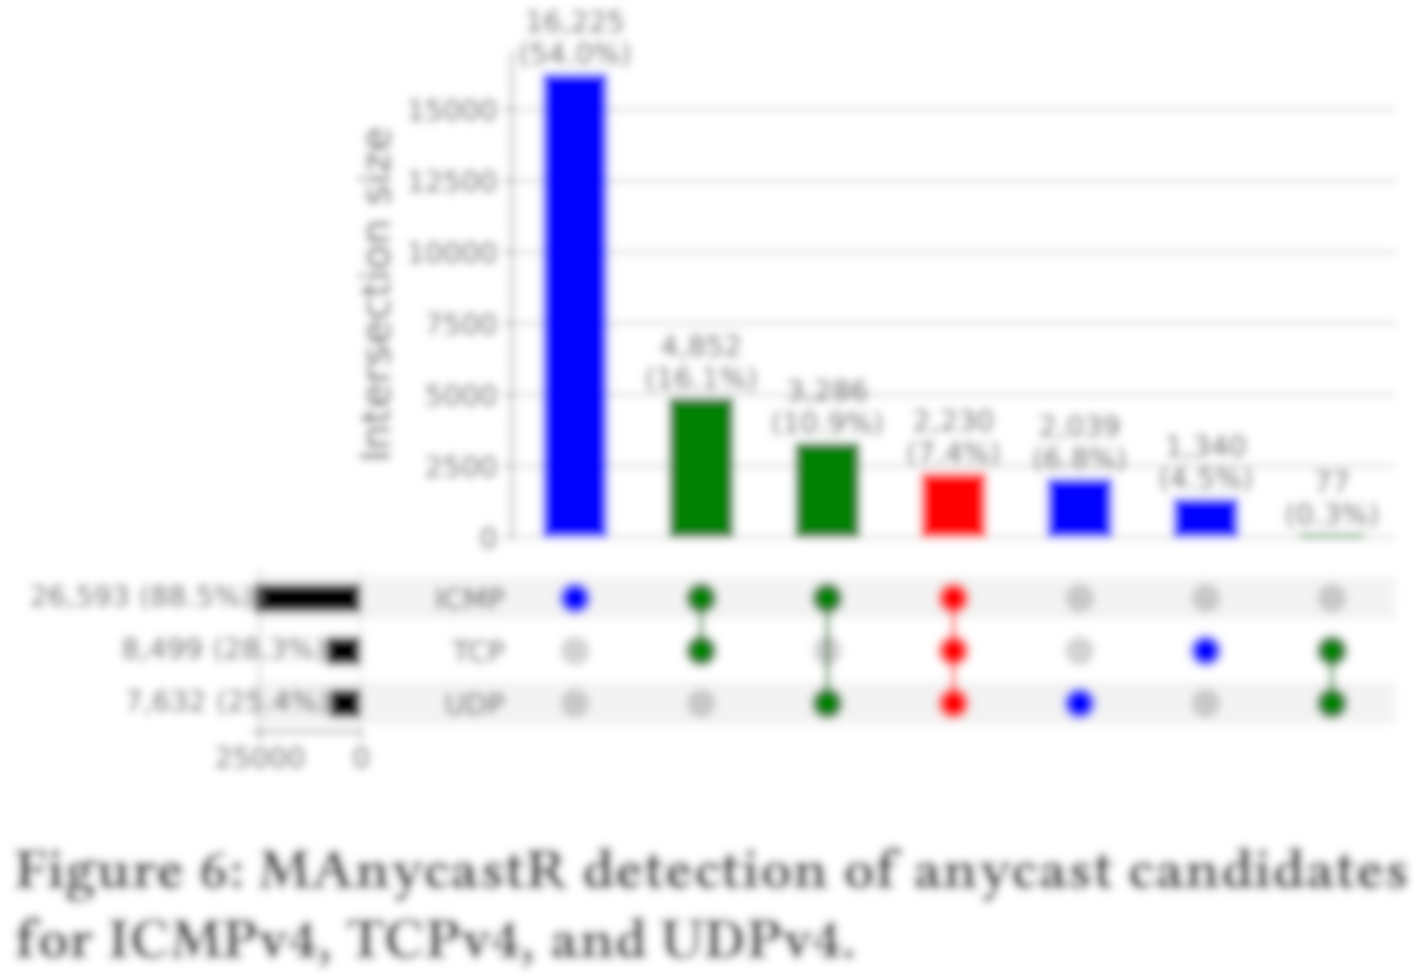
Results
Anycast-based by protocol
Notes:
This graph shows the results of the anycast-based approach
On the bottom left, we show the total count of prefixes found for each protocol.

Slide 32
Results
Anycast-based by protocol
Notes:
And the bar graph shows the complement of the intersection.
The blue bars are prefixes, discoverable with only one protocol.
The green bars are detected using two protocols
And the red bar is detected using all three protocols

Slide 33
Results
Anycast-based by protocol
Main takeaways:
Majority detectable using ICMP (89%)
Notes:
The main takeaways from this graph are that the majority of anycast is detectable with ICMP

Slide 34
Results
Anycast-based by protocol
Main takeaways:
Majority detectable using ICMP (89%)
Additional prefixes found (not detected with traditional approaches)
  2.0k UDP
  1.3k TCP
Notes:
However, there is a considerable number of prefixes that are not discoverable with ping
That would be missed by traditional approaches
These are 2 thousand prefixes only discoverable with UDP
And 1.3 thousand only discoverable with TCP

Slide 35
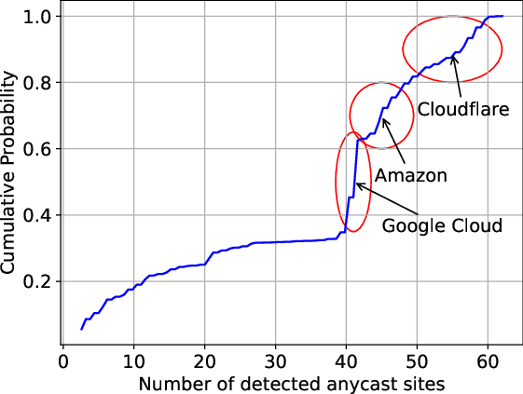
Results
Enumerating deployments
Notes:
This graph shows a CDF of the enumeration count that our latency-based approach finds for prefixes in our census

Slide 36
Results
Enumerating deployments
1/3 of anycast prefixes we detect < 40 sites
2/3 of anycast prefixes we detect >= 40 sites
Notes:
We find that 30% of anycast prefixes have less than 40 sites behind them
And 70% of prefixes have 40 or more anycast sites that we detect
For these large deployments, we find the most are prefixes from Google, Amazon, and Cloudflare

Slide 37
Results
Enumerating deployments
1/3 of anycast prefixes we detect < 40 sites
2/3 of anycast prefixes we detect >= 40 sites
Enumeration:
Lower bound of real deployment
Fairly accurate for small deployments
Indication of size for large deployments
Notes:
Overall the enumeration we find is the lower bound of real deployments
It is fairly accurate for small anycast deployments
And an indication of size for large deployments.

Slide 38
Longitudinal observations
(preliminary)
Longitudinal measurement lets us map the development of Anycast
Daily measurement allows us to observe:
  Anycast deployments regularly changing in size
  Prefixes switching between unicast and anycast (on-demand anycast)
  Cases of BGP prefix hijacking
  Cases of temporary anycast (anti-DDoS?)
  Anycast outages (entirely or at particular sites)
Notes:
As mentioned, we perform this census daily
Which allows us to map the development of anycast over time
So far we’ve seen deployments that regularly change in size
Prefixes that switch between unicast and anycast
Cases of BGP Prefix hijacking
Cases of temporary anycast
And anycast outages

Slide 39
Census summary
Created responsible, scalable, accurate anycast measurement pipeline
A daily census of anycast
  Detection, enumeration, and geolocation
  Providing results from two methodologies
We hope our census is useful to the community
Notes:
To summarize, we created a responsible, scalable and accurate anycast measurement pipeline
And we provide a daily census of anycast
Consisting of detection, enumeration, and geolocation of anycast prefixes

Slide 40
Content
Anycast
Census
Introduction
Conclusion
Q&A
Anycast
Measurement
Tool
Methodology
Results
Notes:
I will now talk about the anycast measurement tool that we initially developed for the census,
But have expanded to provide many types of measurement for analyzing the performance of an anycast infrastructure

Slide 41
Anycast measurement tool
So far, we looked at measuring anycast deployments externally
Tool also built for measuring anycast deployments themselves
Allows anycast operators to assess the performance of their deployment
Example: Catchment mappings (like done with Verfploeter [1])
  I.e., mapping for each address, the anycast site that it routes to
  Tool can map the IPv4 space in a few minutes with ease
  [1] De Vries et al. "Verfploeter: Broad and Load-Aware Anycast Mapping" ACM IMC ‘17
Notes:
So far we looked at how the measurement tool detects external anycast deployments on the Internet
Now I will share some examples on how the tool can measure anycast deployments themselves
This is useful for operators, as it allows them to assess the performance of their deployment
The main example is that it allows for catchment mappings, using the Verfploeter technique
A catchment mapping, is mapping for each address the anycast site that it routes to.
And this tool can map the IPv4 space in a few minutes with ease
Which makes daily and even hourly catchment mappings trivial

Slide 42
Catchment analysis
Anycast RTT data
Measurement tool can synchronously probe the hitlist from all VPs
  i.e., each hitlist target receives a probe from all anycast sites (with 1-second intervals)
  Technique used to perform anycast-based measurement
Filter on sender == receiver,
for all probed IPs
  Example: filter on probe from BNA
  (discard all others)
  Result: RTT data (like regular unicast ping)
  for entire hitlist
Notes:
As mentioned, the tool can probe a hitlist synchronously from all anycast sites
Like we do for the anycast-based measurements
For the target this looks like a regular ping measurement, as each site sends out its probe 1 second after the other
If you take this measurement data, and filter on sender is equal to receiver for all targets
You get round trip times that the anycast deployment achieves for each target, just like regular unicast ping
So, in this example you would filter on the probe from BNA for this particular target

Slide 43
Catchment analysis
Anycast RTT data (example)
Latency towards
USC/ISI IPv4 hitlist
Average 65.7 ms
25% 9.8 ms
50% 23.5 ms
75% 74.1 ms
Our anycast deployment (32 locations)
Notes:
For our anycast deployment, we find the average latency is 66 milliseconds
With a median of 23.5 milliseconds

Slide 44
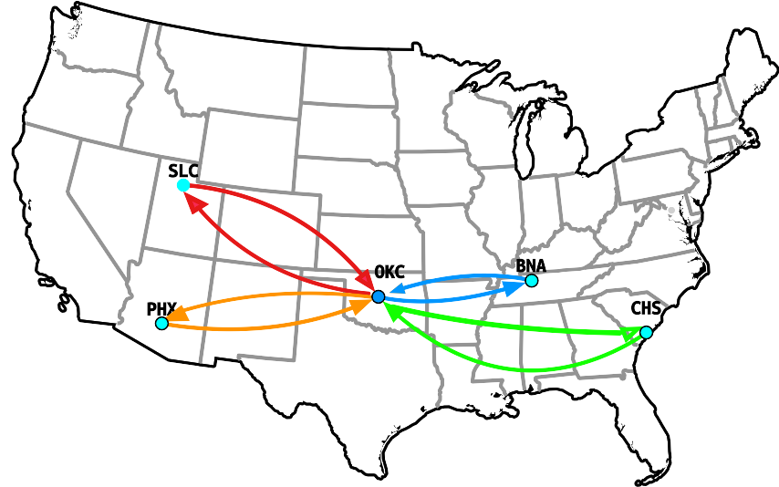
Catchment analysis
Anycast RTT data vs. best-case unicast RTT
Measurement tool allows for probing hitlist from all VPs with their unicast IPs
  Result: RTT data from all anycast sites to the probed IP
Notes:
Our measurement tool also allows for synchronous probing using the unicast addresses of the anycast sites
And this yields the RTT data from all anycast sites to the probed IP
So in this example we would have the RTT from this target to all of these anycast sites
And you can compare this with the RTT you achieve with the anycast address, to evaluate whether it is in fact routing to the nearest site

Slide 45
Catchment analysis
Anycast RTT data vs. best-case unicast RTT
Filter on min(RTT_{unicast}) -> best-case unicast RTT
  I.e., the site that has the lowest RTT towards a target
  The highest achievable performance (in terms of latency) for the anycast deployment
Notes:
So for each target you can find the minimum unicast RTT, which would be the site nearest to the target
If you calculate the average of these minimum RTTs, you would have the highest achievable performance for the anycast deployment
And you can compare this with the actual RTT achieved with anycast.
This gives insights into regions and ASes that experience sub-optimal anycast routing

Slide 46
Catchment analysis
Anycast RTT data vs. best-case unicast RTT
min(RTT_{unicast}) mean is 39.4 ms
Notes:
For our anycast deployment, we find that the average of the minimum RTTs is 40 ms

Slide 47
Catchment analysis
Anycast RTT data vs. best-case unicast RTT
min(RTT_{unicast}) mean is 39.4 ms
RTT_{anycast} mean is 65.7 ms
Notes:
The anycast average latency is 66 ms

Slide 48
Catchment analysis
Anycast RTT data vs. best-case unicast RTT
min(RTT_{unicast}) mean is 39.4 ms
RTT_{anycast} mean is 65.7 ms
Δ = RTT_{anycast} - min(RTT_{unicast}) = 26.3 ms
Notes:
This means that our anycast deployment has an average latency inflation of 26 milliseconds due to sub-optimal anycast routing

Slide 49
Catchment analysis
Anycast RTT data vs. best-case unicast RTT
min(RTT_{unicast}) mean is 39.4 ms
RTT_{anycast} mean is 65.7 ms
Δ = RTT_{anycast} - min(RTT_{unicast}) = 26.3 ms
  Substantial latency inflation due to sub-optimal anycast routing
  Large gain in performance (+40%) possible using e.g., BGP prepending, selective announcements, …
Notes:
By directing all targets to the nearest anycast site, the performance can be improved with 40%
And this can be done using for example BGP prepending, and selective BGP announcements

Slide 50
Catchment analysis
Anycast RTT data vs. best-case unicast RTT
min(RTT_{unicast}) mean is 39.4 ms
RTT_{anycast} mean is 65.7 ms
Δ = RTT_{anycast} - min(RTT_{unicast}) = 26.3 ms
  Substantial latency inflation due to sub-optimal anycast routing
  Large gain in performance (+40%) possible using e.g., BGP prepending, selective announcements, …
Future work:
  Automated detection and solving of sub-optimal anycast routing
Notes:
Future work is to automatically detection and solving of sub-optimal anycast routing

Slide 51
Measurement tool
Further use cases
Identifying load distribution (as done in the Verfploeter paper)
Simultaneous probing with multiple prefixes
  Side-to-side comparison of catchment mapping for two different prefixes
    e.g., assessing effectiveness of changed BGP announcements
    e.g., what if site X were unavailable, where would its traffic go?
IPv6, TCP, UDP/DNS and CHAOS probing
Detect network regions experiencing 'site flipping' due to Load-Balancers
And much more...
Notes:
I just showed some examples of the types of analysis and measurements that the tool allows
It can be used for many more use cases
For example, identifying load distribution
Doing a side-to-side comparison of two prefixes, since the tool can probe with multiple prefixes simultaneously
This can be used to assess what would happen if a certain site becomes inactive
Or assess the effectiveness of changing a BGP announcement
It supports IPv6, TCP, DNS, CHAOS probing
And it can be used to detect network regions that experience site flipping, where a client will have its traffic end up at multiple anycast sites due to load balancers
And there’s much more possible

Slide 52
Content
Anycast
Census
Introduction
Conclusion
Q&A
Anycast
Measurement
Tool
Methodology
Results

Slide 53

Conclusion
A daily census of anycast
  Using two methodologies
    Anycast-based approach
    Latency-based approach
  Publicly available
Developed measurement tool
  Public release soon
Public census repo
github.com/anycast-census/anycast-census
Notes:
To conclude,
We created a daily anycast census that combines two methodologies
It is publicly available at this link
And we developed an anycast-based measurement tool,
We intend on publicly releasing this soon.

Slide 54
Future
Refining/improving pipeline
  E.g., canary outage detection
Web-interface/API for live measurements
User-friendly dashboard to visualize data
Signal-based measurement
of short-lived anycast
  Anti-DDoS ASes announcements
  BGP route collector
Longitudinal analysis of anycast
Public census repo
github.com/anycast-census/anycast-census
Notes:
Future work is to continue with improving and refining the pipeline
The public release of the anycast-based measurement tool
Creating a web API, to allow people to do live measurements
An user-friendly dashboard to visualize data
And we want to explore signal based measurements for short-lived anycast
Finally, we want to do an extensive longitudinal analysis of ancyast

Slide 55
Call for contribution
Please let us know if your prefix is covered
We need ground truth validation.
We are looking to collaborate
  Expand testbed infrastructure (unicast & anycast)
      New providers/upstreams
      More geographical coverage
      Interested in economically developing regions
  Measurement tooling
    Feel free to contact us
Contact:
  remi.hendriks@utwente.nl
Public census repo
github.com/anycast-census/anycast-census
Notes:
Finally, we have a call for action.
We would like to know whether our census covers your prefix, since we need ground truth operator validation.
Furthermore, we are looking to collaborate,
We would like to expand our testbed infrastructure.
We are interested in expanding topological diversity and geographical coverage,
Especially in expanding in economically developing regions.
For the measurement tooling, we are also looking to collaborate and hear from anycast operators what they would like from such a tool
And how we can make the tool as accessible and easy to use as possible

Slide 56
Appendix slides

Slide 57
Catchment analysis
Anycast RTT data (example)
Site | Mean RTT (in ms) | Catchment size
de-fra | 111.3 | 385,264
kr-icn | 60.8 | 379,341
us-ewr | 29.3 | 268,475
in-bom | 146.1 | 264,222
jp-nrt | 88.3 | 233,544
us-ord | 29.3 | 194,599
us-mia | 109.2 | 150,184
us-lax | 51.3 | 146,907
br-sao | 101.6 | 146,285
gb-lhr | 33.1 | 140,632
Our anycast deployment (32 locations)

Slide 58
Catchment analysis
Anycast RTT data (example)
Site | Mean RTT (in ms) | Catchment size
de-fra | 111.3 | 385,264
kr-icn | 60.8 | 379,341
us-ewr | 29.3 | 268,475
in-bom | 146.1 | 264,222
jp-nrt | 88.3 | 233,544
us-ord | 29.3 | 194,599
us-mia | 109.2 | 150,184
us-lax | 51.3 | 146,907
br-sao | 101.6 | 146,285
gb-lhr | 33.1 | 140,632
Our anycast deployment (32 locations)

Slide 59
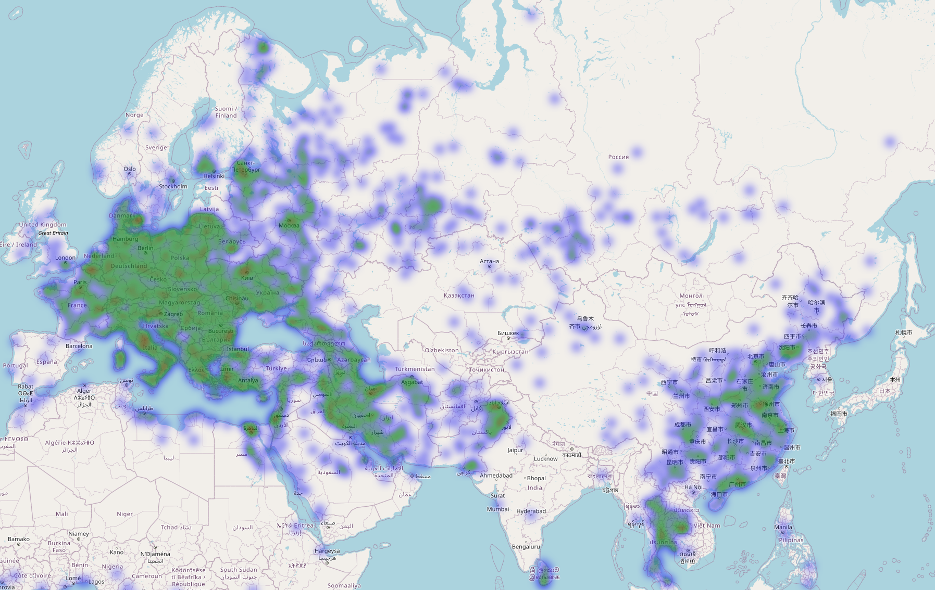
Catchment analysis
Anycast RTT data (example)
Zooming in on de-fra
Mapping target locations using ip2location
Large number of Chinese prefixes (99k)
  Most from a few ASes

Slide 60
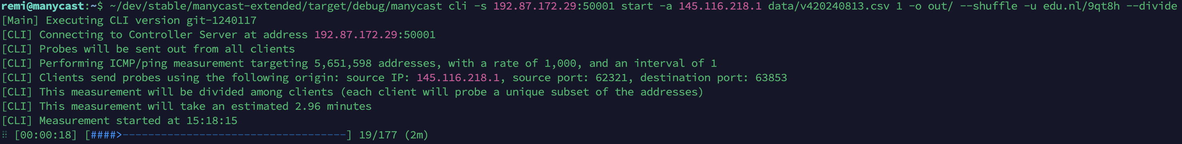
Anycast measurement tool
Catchment mapping of 5.7 million addresses in 3 minutes (using a probing rate of 1,000 at each anycast site)
Measurement tool allows for mapping the catchment of the IPv4 space in a few minutes with ease
  Catchment mapping: the set of anycast targets that route to each anycast site
Speed and 'ease' makes daily (or even hourly) catchment mappings trivial

Slide 61
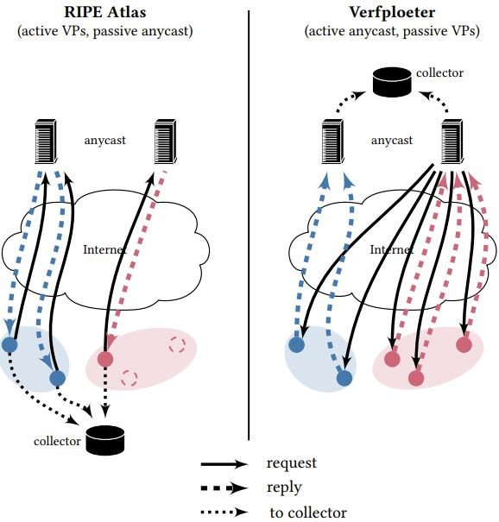
Verfploeter
Methodology to perform catchment mapping
  i.e., mapping the set of addresses that route to each anycast site

Slide 62
Verfploeter
Methodology to perform catchment mapping
  i.e., mapping the set of addresses that route to each anycast site
Verfploeter allows for catchment mapping at Internet scale
  Uses responsive hosts on the Internet
  Not restricted by deployment of e.g., RIPE Atlas
  Allows for pro-active analysis

Slide 63
Verfploeter
Methodology to perform catchment mapping
  i.e., mapping the set of addresses that route to each anycast site
Verfploeter allows for catchment mapping at Internet scale
  Uses responsive hosts on the Internet
  Not restricted by deployment of e.g., RIPE Atlas
  Allows for pro-active analysis
Catchment mappings help operators to
  Assess anycast performance
  Plan infrastructure expansions

Slide 64
Appendix slides
Daily census output snippet classification + enumeration
File: YYYY/MM/DD/YYYY-MM-DD_v4.json
{"prefix": "1.0.0.0/24", "characterization":
{"MAnycastICMPv4": {"anycast": true, "instances": 26},
"MAnycastTCPv4": {"anycast": true, "instances": 26},
"MAnycastUDPv4": {"anycast": null, "instances": 0},
"iGreedyICMPv4": {"anycast": true, "instances": 60},
"iGreedyTCPv4": {"anycast": true, "instances": 26}
}
},
...

Slide 65
Appendix slides
Daily census output snippet locations
File: YYYY/MM/DD/YYYY-MM-DD_v4_locations.json
{
"prefix": "1.0.0.0/24",
"count": 60,
"instances": [
{
"marker": {
"city": "Honolulu",
"code_country": "US",
"id": "HNL",
"latitude": 21.3187007904,
"longitude": -157.9219970703
}
},
...

Slide 66
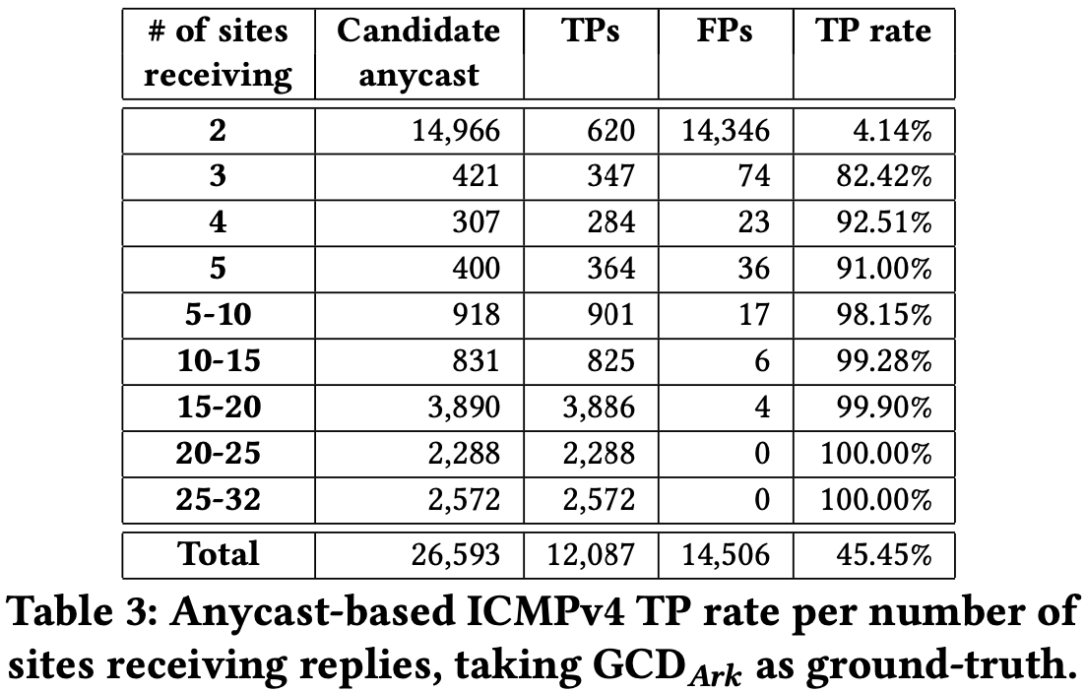
Appendix slides
MAnycastR FNs breakdown

Slide 67
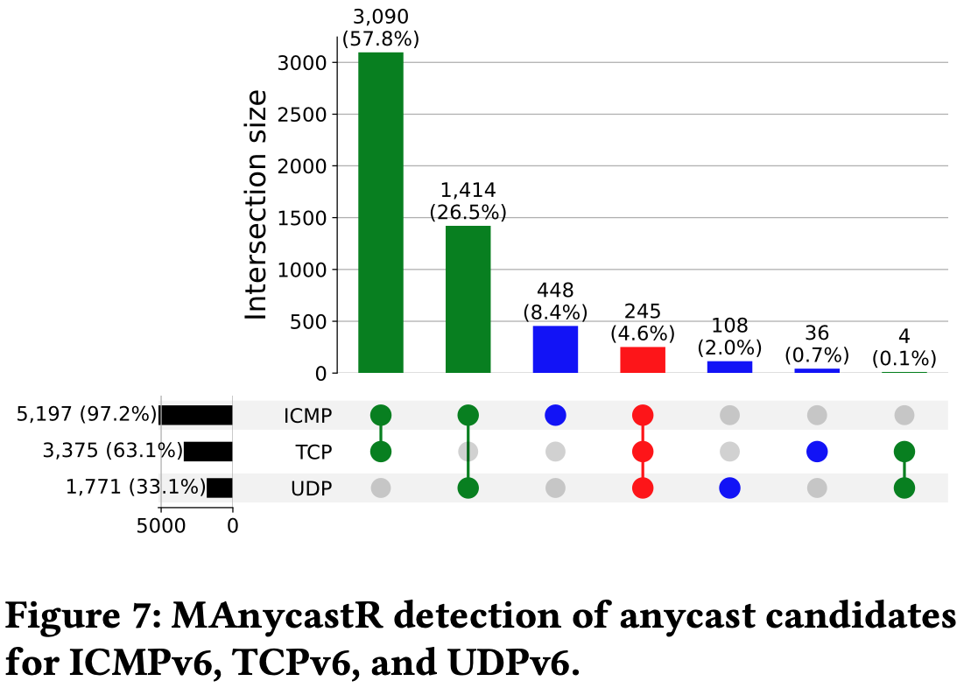
Appendix slides
MAnycastR IPv6 ATs by protocol

