Slide 1
Global BGP Attacks that Evade Route Monitoring
Henry Birge-Lee
Princeton University
With
Jennifer Rexford (Former CS Department Chair/Current Provost)
Maria Apostolaki (Prof. Electrical and Computer Engineering)

Slide 2
Overview
Motivation and Terminology
Background
Launching the Attack in the Real World
Attack Viability
Countermeasures

Slide 3
What is BGP monitoring and why is it important
Using a combination public (e.g., RIPE NCC RIS) and/or private data feeds to observe global BGP updates
Monitoring can identify BGP attacks for real time responses/mitigations or after-the-fact incident investigation
BGP monitoring systems are coming to play a large role in routing security given the relatively slow adoption of high-security interdomain routing protocols (e.g., BGPSEC)

Slide 4
Why are we are interested in stealthy BGP attacks
If you can make your attack stealthy you can (potentially) evade detection and mitigation
Stealthy attacks are possible and studied by prior work Birge-Lee et al. ‘19 SICO https://doi.org/10.1145/3319535.3363197 Milolidakis et al. ‘23 “On the Effectiveness of BGP Hijackers That Evade Public Route Collectors," https://doi.org/10.1109/ACCESS.2023.3261128 Morillo et al. ‘21 ROV++ https://dx.doi.org/10.14722/ndss.2021.24438

Slide 5
Exactly what do we mean by “stealthy attack”
Many different metrics:
How much of the Internet sees your route?
Do attack detection algorithms think your attack is just background noise? N.A. for this talk
Do networks using the route see the route? also achieved by our attack
Do BGP monitoring services see the route? (focus of today’s talk)

Slide 6
Terminology
Other ASes
BGP Monitoring Vantage Point
I announce 2.2.2.0/23
BGP Monitoring Vantage Point
BGP Monitoring Vantage Point
AS 174
Client Network
São Paulo
Datacenter
Adversary

Slide 7
Terminology
Other ASes
BGP Monitoring Vantage Point
I announce 2.2.2.0/23
BGP Monitoring Vantage Point
BGP Monitoring Vantage Point
AS
Client Network
São Paulo
Datacenter
Equally-specific attack: announce 2.2.2.0/23
Subprefix attack:
announce 2.2.2.0/24
Adversary

Slide 8
Overview
Motivation and Terminology
Background
Launching the Attack in the Real World
Attack Viability
Countermeasures

Slide 9
Work to Date on Stealthy Attacks
Use an equally-specific BGP attack and shaping your announcement (BGP communities/AS-path poisoning) to avoid public monitors
Upside: Viable (Birge-Lee et al. ‘19 SICO; Milolidakis et al. ‘21 Smart BGP Hijacks)
Downside: Lot of monitors means only a small portion of the uses the malicious route
Downside: Networks using the malicious route (source victims) see it in their tables
Use a subprefix attack and stop it from spreading to the source victim
Upside: Source victims have not knowledge of the malicious route they are using (Morillo et al. ‘21 ROV++)
Downside: Subprefix attacks spread all over the Internet, not stealthy at all from public monitors
SICO: Surgical Interception Attacks by Manipulating BGP Communities
https://dl.acm.org/doi/10.1145/3319535.3363197
A. Milolidakis, T. Bühler, K. Wang, M. Chiesa, L. Vanbever and S. Vissicchio, "On the Effectiveness of BGP Hijackers That Evade Public Route Collectors," in IEEE Access, vol. 11, pp. 31092-31124, 2023, https://doi.org/10.1109/ACCESS.2023.3261128
ROV++: Improved Deployable Defense against BGP Hijacking
https://www.ndss-symposium.org/ndss-paper/rov-improved-deployable-defense-against-bgp-hijacking/

Slide 10
Real-world Stealthy Attacks
Adversary established direct peering with source victim (Yahoo mail) at DE-CIX
Announced malicious subprefix only over direct peering
Avoided all BGP monitors
Was eventually caught via coordination from prefix owner and Yahoo
Yahoo confirmed that the networks in their table were not the same as the networks announced by the prefix owner
Attack was limited in spread and could not be scaled: only spread to Yahoo
Invisible_Hijacking
https://ripe72.ripe.net/presentations/45-Invisible_Hijacking.pdf

Slide 11
Current beliefs on stealthy attacks
“Although higher-Type attacks [i.e., attacks with more AS prepends] may sometimes be completely stealthy to the infrastructure (e.g., in 21% of the attacks for the Type-4 simulations), such hijackers could not affect while
remaining stealthy more than 2% of the Internet.” [1]
[1] A. Milolidakis, T. Bühler, K. Wang, M. Chiesa, L. Vanbever and S. Vissicchio, "On the Effectiveness of BGP Hijackers That Evade Public Route Collectors," in IEEE Access, vol. 11, pp. 31092-31124, 2023, https://doi.org/10.1109/ACCESS.2023.3261128

Slide 12
Current beliefs on stealthy attacks
“Although higher-Type attacks [i.e., attacks with more AS prepends] may sometimes be completely stealthy to the infrastructure (e.g., in 21% of the attacks for the Type-4 simulations), such hijackers could not affect while
remaining stealthy more than 2% of the Internet.” [1]
We achieve an attack that:
affects the vast majority of the Internet
is seen by zero BGP monitors
is not in the routetable of affected networks
[1] A. Milolidakis, T. Bühler, K. Wang, M. Chiesa, L. Vanbever and S. Vissicchio, "On the Effectiveness of BGP Hijackers That Evade Public Route Collectors," in IEEE Access, vol. 11, pp. 31092-31124, 2023, https://doi.org/10.1109/ACCESS.2023.3261128

Slide 13
Overview
Motivation and Terminology
Background
Launching the Attack in the Real World
Attack Viability
Countermeasures

Slide 14
Key Attack Insight
BGP communities are 32-bit tags attached to BGP routes which can impact how routers propagate BGP announcements
The RFC that introduced BGP communities (RFC 1997) defined several well-known communities including NO_EXPORT which tells routers not to propagate a BGP announcement outside of their own AS
The NO_EXPORT community (supported out of the box by routers) prohibits the exporting of a route to BGP monitoring even if a network is a direct peer of a BGP monitoring service
Previous work on stealthy BGP attacks assumes if a network is a peered with a monitoring service, it will send all routes it uses to the monitoring service
This insight overcomes this allowing for much more effective stealthy attacks

Slide 15
Differentiation with previous work
Previous work: if malicious route is used by peer network, monitoring service sees route
Our work: peer networks do not share their routes with monitoring services
Peering router sees RRC25 as external AS; applies NO_EXPORT
eBGP session remote AS 12654
eBGP session remote AS 12654
RIPE RIS RRC25
RIPE RIS RRC25
AS 174
Cogent
AS 174
Cogent
Malicious BGP announcement propagation
Malicious BGP announcement propagation with NO_EXPORT

Slide 16
Attack Steps
Announce a malicious sub-prefix of your victim’s prefix to a major transit provider (attacker needs to social engineer or otherwise bypass prefix filters)
Attach the RFC NO_EXPORT community to your announcement
Currently BGP monitoring services work by establishing eBGP sessions with peers (e.g., major transit networks that provide route tables to the monitoring service)
To these the routers that run these sessions, the sessions appear to be standard eBGP sessions to what looks like a remote network, thus the RFC NO_EXPORT community applies
The malicious route will be installed in a major transit provider (optimally your victim’s upstream)
The malicious route will not be sent to BGP monitoring

Slide 17
All real world attacks were conducted ethically
Hijack ourselves approach (we controlled IP prefix)
All nodes (including “adversary”) were authorized to announce route
No real services on prefix used in experiment

Slide 18
Benign Setup
Other ASes
BGP Monitoring Vantage Point
2604:4540:82::/47
BGP Monitoring Vantage Point
BGP Monitoring Vantage Point
AS 174
Client Network
São Paulo
Silicon Valley Datacenter
Routing Not Under Attack
Flow of Client’s Network Traffic

Slide 19
Standard sub-prefix attack
Other ASes
BGP Monitoring Vantage Point
2604:4540:82::/47
BGP Monitoring Vantage Point
BGP Monitoring Vantage Point
AS 174
Cogent
Client Network
São Paulo
Silicon Valley Datacenter
Non-stealthy Routing Attack
Flow of Client’s Network Traffic
Propagation of Adversary’s Malicious Announcement
2604:4540:82::/48
Network With Adversary’s Route Installed

Slide 20
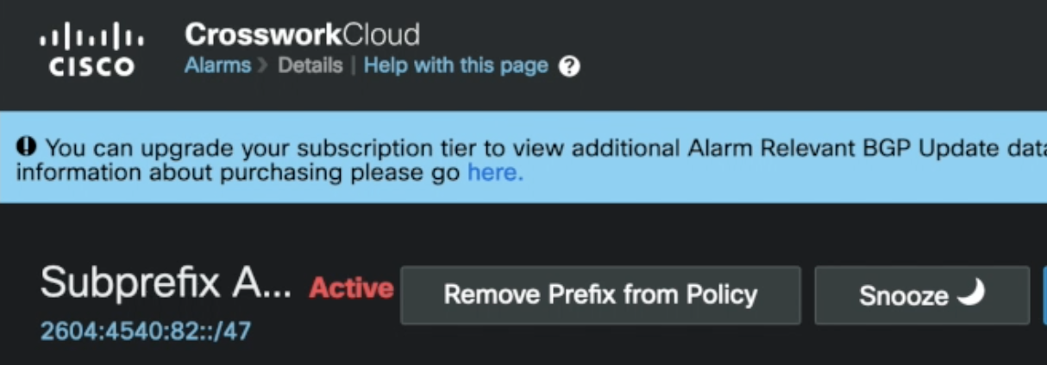
Standard subprefix attack is seen everywhere
ris_subscribe_ok {'subscription': {'prefix': '2604:4540:82::/48', 'moreSpecific': True, 'lessSpecific': False}, 'socketOptions': {'includeRaw': True, 'acknowledge': True}}
ris_message {'timestamp': 1663691310.63, 'peer': '2001:978:4::b', 'peer_asn': '174', 'id': '25-28178-16349017', 'host': 'rrc25', 'type': 'UPDATE', 'path': [174, 20473], 'origin': 'igp', 'med': 78041, 'announcements': [{'next_hop': '2001:978:4::b', 'prefixes': ['2a0e:97c6:5226::/48', '2a0e:97c6:506d::/48', '2604:4540:82::/48']}]

Slide 21
Stealthy sub-prefix attack
Other ASes
BGP Monitoring Vantage Point
2604:4540:82::/47
BGP Monitoring Vantage Point
BGP Monitoring Vantage Point
AS 174
Cogent
Client Network
São Paulo
Silicon Valley Datacenter
Stealthy Routing Attack
2604:4540:82::/48
Flow of Client’s Network Traffic
Community:
NO_EXPORT (RFC 1997 or 174:990 for Cogent)
Propagation of Adversary’s Malicious Announcement
Network With Adversary’s Route Installed

Slide 22
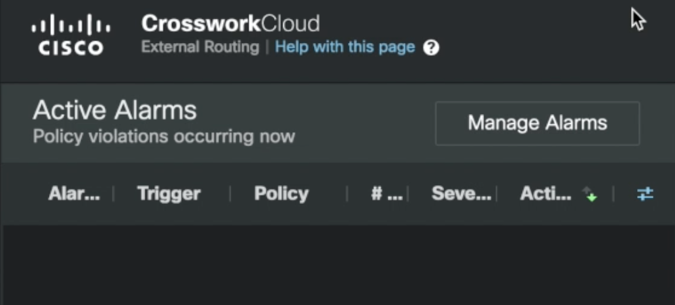
Stealthy attack is seen nowhere
ris_subscribe_ok {'subscription': {'prefix': '2604:4540:82::/48', 'moreSpecific': True, 'lessSpecific': False}, 'socketOptions': {'includeRaw': True, 'acknowledge': True}}

Slide 23
100% of Internet was affected by stealthy route
Ran a ping scan to a 1k randomly selected ping hosts
Source IP address of the scan was within the hijacked prefix
I.e., Hosts responded to either victim or adversary depending on whether they were affected by the attack
In scan, 100% of responses went to adversary
Prefix owner exclusively used Cogent for transit
See attack demo video for more: https://drive.google.com/file/d/19Cr0JNRXeYqlWKoPR8K39JlDImlnPmC4/view?usp=sharing

Slide 24
Overview
Motivation and Terminology
Background
Launching the Attack in the Real World
Attack Viability
Countermeasures

Slide 25
How many networks have this behavior
Network | Cogent | Telia | NTT | Sprint
Supports NO_EXPORT | Yes | Yes | Yes | Yes
BGP Monitoring Session with RIPE RIS | Yes | Yes | Yes | Yes
Suppressed session with RIPE | Yes | Yes | Yes | Yes
Invisible from Thousandeyes | Yes | Yes | Yes | Yes
Invisible from Cisco Crosswork Cloud | Yes | Yes | Yes | Yes
Many thanks to:
RGNet
Edge
Princeton OIT

Slide 26
How much of the Internet is hijackable via these networks
Ran simulations of AS-level paths between 150 random ASes using the CAIDA topology
Just assuming an adversary installed a malicious route in the networks from the previous slide, picked a random victim AS’s prefix to hijack, the adversary would affect traffic from 23% source ASes on the Internet (on average)
If an adversary instead chooses the top 5 largest ASes by customer cone, (3356, 1299, 174, 2914, 6762), on average it could hijack traffic from 39% of source ASes
previous work on stealthy hijacks 2% of Internet traffic (90th percentile) and median case is < .2%
A strategic adversary could do even better (e.g., 100% like in our experiment)

Slide 27
How viable is a subprefix attack
RPKI can prevent subprefix attacks
RPKI ROAs specify proper prefix length, announcements for other prefix lengths are blocked
ROAs now cover ~50% of IP prefixes, ~50% still not protected
Of the ~50% of IP prefixes covered by RPKI, about 36% (18% of total) have an improper maxLength attribute leaving them still vulnerable to sub-prefix attacks [1] [2]
My 2023 Usenix Security Paper [2] “How Effective is Multiple-Vantage-Point Domain Control Validation?” looked at TLS domains and found only %29.2 had all A record and Nameserver IPs protected against subprefix attacks
About half of these protected domains (15.2%) ran exclusively out of /24 announcements. Only %18.2 of domains were protected because of RPKI.
Even with great RPKI progress, subprefix attacks are still highly viable (massive numbers in the wild each year)
[1] Yossi Gilad, Omar Sagga, and Sharon Goldberg. 2017. MaxLength Con-
sidered Harmful to the RPKI. In International Conference on Emerging
Networking EXperiments and Technologies (Incheon, Republic of Korea)
(CoNEXT). Association for Computing Machinery, New York, NY, USA,
101–107. https://doi.org/10.1145/3143361.3143363

Slide 28
Would a major network really propagate a malicious route directly from a customer?
Unfortunately: Yes
Some examples:
“AS3266: BitCanal hijack factory, courtesy of Cogent, GTT, and Level3” https://mailman.nanog.org/pipermail/nanog/2018-June/096034.html
“I guess AS1299 Arelion doesn't check if the origin AS of an announcement is in the customer's AS-SET but it's pretty normal and understandable.” https://mailman.nanog.org/pipermail/nanog/2022-August/220320.html
“As such, it seems likely a peer or customer of AS6461 [Zayo] was [launching BGP hijacks].” https://mailman.nanog.org/pipermail/nanog/2022-February/217602.html
Know your customer is important but only effective to an extent because it does not rely on true cryptographic identifiers.

Slide 29
Overview
Motivation and Terminology
Background
Launching the Attack in the Real World
Attack Viability
Countermeasures

Slide 30
Countermeasures
Networks need to not allow customer-applied NO_EXPORT to control exporting behavior to route monitoring
Customer networks should not decide what is sent to BGP monitoring
Option 1: Translate RFC NO_EXPORT to a different AS-specific use community that only applies to normal BGP neighbors and not route monitoring
Option 2: Run BGP monitoring over iBGP sessions
Currently used by kentik, still appears to not be pervasive enough to catch our sample attacks
Still vulnerable to NO_ADVERTISE
Option 3: Move monitoring to BMP (optimal long term)
Option 4: Vender support flag (e.g., route_monitor_session BGP config flag)

Slide 31
Config Changes to Major Networks (option 1 rewriting)
(pseudo config for AS 1234)
filter route_in {
if (NO_EXPORT) in bgp_community then {
bgp_community.delete([NO_EXPORT]);
bgp_community.add(1234:997);
}
if (NO_EXPORT_SUBCONF) in bgp_community then {
bgp_community.delete([NO_EXPORT_SUBCONF]);
bgp_community.add(1234:998);
}
if (NO_ADVERTISE) in bgp_community then {
bgp_community.delete([NO_ADVERTISE]);
bgp_community.add(1234:999);
}
accept;}
filter bgp_neighbor_out {
if (1234:997 or 1234:998 or 1234:999) in bgp_community then {
reject;
}
accept;}
filter ripe_routeviews_out {accept;}

Slide 32
Config Changes to Major Networks (option 2 iBGP)
(pseudo config for AS 1234)
protocol bgp routeviews {
local as 1234;
neighbor 10.142.12.6 as 1234; # RIPE/Routeviews could be configured to establish iBGP sessions using peer ASNs
import none;
export all;
filter
next hop self; # Don’t leak internal nexthop details to RIPE/RotueViews
}
RIPE NCC Admins: Please consider iBGP sessions with peers
(this is highly viable and already used by Kentik’s BGP monitoring https://kb.kentik.com/v0/Bd01.htm#Bd01-Router_BGP_Considerations )

Slide 33
Interest at Networks
Among US R&E networks: ESNet and Internet 2 are considering deploying countermeasures
Any networks interested in deploying countermeasures for NO_EXPORT please reach out ( birgelee@princeton.edu )
See our technical report for more details https://arxiv.org/abs/2408.09622

Slide 34
Questions
Henry Birge-Lee
Research Software Engineer Princeton Electrical Engineering and Computer Science birgelee@princeton.edu https://henrybirgelee.com

