Slide 1

RIPE RPKI Update
….and an overview of the RIPE NCC RPKI infrastructure and processes
Tim Bruijnzeels| RIPE NCC | 31 October 2024

Slide 2
Table of Contents
1.
2.
3.
News
Infrastructure and Processes
What’s Next
Notes:
Will keep the update part of this presentation short
Focus on infrastructure

Slide 3
News

Slide 4
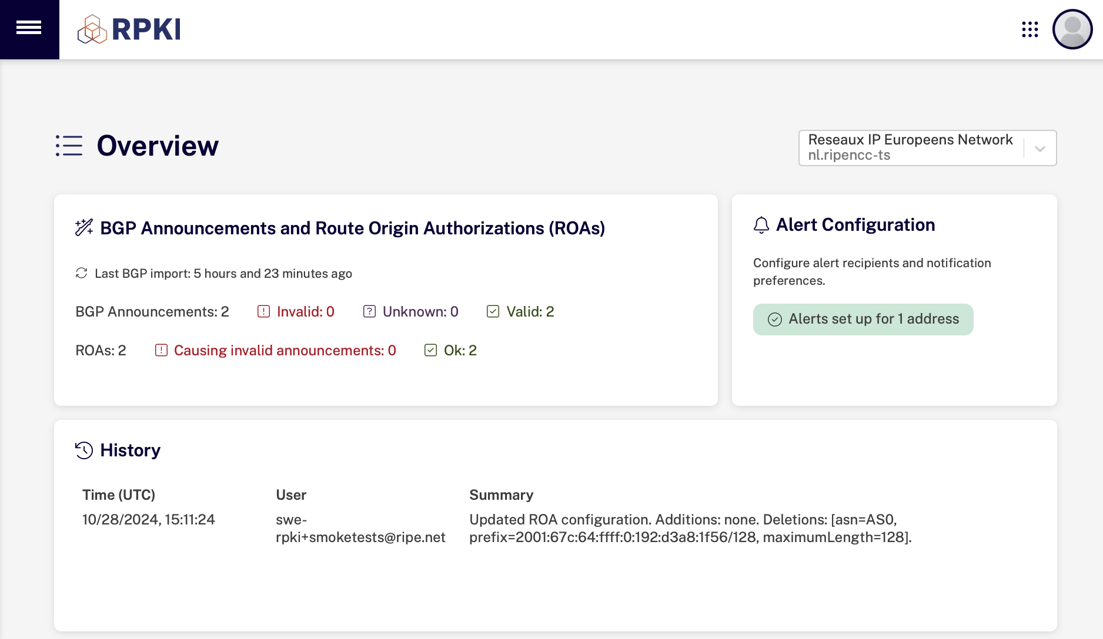
New RPKI Dashboard
https://dashboard.rpki.ripe.net/
Notes:
Before we start:
Part of the reason to redo the interface was to improve usability
You can try it now
Feedback welcome
UX done by Antonella - she is here as well
The other reason is to update the technology stack:
Easier to deal with security issues in dependencies
Re-embed knowledge in the team
Be ready for future development
The overview page is the new landing page. It shows the sections for setting up alerts and reviewing history much more prominently than before.

Slide 5
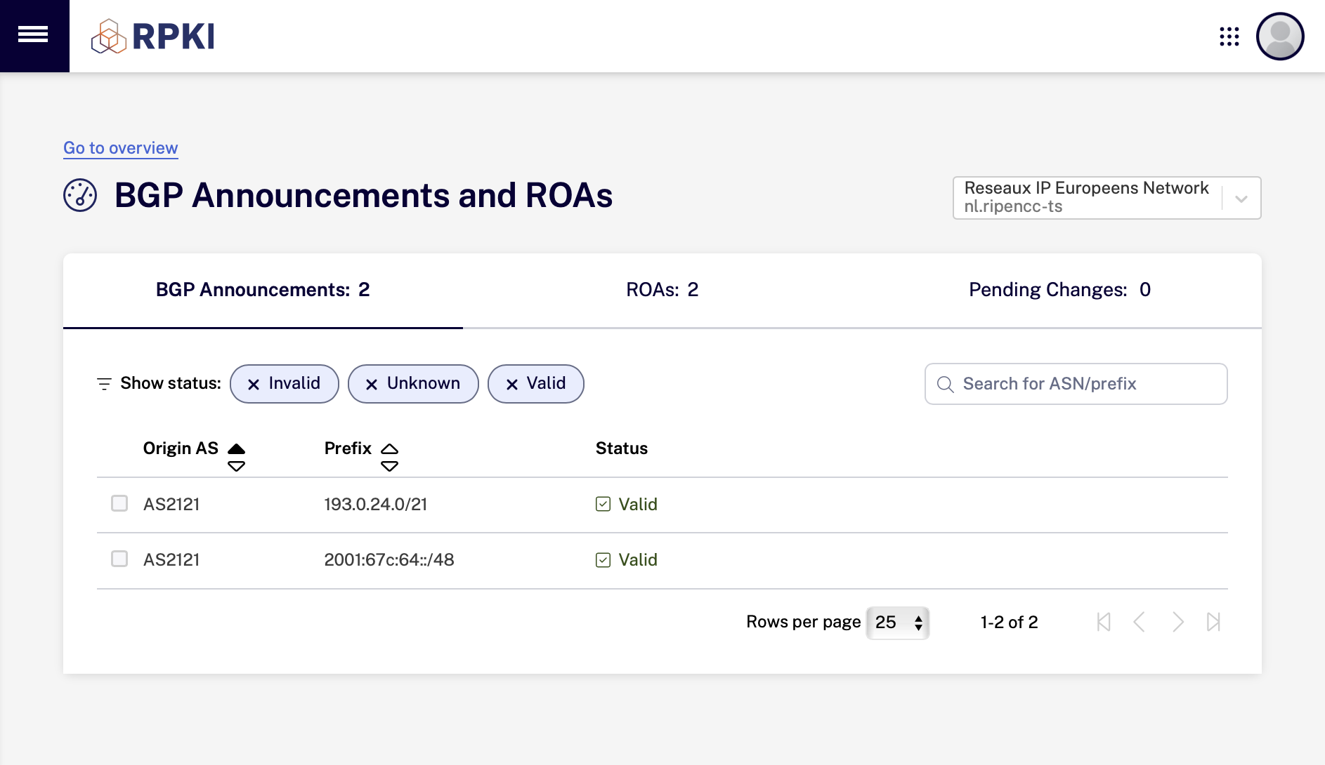
New RPKI Dashboard
https://dashboard.rpki.ripe.net/
Notes:
The ROA dashboard has an updated look and feel but offers the same functionality as before.
Note that “Pending Changes” is now shown more prominently

Slide 6
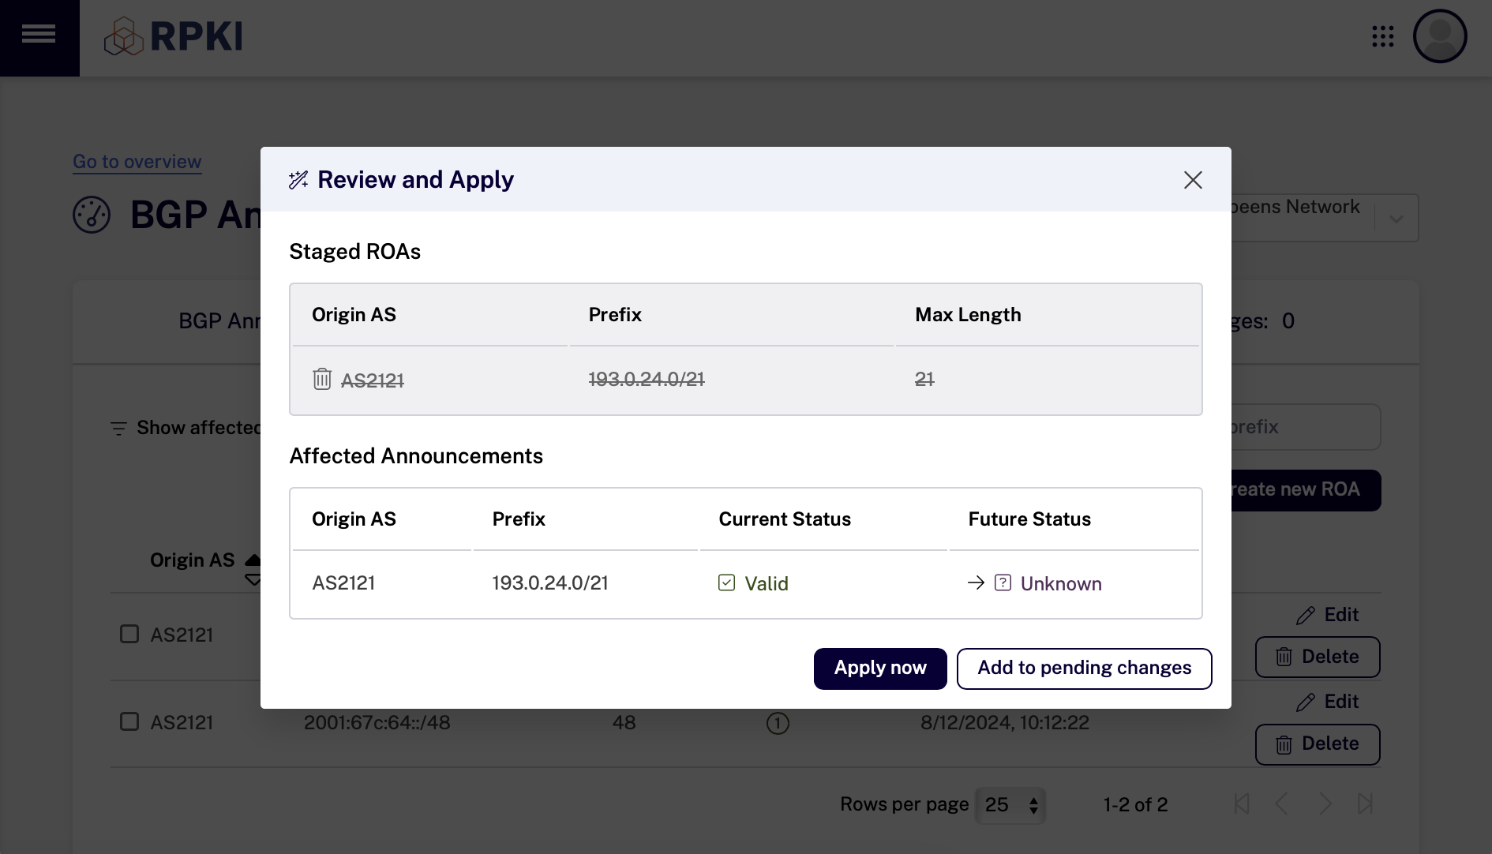
New RPKI Dashboard
https://dashboard.rpki.ripe.net/
Notes:
When adding a ROA choose between
Apply now
Add to pending changes (and make more changes) - like a shopping kart
Example use case make a ROA for a multi-homed prefix
Add ROA for ASN A to pending changes
Add ROA for ASN B to pending changes
Review pending changes
Old interface would always force a pending changes
A button in the bottom-right corner would appear
User needs to click it to review and apply
But this was easily missed!

Slide 7
SOC 2 Type I Assurance Report
The RPKI service received a SOC 2 (ISAE 3000) Type I assurance report issued by EY
Security
SOC 2 Trust Services Principles
Controls
Policies
Availability
design and implementation
Processes
Confidentiality
Infrastructure
Processing Integrity
evidence
Type I: 2024 Type II: 2025
(planned)
Notes:
Trust Service Principles fundamental unit of SOC 2
Determines the Controls implemented that describe Policies, Processes and Infrastructure
RPKI service received SOC 2 Type I assurance report by EY
Verifies that controls are fit for purpose and implemented - we need to provide evidence in this process
Type II is planned for 2025 - continued implementation of controls
How it helped us in practical terms:
Formal write up of processes
Write up of business continuity plan and infrastructure
Improve backups for the database
Which also gives me a nice bridge to talk to you about the relevant TA signing processes and infrastructure
Trust service criteria/principles: Trust service criteria, or TSCs, can be considered the fundamental unit of the SOC 2 framework. They are the essential requirements or controls to be implemented by an organization.
The RPKI service has officially received a SOC 2 (ISAE 3000) Type I assurance report issued by EY! For those unfamiliar, this report verifies that we have the right controls in place for the RPKI service to ensure security, availability, confidentiality and processing integrity at a specific point in time.
Receiving this Type I report shows we have built a strong foundation in our Information Security and Risk and Compliance procedures. Now, we have set our eyes on the next challenges: maintaining these standards for the SOC 2 Type II audit. The journey doesn’t end here, and we will need continued collaboration and focus to maintain and improve upon the standards we’ve set.
Our controls describe what we do in terms of processes, policies and infrastructure.
The type I audit confirms that we have the right controls to meet our TSCs and that we execute them (evidence provided)
In type II, planned for 2025, we will be audited for continued implementation of our controls and/or modifying (with motivation) changes to controls where necessary (in other words, controls can change when needed)
There is a form where people can register to ask for the report
https://www.ripe.net/manage-ips-and-asns/resource-management/rpki/security-and-compliance/
https://www.ripe.net/about-us/news/rpki-service-receives-soc-2-type-i-assurance-report/

Slide 8
Infrastructure and Processes

Slide 9
Trust Anchor to ROAs
OFFLINE
ONLINE
REQ
Trust Anchor
all resources
All (resources) CA
all resources
Production
CA
RIPE NCC resources
Member
CA
member resources
ROA
RES
Publish
Notes:
This is a high level overview of the RPKI tree structure at the RIPE NCC
TA re-signs manifest and CRL and a certificate for an online CA every 8-12 weeks
TA and subsidiary CA claim all resources - because we cannot update them more often
Production CA claims only the resources managed by RIPE NCC - can change any time because of TX
Signs members that sign ROAs

Slide 10
Trust Anchor Signing Process
OFFLINE
ONLINE
REQUEST
Trust Anchor
Trust
Anchor
Proxy
All (resources) CA
all resources
HSM
3 / 10
CARDS
RESPONSE
“Sneakernet”
Publish
Notes:
A more detailed look at the TA signing process
The TA signer is operated on a laptop with a USB based HSM that is kept in a safe
Offline (always)
Turned off in the safe
Backups are taken after every session
Backups do not include the private key - that is in HSM
3/10 card holders need to approve that the HSM can use the key
Process:
Logically we have code in our online system that together act as a kind of TA proxy
Operator generates a request to re-sign the manifest/crl or cert for the ACA
Transferred over sneakernet: on a USB stick
Laptop taken from the safe (sealed bag)
3/10 card holders
HSM will sign new objects
Response is copied to USB
Backup is done
Response is uploaded to online system - this publishes and gives the cert to the ACA

Slide 11
Online CAs - Availability
CORE Primary
- Background jobs
- Publication
Net HSM
- Good random
- No private keys in DB
Database
- Write Ahead Logs /10 mins
- Manual failover (for now)
POP 1
POP 2
Front End
Front End
CORE
primary
CORE
secondary
NetHSM
NetHSM
Publication
Server
x3
DB
primary
DB
replicated
Notes:
This describes the availability of our CA service
Note this is separate from the availability of our repository - will talk about that on the next slide
We have two points of presence (both in amsterdam equinix AM3 and AM5, looking at alternative for one of these)
Front-ends connect to backend core systems (either)
Core uses both netHSMs
Primary core responsible for background jobs - manual failover by 24/7 engineer
DB primary with replication - manual failover
In future we may want to have active-active database setup for immediate failover and 0 downtime patching

Slide 12
Online CAs - Availability
rsync.ripe.net
rrdp.ripe.net
DNS
POP 1
POP 2
CDN A
CDN B
RSYNC
RSYNC
config
POP 1
POP 2
POP 3
RRDP
RRDP
RRDP
Publication
Server
Publication
Server
Publication
Server
Notes:
RPKI Core publishes to 3 separate publication servers that do not share state (AM3, AM5 and Linode)
Each publication server publishes RRDP (different sessions)
We have two CDNS and switch weekly (DNS change)
Switch by 24/7 when we suspect any issue (faster than debugging)
CDN is configured to use one primary publication server, can be switched manually (serve stale)
Rsync uses:
load balancer
Two rsync nodes that take content from primary internal RRDP

Slide 13
What’s Next

Slide 14
Future Work
Usability Improvements
  ROA History
  Faster BGP Information
RPKI Object Types
  ASPA
  BGPSec
  RSC under evaluation

Slide 15



?
Questions
& Comments
tbruijnzeels@ripe.net

