Slide 1
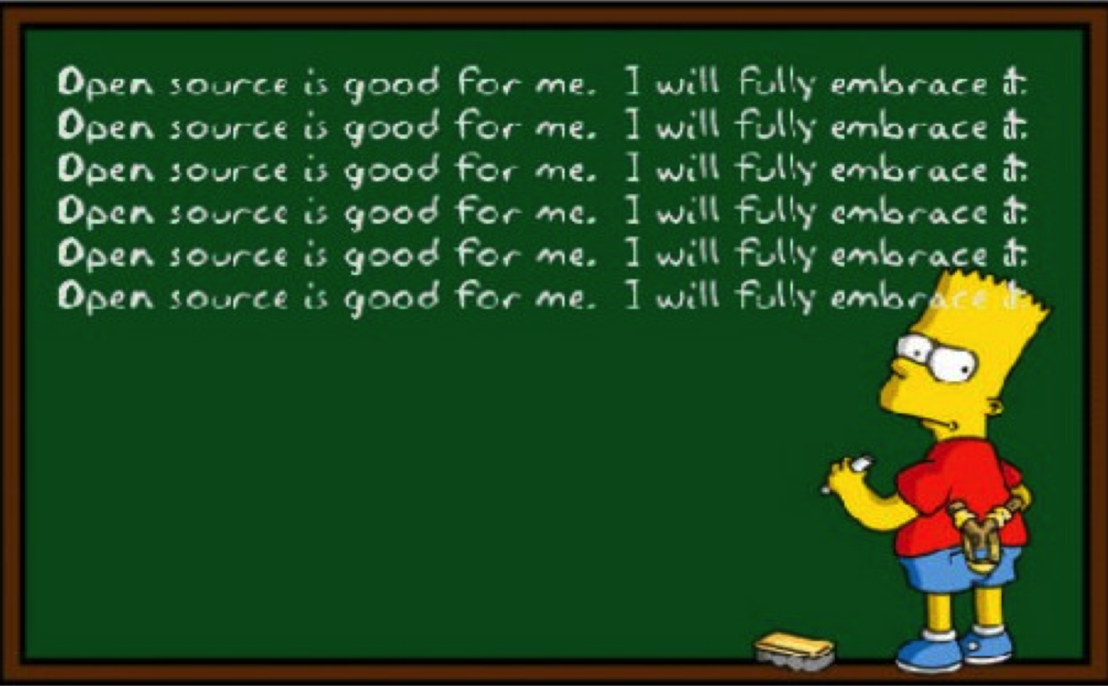
Open Source Working Group
RIPE 89, Thu Oct 31, 2024 11:00-12:30
Martin Winter &
Marcos Sanz &
Sasha Romijn

Slide 2
Agenda
Administrative Matters [WG Chairs]
  Welcome
  finalize agenda
  approval of minutes from previous WG meeting(s)
Chair Changes
(Martin Winter, Co-chair)

Slide 3
Agenda
Leveraging Vagrant to Simulate Complex Systems for Network Application Development
(Barry O’Donovan)
PiranhaBGP: Failure Detection in BGP Networks
(Pascal Gloor)

Slide 4
Agenda
  Lightning Talks
    CRA and Open source projects
    (August Bournique)
    Green tech hackathon
      (Vesna Manojlovic)
    Using YANG for code generation
    (Maria Matejka, Vojtech Vilimek)
  AOB

Slide 5
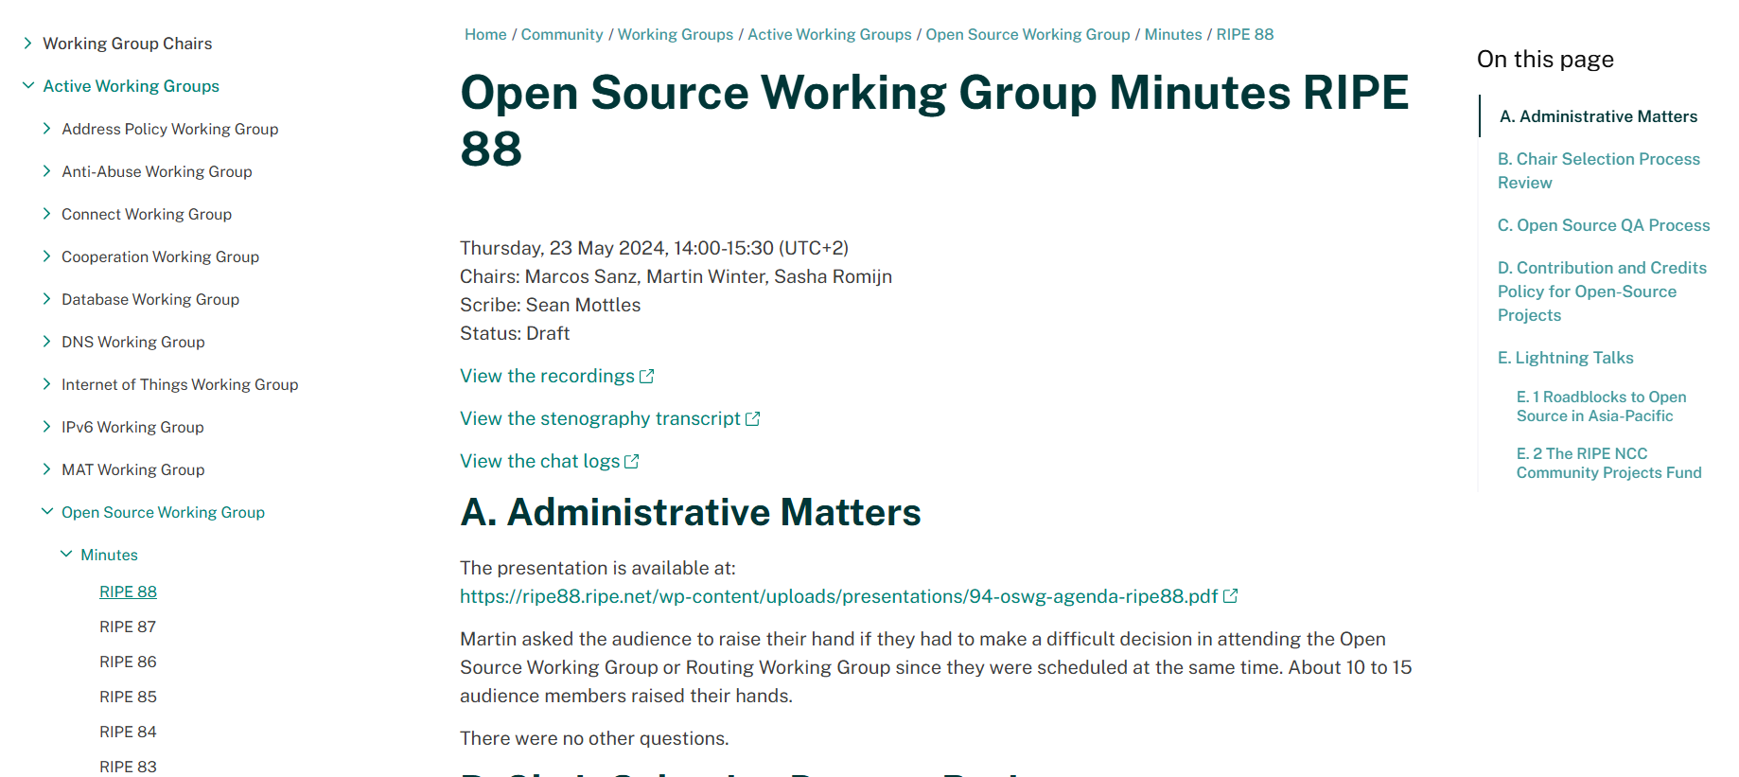
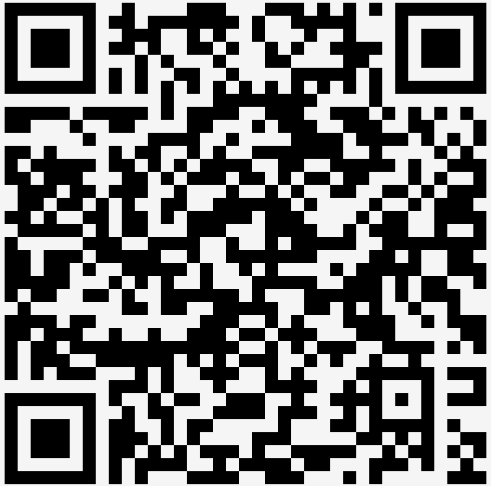
Approval of Minutes

Slide 6
Chair Changes
An announcement by Martin Winter

